Slide 1
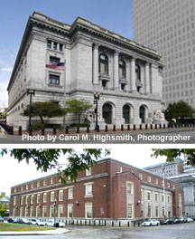
HOPE Court Helping Offenders Prepare for re- Entry
District of Rhode Island
FACTS AND DATA
2014 – 2024

Slide 2
HOPE – Rhode Island’s motto since 1664

Slide 3
Mission…
HOPE Court is an alternative to traditional supervision for post-conviction offenders who are at moderate to high-risk of reoffending.
Its goal is to produce better outcomes for participants and the community than traditional supervision is able to achieve.

Slide 4
Data as of November 1, 2024:
Total participants since inception: 81
Number of participants currently: 10
Number of participants who have graduated
since inception: 32
% total participants who have graduated since inception: 48%
Average length of time in HOPE Court for graduates: 16 months
Number of participants who have been terminated
since inception: 34
% of terminations that occur in Phase 1: 41%

Slide 5
More data…
Success of HOPE Court’s 32 graduates…
Successful Completion of TSR: 24 (75%).
Currently on TSR with successful progress: 3 (9%).
Violation conduct after graduation while on TSR: 4 (13%)
Deceased while on TSR: 1 (3%).
Changes in risk assessment score for HOPE Court graduates: 9% increased in risk level, 44 % decreased in risk level, and 47% experienced no change in risk level.

