Slide 1
Deposition Ethics
U.S. District Court
District of Rhode Island
May 8, 2015
Notes:
This template can be used as a starter file for presenting training materials in a group setting.
Sections
Right-click on a slide to add sections. Sections can help to organize your slides or facilitate collaboration between multiple authors.
Notes
Use the Notes section for delivery notes or to provide additional details for the audience. View these notes in Presentation View during your presentation.
Keep in mind the font size (important for accessibility, visibility, videotaping, and online production)
Coordinated colors
Pay particular attention to the graphs, charts, and text boxes.
Consider that attendees will print in black and white or grayscale. Run a test print to make sure your colors work when printed in pure black and white and grayscale.
Graphics, tables, and graphs
Keep it simple: If possible, use consistent, non-distracting styles and colors.
Label all graphs and tables.

Slide 2

The Dos and Don’ts
of Being a
Potted Plant

Slide 3
Overview
State – Kelvey v. Coughlin
Federal – Fed. R. Civ. P. 30 (c) and (d)
Notes:
Give a brief overview of the presentation. Describe the major focus of the presentation and why it is important.
Introduce each of the major topics.
To provide a road map for the audience, you can repeat this Overview slide throughout the presentation, highlighting the particular topic you will discuss next.

Slide 4
Kelvey v. Coughlin
FACTS
Medical negligence case; involving allegations of negligent treatment of Ms. Kelvey’s newborn son, Benjamin
Deposition of Defendant ObGyn, Dr. John Coughlin;
Defendant's counsel:
  offered gratuitous comments,
  directed the deponent’s answers through suggestive objections,
  instructed the deponent not to answer certain non-privileged questions.
Notes:
Summarize presentation content by restating the important points from the lessons.
What do you want the audience to remember when they leave your presentation?
Save your presentation to a video for easy distribution (To create a video, click the File tab, and then click Share. Under File Types, click Create a Video.)

Slide 5
Kelvey v. Coughlin,
625 A.2d 775 (R.I. 1993)
Came to the R.I. Supreme Court by way of Writ of Certiorari after a ruling by the Motion Calendar
trial court
Trial court granted Plaintiff’s motion under Rule 37(a) and ordered:
  the deponent to be redeposed under certain conditions
Notes:
Summarize presentation content by restating the important points from the lessons.
What do you want the audience to remember when they leave your presentation?
Save your presentation to a video for easy distribution (To create a video, click the File tab, and then click Share. Under File Types, click Create a Video.)

Slide 6
Defendant’s argument
If a deponent refuses to answer any question propounded at a deposition, the deposition should be completed on other matters and the deponent should be required to seek a court order to compel the answers

Slide 7
RI Supreme Court Ruling
Affirmed the discretion of the trial justice to impose appropriate sanctions for discovery abuse pursuant to Rule 37(a)
Rules 26 and 30 are so clear and direct that there should be no question about their meaning
Issued 5 conditions for depositions in RI

Slide 8
Kelvey v. Coughlin
RULE #1
Counsel for the deponent shall refrain from gratuitous comments and directing the deponent in regard to times, dates, documents, testimony, and the like.
Notes:
Summarize presentation content by restating the important points from the lessons.
What do you want the audience to remember when they leave your presentation?
Save your presentation to a video for easy distribution (To create a video, click the File tab, and then click Share. Under File Types, click Create a Video.)

Slide 9
NOT ALLOWED
Gratuitous remarks: “If you know . . .”
Directing the deponent:
  “He’s asking you about the 25th, not the 26th.”
  “Look at the documents in front of you.”
  “I can’t imagine how he would know that”

Slide 10
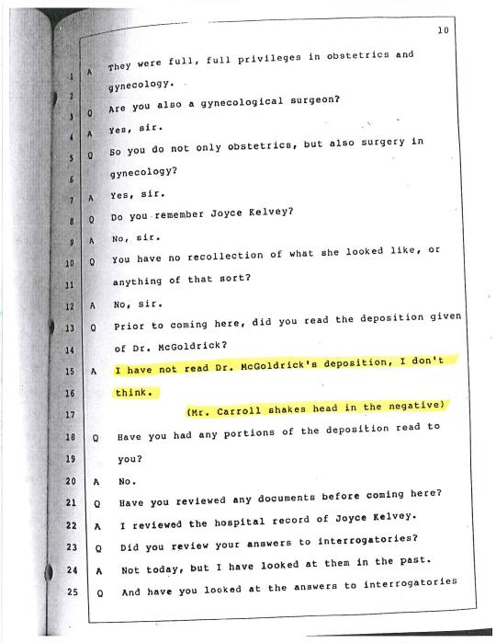

Slide 11
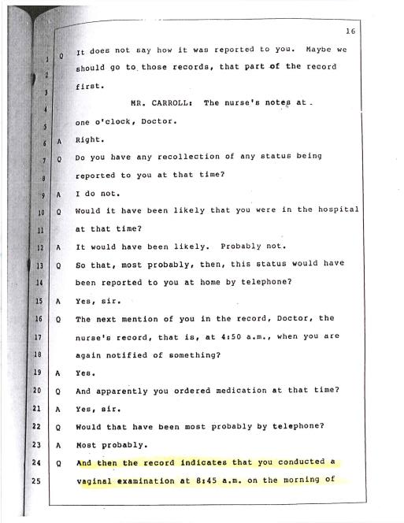

Slide 12
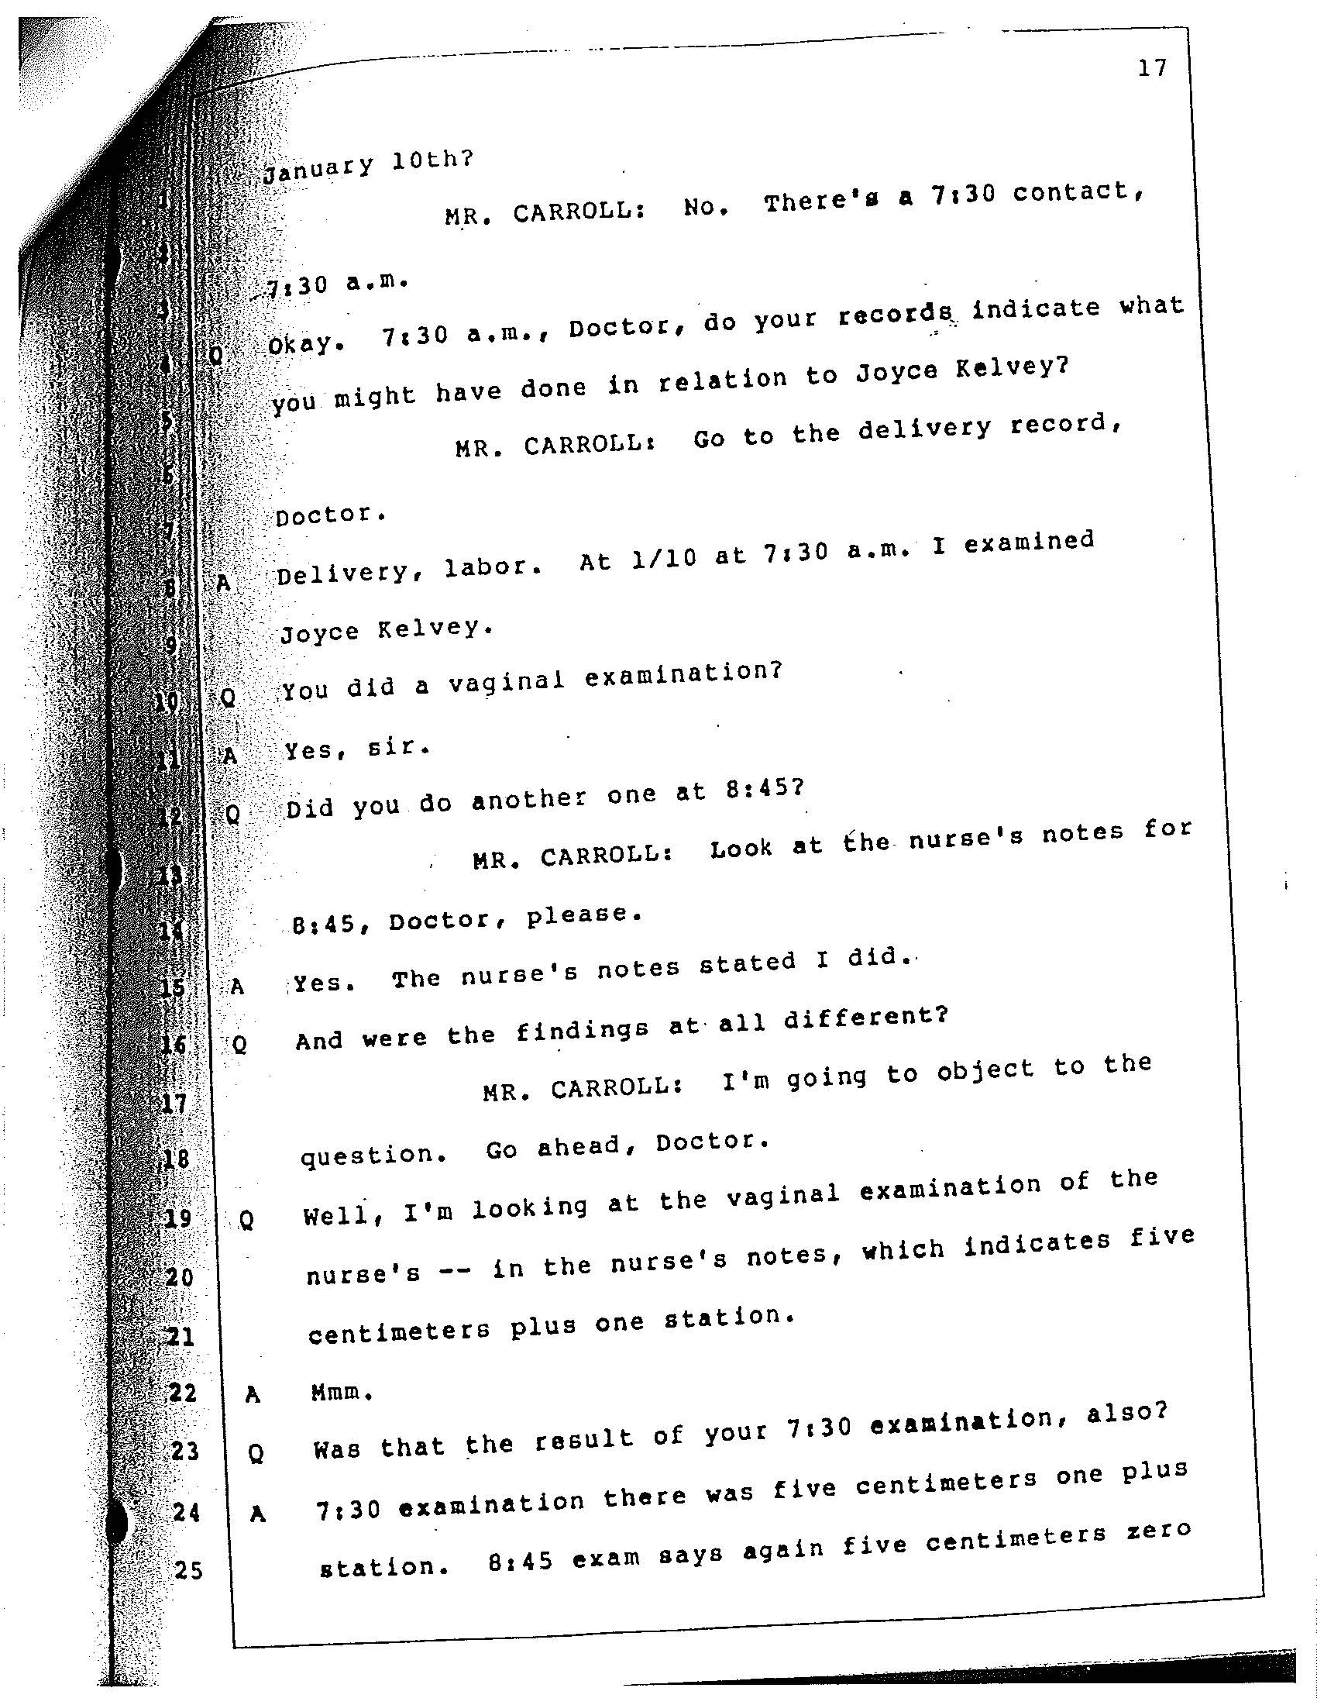

Slide 13
Kelvey v. Coughlin
RULE #2
Counsel shall refrain from cueing the deponent by objecting in any manner other than stating an objection for the record followed by a word or two describing the legal basis for the objection.
Notes:
Summarize presentation content by restating the important points from the lessons.
What do you want the audience to remember when they leave your presentation?
Save your presentation to a video for easy distribution (To create a video, click the File tab, and then click Share. Under File Types, click Create a Video.)

Slide 14
ALLOWED
“Objection, to the form of the question.”
“Objection, compound question.”
“Objection, misstates the facts.”

Slide 15
NOT ALLOWED
“Objection, the question asks her to talk about a meeting she did not attend.”
“Objection, you have misstated the standard of care.”
“Objection, the light was red when the defendant went through the intersection, not green.”

Slide 16
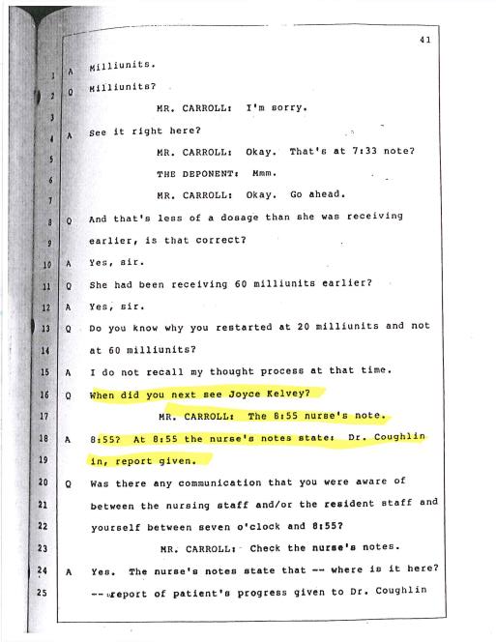

Slide 17
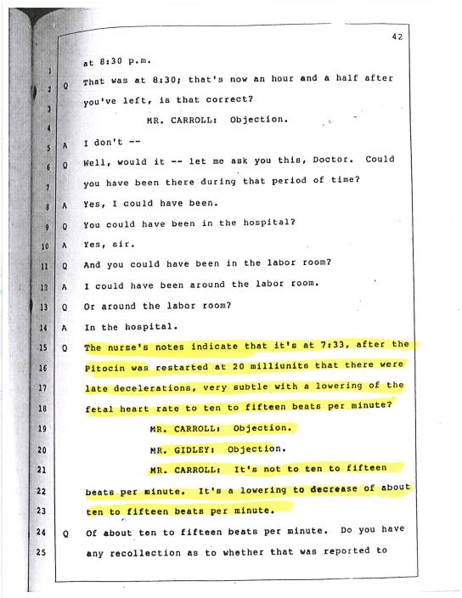

Slide 18
Kelvey v. Coughlin
RULE #3
Counsel shall refrain from directing the deponent not to answer any question submitted unless the question calls for privileged information.
Notes:
Summarize presentation content by restating the important points from the lessons.
What do you want the audience to remember when they leave your presentation?
Save your presentation to a video for easy distribution (To create a video, click the File tab, and then click Share. Under File Types, click Create a Video.)

Slide 19
Kelvey, 625 A.2d at 776
“The only instance, we repeat, the only instance in which an attorney is justified in instructing a deponent not to answer is when the question calls for information that is privileged.”
Notes:
Summarize presentation content by restating the important points from the lessons.
What do you want the audience to remember when they leave your presentation?
Save your presentation to a video for easy distribution (To create a video, click the File tab, and then click Share. Under File Types, click Create a Video.)

Slide 20
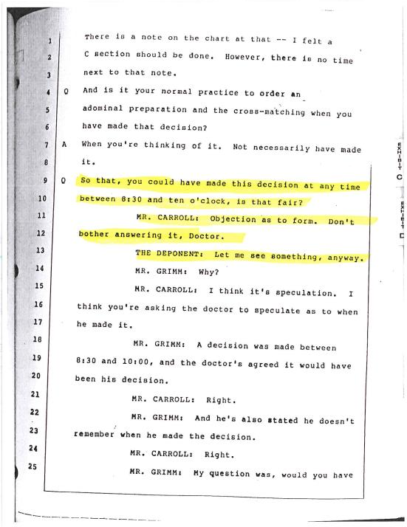

Slide 21
Post-Kelvey Rulings
Cunningham v. Heard (1995): Deponent asked to draw a diagram and was instructed not to draw. RI Supreme Court ruled: improper.
Menard v. Blazar (1996): Defendant doctor deponent was asked about the “standard of care” and was instructed not to answer. RI Supreme Court ruled: improper.
Irvine v. Inn at Castle Hill (1996): Deponent asked about what he said to the defendant’s insurance carrier investigator and was instructed not to answer on a work product objection. RI Supreme Court ruled: improper.
Notes:
Summarize presentation content by restating the important points from the lessons.
What do you want the audience to remember when they leave your presentation?
Save your presentation to a video for easy distribution (To create a video, click the File tab, and then click Share. Under File Types, click Create a Video.)

Slide 22
Plante v. Stack
109 A.3d 846 (Feb. 6, 2015)
Auto collision case – defense att’y asked injured Pltf’s mother the reason for her divorce – Pltf counsel instructed her not to answer
RI Supreme Ct: “Although plaintiff’s cosunel did not comply with our holding in Kelvey, we nevertheless conclude that the hearing justice did not err in denying defendant’ motion to reopen discovery.”

Slide 23
Plante v. Stack
109 A.3d 846 (Feb. 6, 2015)
“Although we do not retreat from our holding I Kelvey, we are not convinced that the hearing justice erred in her denial of the motion to compel, especially in light of the length of both depositions, and the point at which they concluded. We find the grounds for the hearing justice’s denial of the motion to compel to be reasonable given the extent of the deposition, and we affirm that portion of the ruling.”

Slide 24
Kelvey v. Coughlin
RULE #4
Counsel shall refrain from dialogue on the record during the course of the deposition.
Notes:
Summarize presentation content by restating the important points from the lessons.
What do you want the audience to remember when they leave your presentation?
Save your presentation to a video for easy distribution (To create a video, click the File tab, and then click Share. Under File Types, click Create a Video.)

Slide 25
Kelvey v. Coughlin
RULE #5
If counsel for any party or person given notice of the deposition believes that these conditions are not being adhered to, that counsel may call for suspension of the deposition and then immediately apply to the court in which the case is pending, or the court in which the case will be brought, for an immediate ruling and remedy. Where appropriate, sanctions should be considered.
Notes:
Summarize presentation content by restating the important points from the lessons.
What do you want the audience to remember when they leave your presentation?
Save your presentation to a video for easy distribution (To create a video, click the File tab, and then click Share. Under File Types, click Create a Video.)

Slide 26
Unanswered Question
What if the questioner engages in harassment or oppressive questioning of the deponent?
Rule 30(d)(3): At any time during a deposition, the deponent or a party may move to terminate or limit it on the ground that it is being conducted in bad faith or in a manner that unreasonably annoys, embarrasses, or oppresses the deponent or party. The motion may be filed in the court where the action is pending or the deposition is being taken. If the objecting deponent or party so demands, the deposition must be suspended for the time necessary to obtain an order.
Notes:
Summarize presentation content by restating the important points from the lessons.
What do you want the audience to remember when they leave your presentation?
Save your presentation to a video for easy distribution (To create a video, click the File tab, and then click Share. Under File Types, click Create a Video.)

Slide 27
Federal Rules of Civil Procedure
Rule 30 (c) and (d)
(c) Examination and Cross-Examination; Record of the Examination; Objections; Written Questions.
(2) Objections. An objection at the time of the examination--whether to evidence, to a party’s conduct, to the officer's qualifications, to the manner of taking the deposition, or to any other aspect of the deposition--must be noted on the record, but the examination still proceeds; the testimony is taken subject to any objection. An objection must be stated concisely in a nonargumentative and nonsuggestive manner. A person may instruct a deponent not to answer only when necessary to preserve a privilege, to enforce a limitation ordered by the court, or to present a motion under Rule 30(d)(3).
(d) Duration; Sanction; Motion to Terminate or Limit.
(2) Sanction. The court may impose an appropriate sanction--including the reasonable expenses and attorney's fees incurred by any party--on a person who impedes, delays, or frustrates the fair examination of the deponent.
(3) Motion to Terminate or Limit.
(A) Grounds. At any time during a deposition, the deponent or a party may move to terminate or limit it on the ground that it is being conducted in bad faith or in a manner that unreasonably annoys, embarrasses, or oppresses the deponent or party. The motion may be filed in the court where the action is pending or the deposition is being taken. If the objecting deponent or party so demands, the deposition must be suspended for the time necessary to obtain an order.
(B) Order. The court may order that the deposition be terminated or may limit its scope and manner as provided in Rule 26(c). If terminated, the deposition may be resumed only by order of the court where the action is pending.
(C) Award of Expenses. Rule 37(a)(5) applies to the award of expenses.
Notes:
Summarize presentation content by restating the important points from the lessons.
What do you want the audience to remember when they leave your presentation?
Save your presentation to a video for easy distribution (To create a video, click the File tab, and then click Share. Under File Types, click Create a Video.)

Slide 28
Rule 30(c) (2)
An objection must be stated concisely in a nonargumentative and nonsuggestive manner.
A person may instruct a deponent not to answer only when necessary to preserve a privilege, to enforce a limitation ordered by the court, or to present a motion under Rule 30(d)(3)
Notes:
Summarize presentation content by restating the important points from the lessons.
What do you want the audience to remember when they leave your presentation?
Save your presentation to a video for easy distribution (To create a video, click the File tab, and then click Share. Under File Types, click Create a Video.)

Slide 29
Rule 30(d) (3)
(3) Motion to Terminate or Limit.
(A) Grounds. At any time during a deposition, the deponent or a party may move to terminate or limit it on the ground that it is being conducted in bad faith or in a manner that unreasonably annoys, embarrasses, or oppresses the deponent or party. The motion may be filed in the court where the action is pending or the deposition is being taken. If the objecting deponent or party so demands, the deposition must be suspended for the time necessary to obtain an order.
Notes:
Summarize presentation content by restating the important points from the lessons.
What do you want the audience to remember when they leave your presentation?
Save your presentation to a video for easy distribution (To create a video, click the File tab, and then click Share. Under File Types, click Create a Video.)

Slide 30
Rule 30(d) (3)
Southgate v. Vermont Mut. Ins. Co., No. CA 06-500 ML, 2007 WL 1813547 (D.R.I. June 21, 2007)
Tower Mfg. Corp. v. Shanghai Ele Mfg. Corp., 244 F.R.D. 125 (D.R.I. 2007)
Notes:
Summarize presentation content by restating the important points from the lessons.
What do you want the audience to remember when they leave your presentation?
Save your presentation to a video for easy distribution (To create a video, click the File tab, and then click Share. Under File Types, click Create a Video.)

