Slide 1
“Top of the Funnel” Examinations
USDC – RI Litigation Academy
U.S. District Court for the District of Rhode Island
Federal Bar Association
Roger Williams University Law School

Slide 2
Discovery Tools
Interrogatories
Requests for Production
Requests for Admission
Depositions

Slide 3
Why Do We Take Depositions?

Slide 4
Why Do We Take Depositions?
-To learn what the witness knows
-To confirm what we think the witness knows
-To discover other witnesses, facts, documents
-To test the completeness of discovery responses
-To authenticate documents
-To secure admissions
-To prepare for cross-examination
-To prepare for a dispositive motion
-To see how a witness will respond to questioning
-To prepare for ADR
-To preserve testimony for trial

Slide 5
When to take Depositions?
Rule 26(d):
A party may not seek discovery from any source before the parties have conferred as required by Rule 26(f)….

Slide 6
When to take Depositions?
Preliminary Discovery:
-interrogatories
-document requests
-subpoenas to third-parties
-requests for admissions
-other depositions
-investigations

Slide 7
The Funnel Method
Open-ended: Who, What, Where, When, Why. Tell me about…
More targeted questions: Follow up. Fill in gaps. Theory test.
Leading: Lock in admissions.

Slide 8
Word Count
Top
Middle
Bottom
You
Witness

Slide 9
The Funnel Method

Slide 10
Top of the Funnel Questioning
-Who
-What
-Where
-Why
-When
-How
-Describe…
-Explain…
-Tell me about…

Slide 11
Oral Prompts
-What next?
-Tell me more about…?
-And then?
-What else?
-How about…?
-Have you now told me everything you know about…?

Slide 12
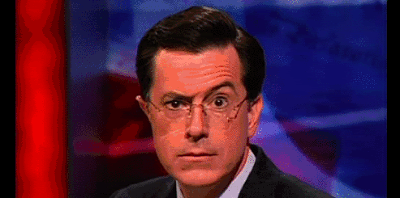
Non-Oral or Visual Prompts
-Silence
-The Head Nod
-The Raised Eyebrow

Slide 13
Don’t
-make assumptions about what the witness knows.
-start a question with: “Do you remember…?” “Do you recall…?”
“Do you know…?”
-be wedded to your notes.

Slide 14
Documents
Author?
When created?
Why created?
What does it say?
Who has seen it?
Where is it kept?
Edits / amendments?
Electronic versions?
Paper copies?
Produced in discovery?

Slide 15
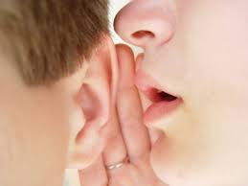
Conversations
Where?
When?
Who heard?
What was said?
Recordings / documents?
Close off.

Slide 16
Meetings
Who called the meeting?
Who attended?
When? Where?
Context?
Documents distributed?
Who said what?
Minutes or notes?
Powerpoint? Charts?
Action items?

Slide 17
“Top of the Funnel” Examinations
USDC – RI Litigation Academy
U.S. District Court for the District of Rhode Island
Federal Bar Association
Roger Williams University Law School

