Slide 1
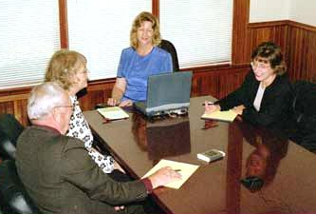
The Fine Art of Taking a Brilliant
Deposition

Slide 2

The Bottom of the Funnel
Where the rubber meets the road:
Change the form of questions
as you slide down the funnel
Move from open-ended to short tight simple questions looking for admissions

Slide 3

Why are you taking this deposition?
  Summary judgment
  Impeachment at trial
  Trial testimony of the witness at trial
  Box the witness out of case
  Settlement

Slide 4

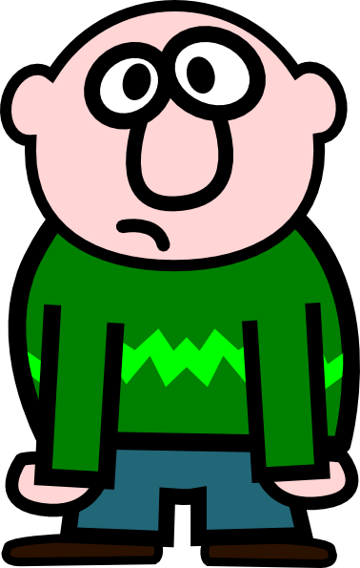
Creating Q/A Pairs to test your theory and get admissions
  --Narrow closed-end questions
  --Witness to confirm or deny one fact per question
  --Break your theory of what this witness has to say into a series of questions
  --See if the witness denies
  any link in the chain
  If he does, shoot back up
  funnel to find out why.

Slide 5
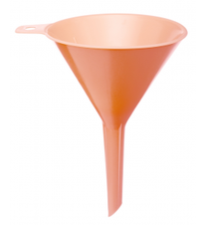
At the Bottom of the Funnel
  Tight, short, clear questions
  Call for tight, short, clear answers YES/NO
  Now is the time to lead
  If question is key, consider scripting it
  One fact per question
  But, beware of simple yes/no
  Pronouns are dangerous
  Reframe if objection colorable

Slide 6
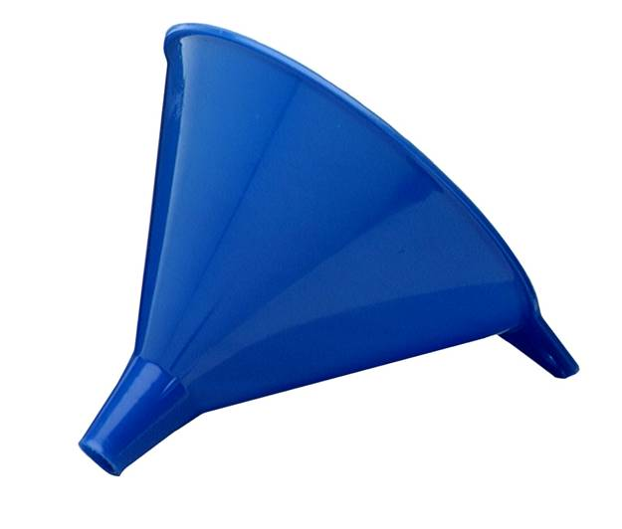
Evidence rules for bottom of funnel
Fed. R. Evid. 602 “No foundation” -- establish witness has personal knowledge
Fed. R. Evid. 611(c) “Leading”
  Is this a witness you can lead?
Fed. R. Evid. 607 “Impeaching”
  Is this a witness you can
  Impeach?
ANTICIPATE AND LISTEN TO
OBJECTIONS

Slide 7

Sample examination

Slide 8
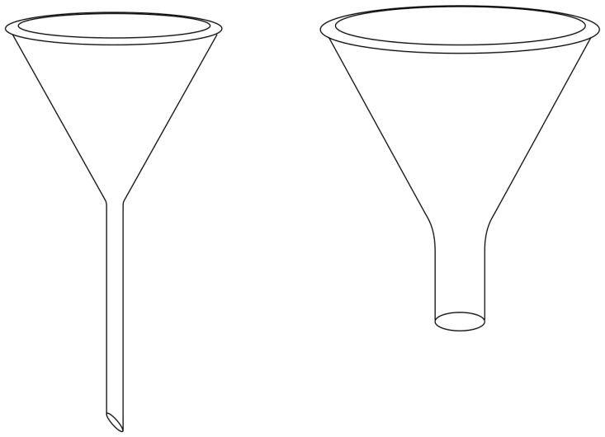

Slide 9


Slide 10


Slide 11

Unpacking
Beware of words the witness might not understand
Dates and times unambiguous
Simple clear Anglo-Saxon words
  Thereafter → then
  Preceding → before
  Accordingly → because
  Subsequent → after

Slide 12

Make sure YES/NO makes sense
Your windshield wipers were on, right?
  YES means they were on
  NO means they were not on
            VS
Do you recall that your windshield wipers were on?
  YES may just mean he/she recalls
  NO may just mean he/she does not recall

Slide 13

More Yes/No trouble
So you were not present?
  YES may mean “Yes, I was not present.”
  NO may mean “No, I was present.”
Fix it: To be clear, you were not present at the 5:00 pm meeting on September 5, 2015, right?

Slide 14

One fact per question
At the June meeting [what year?], do you recall whether or not the CEO said the Board voted to approve the plan?
What does YES/NO mean?
  I don’t recall the meeting.
  The CEO did not say anything.
  The Board did not vote.
  The vote was not to approve.

Slide 15
Mix it up
Some questions call for yes
Some questions call for no
Some questions call for a one word answer
You drove the entire trip? YES
Did your wife drive at all? NO
What color was the car? GREEN

Slide 16
Make sure you laid foundations
During top and middle of funnel, get all the TIME/PLACE data
You know your witness has personal knowledge
If any doubt, shoot back up funnel and get foundation laid
    Be sure to ask “You were at the June 2014 board meeting?”
    Before asking, “CEO was at June 2014 board meeting, right?”

Slide 17
Don’t forget
Listen to objection and reform question if it conceivably has merit.
Listen to answer!!!
Ask if again until it responds to question.
Consider whether “explanation” to be permitted

Slide 18
Finish the list
Is that all?
Anything else?
Have you told me everything you recall?
Anything that would refresh your memory?

Slide 19
Looping and leading
  Loop prior answer(s) into next question
      You stopped at store on your way home? YES
      You were driving? YES
      You were driving to the store? YES
  Listen for “Objection, misstates prior testimony”

Slide 20

Techniques for lying witness
Be the Omniscient Examiner - use documents to make witness believe you know everything already
Have testimony from middle of funnel ready
OR let him/her lie – the deposition is not necessarily the time to impeach

Slide 21
Mistakes to avoid
Long questions with ten pound words
Double negatives
Pronouns with an antecedent 20 pages back
Dates, places, times defined 40 pages back
Compound
Forgetting to close the list
Opinion questions without a strong foundation

Slide 22
And when it’s over . . .
Check the transcript!
Did “You were not driving, correct?”
Get transcribed as “You were driving, correct?

Slide 23
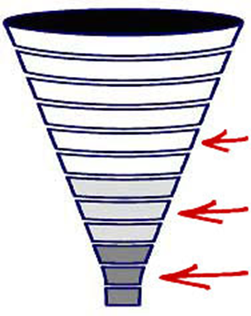
Questions?

