Slide 1
Middle of the funnel or the other stuff you need to be thinking about.
Dennis J. McCarten, Esq.

Slide 2
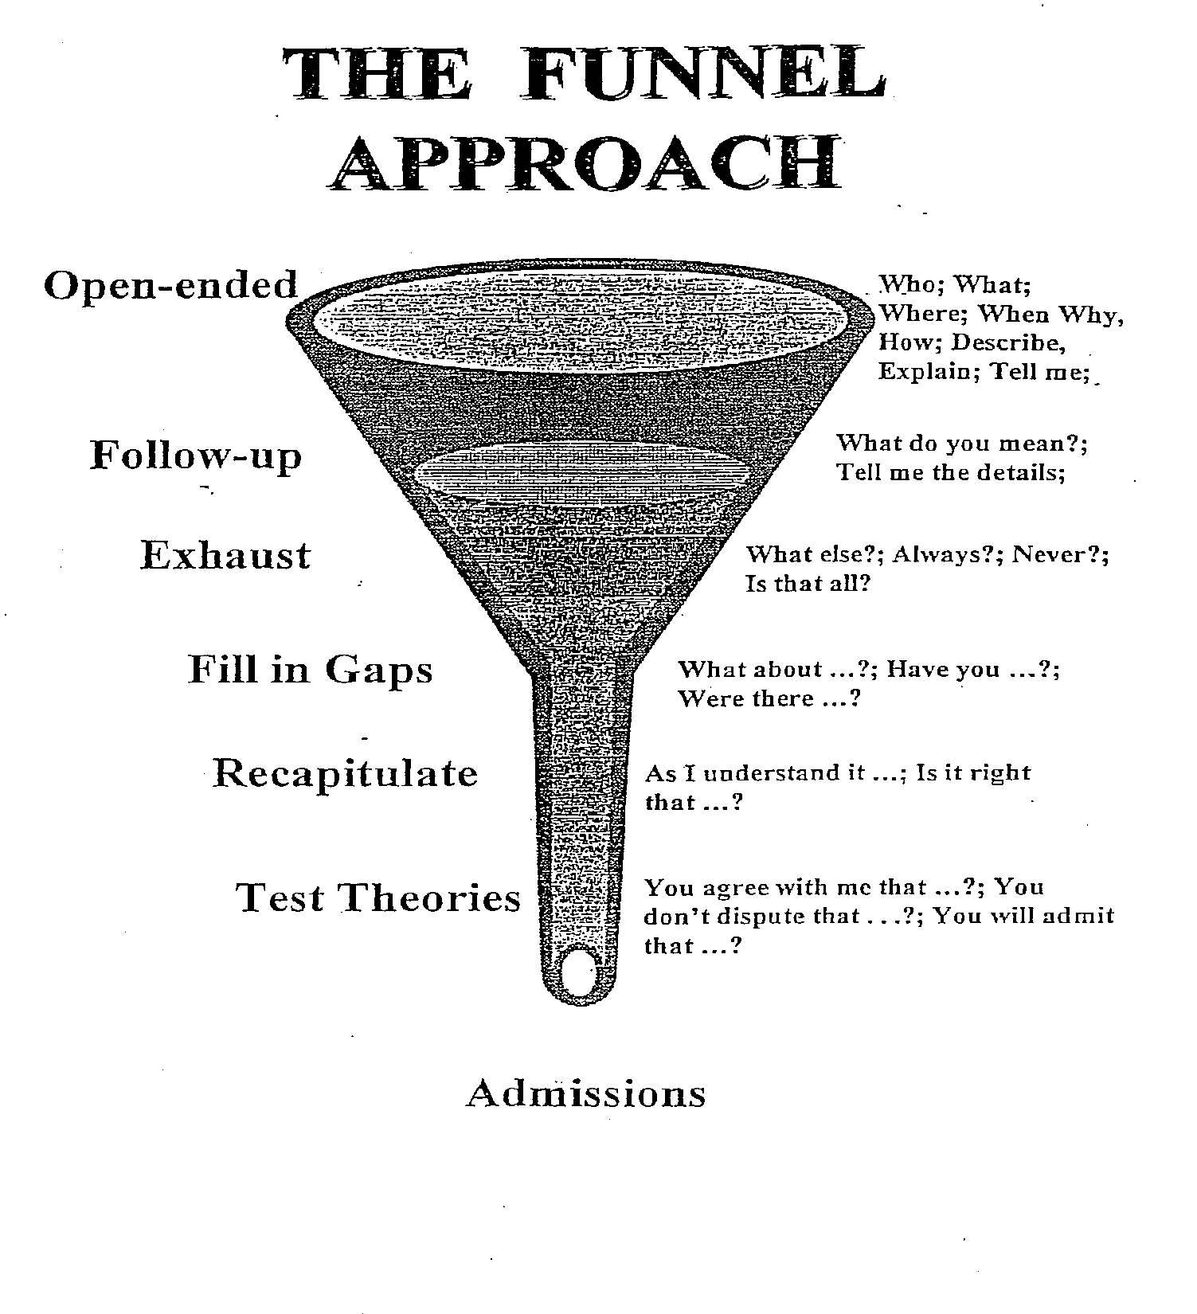

Slide 3
You’re Half Way There….
Or so you think. “Middle” is a misnomer.
Funnels galore
Open-ended questions
Narrative answers
Feeling good!! But you feel the need...

Slide 4
To follow up
To learn facts that underlie answers to your open-ended questions
To flesh out details of a topic
To fully explore the witness’ knowledge
Notes:
This is a test of the notes function

Slide 5
Q: When did you first see the plaintiff?
A: He was about 200 yards away – on Kirby, approaching Main Street.
Q: How far was plaintiff from the intersection?
A: About 100 yards.
Q: How far were you from the intersection?
A: About the same distance.

Slide 6
Q: “Describe the process for shipping parts once they have been ordered.”
A: “My assistant will send an email to the warehouse. The warehouse will pick the parts, package them, notify UPS to come get them and then they are taken away, usually by the end of the same day.”

Slide 7
Q: “Who was your assistant in December 2013?”
A: “Virginia Young.”
Q: “How long had Virginia Young been your assistant?”
A: “Just over three years.”
Q: “Describe Virginia Young’s experience with processing shipments prior to December 2013.”
A: “[yadda, yadda, yadda.]”
And so on…...

Slide 8
CLOSE OFF AND LOCK IN
Q: “Have you told me everything you know about the topic?”
[But the witness is well-prepared.]
A: “That’s all I can remember at this time”

Slide 9
Did you make notes?
Did anyone else make notes?
Did you talk to anyone else about it?
Is there any place you can check?
Is there anyone you can talk to?
Is there anything that might trigger a memory?
If you had to do something to record it what would that be?
What are your habits or procedures?

Slide 10
Going Back up the Funnel
Funnel rarely ends with “Yes” or “No”
More often its “Yes, but…...” or “No, but sometimes......”
New information – New funnel

Slide 11
Multiple Funnels
New series of funnels for each new subtopic in a single topic
Topic – How witness learned information
  Q: “How did you learn that the buyer wanted insurance on the shipment?”
  A: “I received an email to that effect.”

Slide 12
New subtopic – Handling of emails
  Q: “How do you receive your email?”
  A: “When I’m in the office, I open them on my lap top computer.”
New sub-subtopic – Handling email when he’s not in the office
  Q: “How is email handled when you’re not in the office?”
  A: “One of my assistants opens them and saves them to my mail folder.”

Slide 13
New sub sub subtopic – The assistants
  Q: “Who are your assistants?”
  A: “Tom, Dick and Harriet.”
New sub sub sub subtopics – Tom, Dick and Harriet
And so on….......

Slide 14
Notes, outlines, scripts and note-taking
Listen
Watch
Observe
Respond

Slide 15
PREPARATION - There is no substitute for knowing your file
ORGANIZATION – Minimal outline
  Key areas
  Key terms
  Perhaps in the order you want to go
NOTE TAKING
  Lists
  Key terms/names
  You have a transcript

Slide 16
Exhaustion
Goal to obtain every important piece of information about a topic
Its important if it:
  Aids your understanding
  Aids your case analysis
  Aids your presentation of the case
  Is NOT a waste of time or money

Slide 17
How far do you go?
  Time available
  Importance of topic
  Budget
Leapfrogging – Dangers
  Forget to go back and pick up
  Breaks your concentration

Slide 18
Suggest new facts
  Get to the end of the funnel and witness says “That’s all.”
  But you know there’s more
    Q: “Describe the shipping process.”
    A: “[blah, blah, blah]”
    Q: “Is that all?”
    A: “Yes.”
    Q: “What about shipping insurance?”
    A: “Oh yeah.”

Slide 19
Conversations
The litany
Where
When
Who
Witnesses*
What was said
  Generally first
  Then specifics
*…and what could they hear

Slide 20
I would add:
  Was it recorded?
    Audio
    Video
    Written
    By you
    By someone else
    Why?

Slide 21
Conversations - The Four C’s
Context
Conversation
Close off
Confirm

Slide 22
Handling Documents
“I am handing a document to the stenographer. Please mark this as Exhibit 1 for the deposition.”
“I am showing Exhibit 1 to opposing counsel and to the witness.”
[to the witness]“Please take as long as you need to review Exhibit 1.”

Slide 23
“Have you had an opportunity to review Exhibit 1?”
“What is Exhibit 1?”
Document now has a new name. It is
EXHIBIT 1!! Every single reference to it now “Exhibit 1”. It is no longer “the letter” or “the contract” or “the ledger” or whatever.

Slide 24
Handling photographs.
“I am handing a photograph to the stenographer. Please mark this as Exhibit 2 for the deposition…. On the back please.”
I am showing Exhibit 2 to opposing counsel and to the witness.”
Have you had a chance to see Exhibit 2?”

Slide 25
“What is Exhibit 2?”
A: “It’s a picture of my house after the flood.”
“Is the photograph marked Exhibit 2 a fair and accurate likeness of your house as it appeared after the flood?”
A: “Yes.”

Slide 26
It’s all about the record!

