Slide 1


Slide 2

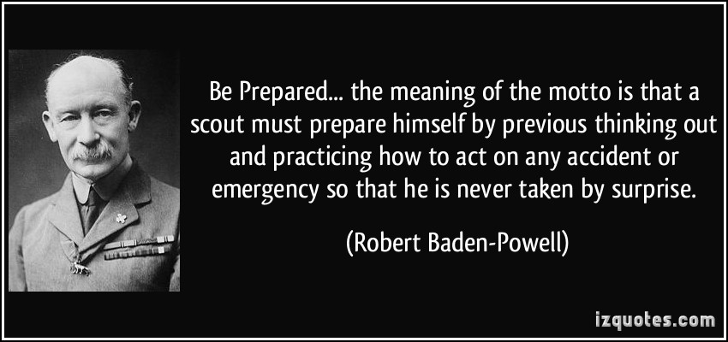

Slide 3
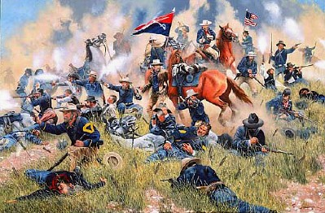

Slide 6
P.R.E.P.
Prepare
Reassure
Educate
Practice

Slide 7


Slide 12

FUNNEL

Slide 13
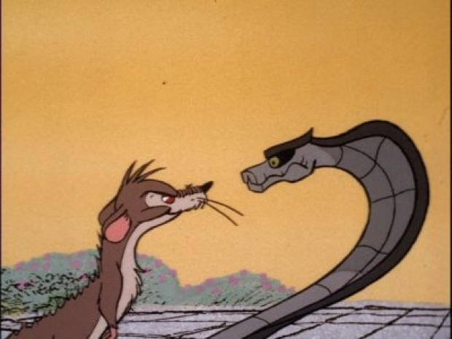

Slide 14
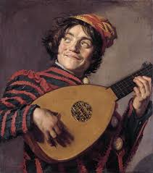
L.U.T.E.
Listen
Understand
Think
Express

Slide 18


Slide 19
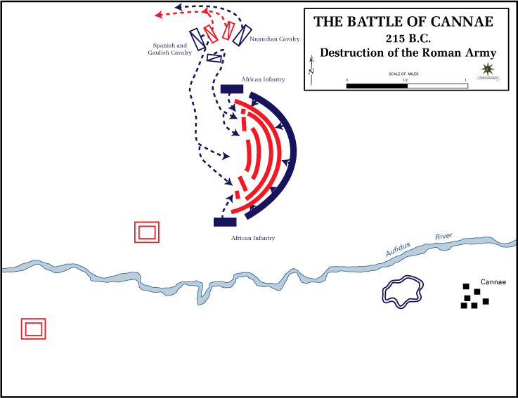

Slide 22


