Slide 1
Flattening Filings,
Unrepresented Litigants,
MDLs, and the Federal Courts
prepared for
The Future of Civil Litigation
in Federal Courts
United States District Court for the
District of Rhode Island Conference, 2017
Judith Resnik
Yale Law School
© All Rights Reserved
March 23, 2017

Slide 2
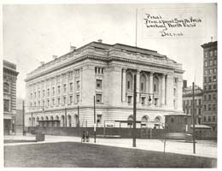
United States Post Office, Court House, and Custom House, 1906.
Renamed the Providence Federal Building and Courthouse, 1961. Architect: Clarke & Howe.
Source: National Archives, RG121-BS, Box 79, Folder M.

Slide 3
Growth Rate of Federal District Court Filings, 1905-2015
Data for 1905–1998 are from William F. Shughart & Gökhan R. Karahan, Determinants of Case Growth in Federal District Courts in the United States, 1904–2002 (ICPSR 3987), Inter-Univ. Consortium for Political & Soc. Research (Jan. 4, 2016), http://www.icpsr.umich.edu/icpsrweb/ICPSR/studies/3987. For data for years 1999–2012, see Fed. Judicial Ctr., Historical Caseloads in the Federal Courts (Jan. 4, 2016), http://www.fjc.gov/history/caseload.nsf/page/caseloads_main_page. Data for 2000 until 2015 were also adapted from tables C & D of the respective yearly reports accessible at Admin. Office of the U.S. Courts, Federal Judicial Caseload Statistics (Jan. 4, 2016), http://www.uscourts.gov/statistics-reports/analysis-reports/federal-judicial-caseload-statistics. The effective annual growth rate reflects growth that would have occurred if filings had increased at a constant rate during the prior five years. This rate, based on actual growth in each of the five years, has been smoothed out. Five-year growth rates for 1905–1908 are based in part upon estimated filings during 1900–1903, projected backwards from years with reported numbers. Data do not include bankruptcy filings.

Slide 4
1995 Projections of 2010 U.S. Federal District Court Filings,
2010 and 2015 Actual Filings in U.S. District Courts
1995 projections of 2010 filings
2010 actual filings
2015 actual filings
610,800
361,323
340,238
This figure is derived from multiple sources. Data for 1995 projects of 2010 filings are derived from Judicial Conference of the United States, Long Range Plan for the Federal Courts 15, tbl. 3 (Dec. 1995), reprinted in 166 Federal Rules Decision 49 (1996). Data for 2010 actual filings and 2015 actual filings are derived from Administrative Office of the United States Courts tables C & D of the respective yearly reports accessible at Admin. Office of the U.S. Courts, Federal Judicial Caseload Statistics (Jan. 4, 2016), http://www.uscourts.gov/statistics-reports/analysis-reports/federal-judicial-caseload-statistics. Note: Criminal filings are of cases, not defendants.

Slide 5
U.S. District Court, District of Rhode Island Filings: 2000-2015
Civil Actions Pending data from 2000 to 2015 are taken from USCourts.gov Caseload Statistics Data Tables, Table C: U.S. District Courts – Civil Cases Filed, Terminated and Pending.” Criminal pending data from 2000 to 2015 are taken from USCourts.gov Caseload Statistics Data Tables, Table D. Cases: “U.S. District Courts—Criminal Cases Filed, Terminated, and Pending (Including Transfers).” All data are for year ending on Sept. 30.

Slide 6
Total Civil Cases Pending in U.S. District Courts: 1972-2015
Civil Actions Pending data from 1968 through 1990 are taken from Admin. Office of U.S. Courts, Reports of the Proceedings of the Judicial Conference of the United States, tbls. C-6a, C-6b. Data are from year ending on June 30. Civil Actions Pending data from 1991 through 2015 are taken from Admin. Office of U.S. Courts, Reports of the Proceedings of the Judicial Conference of the United States, tbl. C-6. Data are from year ending on Sept. 30.

Slide 7
The Percentage of the Pending Federal Civil Docket
in Multidistrict Litigation: 1972-2015
Civil Actions Pending data from 1968 through 1990 are taken from Admin. Office of U.S. Courts, Reports of the Proceedings of the Judicial Conference of the United States, tbls. C-6a, C-6b. Data are from year ending on June 30. Civil Actions Pending data from 1991 through 2015 are taken from Admin. Office of U.S. Courts, Reports of the Proceedings of the Judicial Conference of the United States, tbl. C-6. Data are from year ending on Sept. 30.Civil Actions Pending in Multidistrict Litigation data from 1972 through 1990 are taken from the Annual Reports of the Judicial Panel on Multidistrict Litigation, available at http://www.jpml.uscourts.gov/statistics-info. Data are from year ending on June 30. Civil Actions Pending in Multidistrict Litigation data from 1991 through 2015 are taken from the United States Judicial Panel on Multidistrict Litigation, Fiscal Year Statistics (1992-2015), available at http://www.jpml.uscourts.gov/statistics-info. Data are from year ending on Sept. 30.

Slide 8
Pending Cases in the Federal Civil Docket
and in Multidistrict Litigation: 1972-2015
Civil Actions Pending data from 1968 through 1990 are taken from Admin. Office of U.S. Courts, Reports of the Proceedings of the Judicial Conference of the United States, tbls. C-6a, C-6b. Data are from year ending on June 30. Civil Actions Pending data from 1991 through 2015 are taken from Admin. Office of U.S. Courts, Reports of the Proceedings of the Judicial Conference of the United States, tbl. C-6. Data are from year ending on Sept. 30.Civil Actions Pending in Multidistrict Litigation data from 1972 through 1990 are taken from the Annual Reports of the Judicial Panel on Multidistrict Litigation, available at http://www.jpml.uscourts.gov/statistics-info. Data are from year ending on June 30. Civil Actions Pending in Multidistrict Litigation data from 1991 through 2015 are taken from the United States Judicial Panel on Multidistrict Litigation, Fiscal Year Statistics (1992-2015), available at http://www.jpml.uscourts.gov/statistics-info. Data are from year ending on Sept. 30.

Slide 9
Pending Civil Cases in U.S. District Court, D. Rhode Island, 2003-2015

Slide 10
Weighted Civil Filings per Authorized Judgeship: 2000-2015
Weighted Civil Filings per Authorized Judgeship from 2001-2015 are taken from Admin. Office of U.S. Courts, Reports of the Proceedings of the Judicial Conference of the United States, tbl. X-1A, Admin. Office of the U.S. Courts. Data are from year ending on Sept. 30. The weighting measure changed in 2004, and changed again in 2015.

Slide 11
Unrepresented Litigants in the U.S. District Courts:
2004-2015
Data are taken from Tables C-13 the Administrative Office of the U.S. Court’s Judicial Reports (2004 -2014), available at Judicial Business, tbls. C-13, Admin. Office of the U.S. Courts, http://www.uscourts.gov/report-names/judicial-business?tn=C-13&pt=All&t=All&m%5Bvalue%5D%5Bmonth%5D=&y%5Bvalue%5D%5Byear%5D. The categories provided by the Administrative Office are “Prisoner Petitions” and “Nonprisoner Petitions.”

Slide 12
Unrepresented Filings in the U.S. Courts of Appeals:
1995-2015
Data for 1996-2014 are taken from Tables B-19 –Pro Se Cases Commenced, by Source—in the Administrative Office of the U.S. Court’s Judicial Reports (1996 - 2014), available at Judicial Business, tbls. B-19, Admin. Office of the U.S. Courts, http://www.uscourts.gov/report-names/judicial-business?tn=B-19&pt=All&t=37&m%5Bvalue%5D%5Bmonth%5D=&y%5Bvalue%5
D%5Byear%5D=. Data for 1995 are taken from Table 2.4—U.S. Courts of Appeals-Pro Se Cases Filed, available at U.S. Courts of Appeals Judicial Facts and Figures, tbl. 2.4, Admin. Office of the U.S. Courts, http://www.uscourts.gov/statistics/table/24/judicial-facts-and-figures/2014/09/30. The categories provided by the Administrative Office are: “Criminal,” “Prisoner Petitions,” “U.S. Civil,” “Private Civil,” “Bankruptcy Appeals,” “Administrative Agency Appeals,” and “Original Proceedings and Miscellaneous Applications.”

Slide 13
Declining Rate of Civil and Criminal Trials, United States Federal Courts, 1976-2000
Criminal
Civil
Provided by the Honorable Patrick Higginbotham, June 2002
Declining Bench Presence,
United States Federal Courts, 2008 - 2013
“. . . an average of only 423 hours of open court proceedings per active district judge . . . – the equivalent of less than two hours per judge per day in the courtroom.”
Jordan M. Singer & William G. Young, Bench Presence 2014: A Updated Look at Federal District Court Productivity, 48 New Eng. L. Rev. 565, 565-566
Notes:
U:Justice Images/Higginbotham Chart, Civil and Criminal Trial Rates

Slide 14
“So how might reality television portray a federal ‘trial’ judge in civil lawsuit garb?
In an office setting without the robe, using a computer and court administrative staff to monitor the entire caseload and individual case progress . . . .
For federal civil cases, the black-robed figure up on the bench, presiding publicly over trials and instructing juries, has become an endangered species, replaced by a person in business attire at an office desk surrounded by electronic assistants.”
The Honorable Brock Hornby,
The Business of the U.S. District Courts,
10 Green Bag 453, 462 (2007)

Slide 15
Comparing the Volume of Filings:
State and Federal Courts, 2010
Sources: Administrative Office of the U.S. Courts, Caseload Statistics, 2010, tbls C-1, D-1 and F, http://www.uscourts.gov/Statistics/Federal JudicialCaseloadStatistics/FederalJudicialCaseloadStatistics2010.aspx. Data on state filings come from the National Center for State Courts, Court Statistics Project, National Civil and Criminal Caseloads (2010), http://www.courtstatistics.org/Other-Pages/StateCourtCaseloadStatistics.aspx. The number of state filings is an estimate, as states do not uniformly report data on all categories; further, this number does not include juvenile or traffic cases.

Slide 16
State Trial Court Filings, 1976-2008
Figures are estimates, as not all states report data in all categories.
Source: National Center for State Courts annual reports, entitled Examining the Work of State Courts,
http://www.ncsconline.org/D_Research/csp/EWSC-pastreports.html.

Slide 17
National Center for State Courts:
The Landscape of Civil Litigation in State Courts, 2012-2013
925,344 civil cases, 10 major urban counties
Contracts | 64%
Debt collection | 37%
Landlord/tenant | 29%
Foreclosure | 17%
Small claims | 16%
Other civil cases | 9%
Tort | 7%
Automobile tort | 40%
Personal injury/property damage | 20%
Medical malpractice | 3%
Products liability | 2%
Case dispositions N = 925,344 |  | Cases without lawyers N = 649,811
Dismissed | 35% | Parties without representation
Judgment unspecified | 26% | Both parties | 6%
Default judgment | 20% | Defendants | 74%
Settled | 10% | Plaintiffs | 8%
Trial, summary judgment, or binding arbitration | 4%

Slide 18
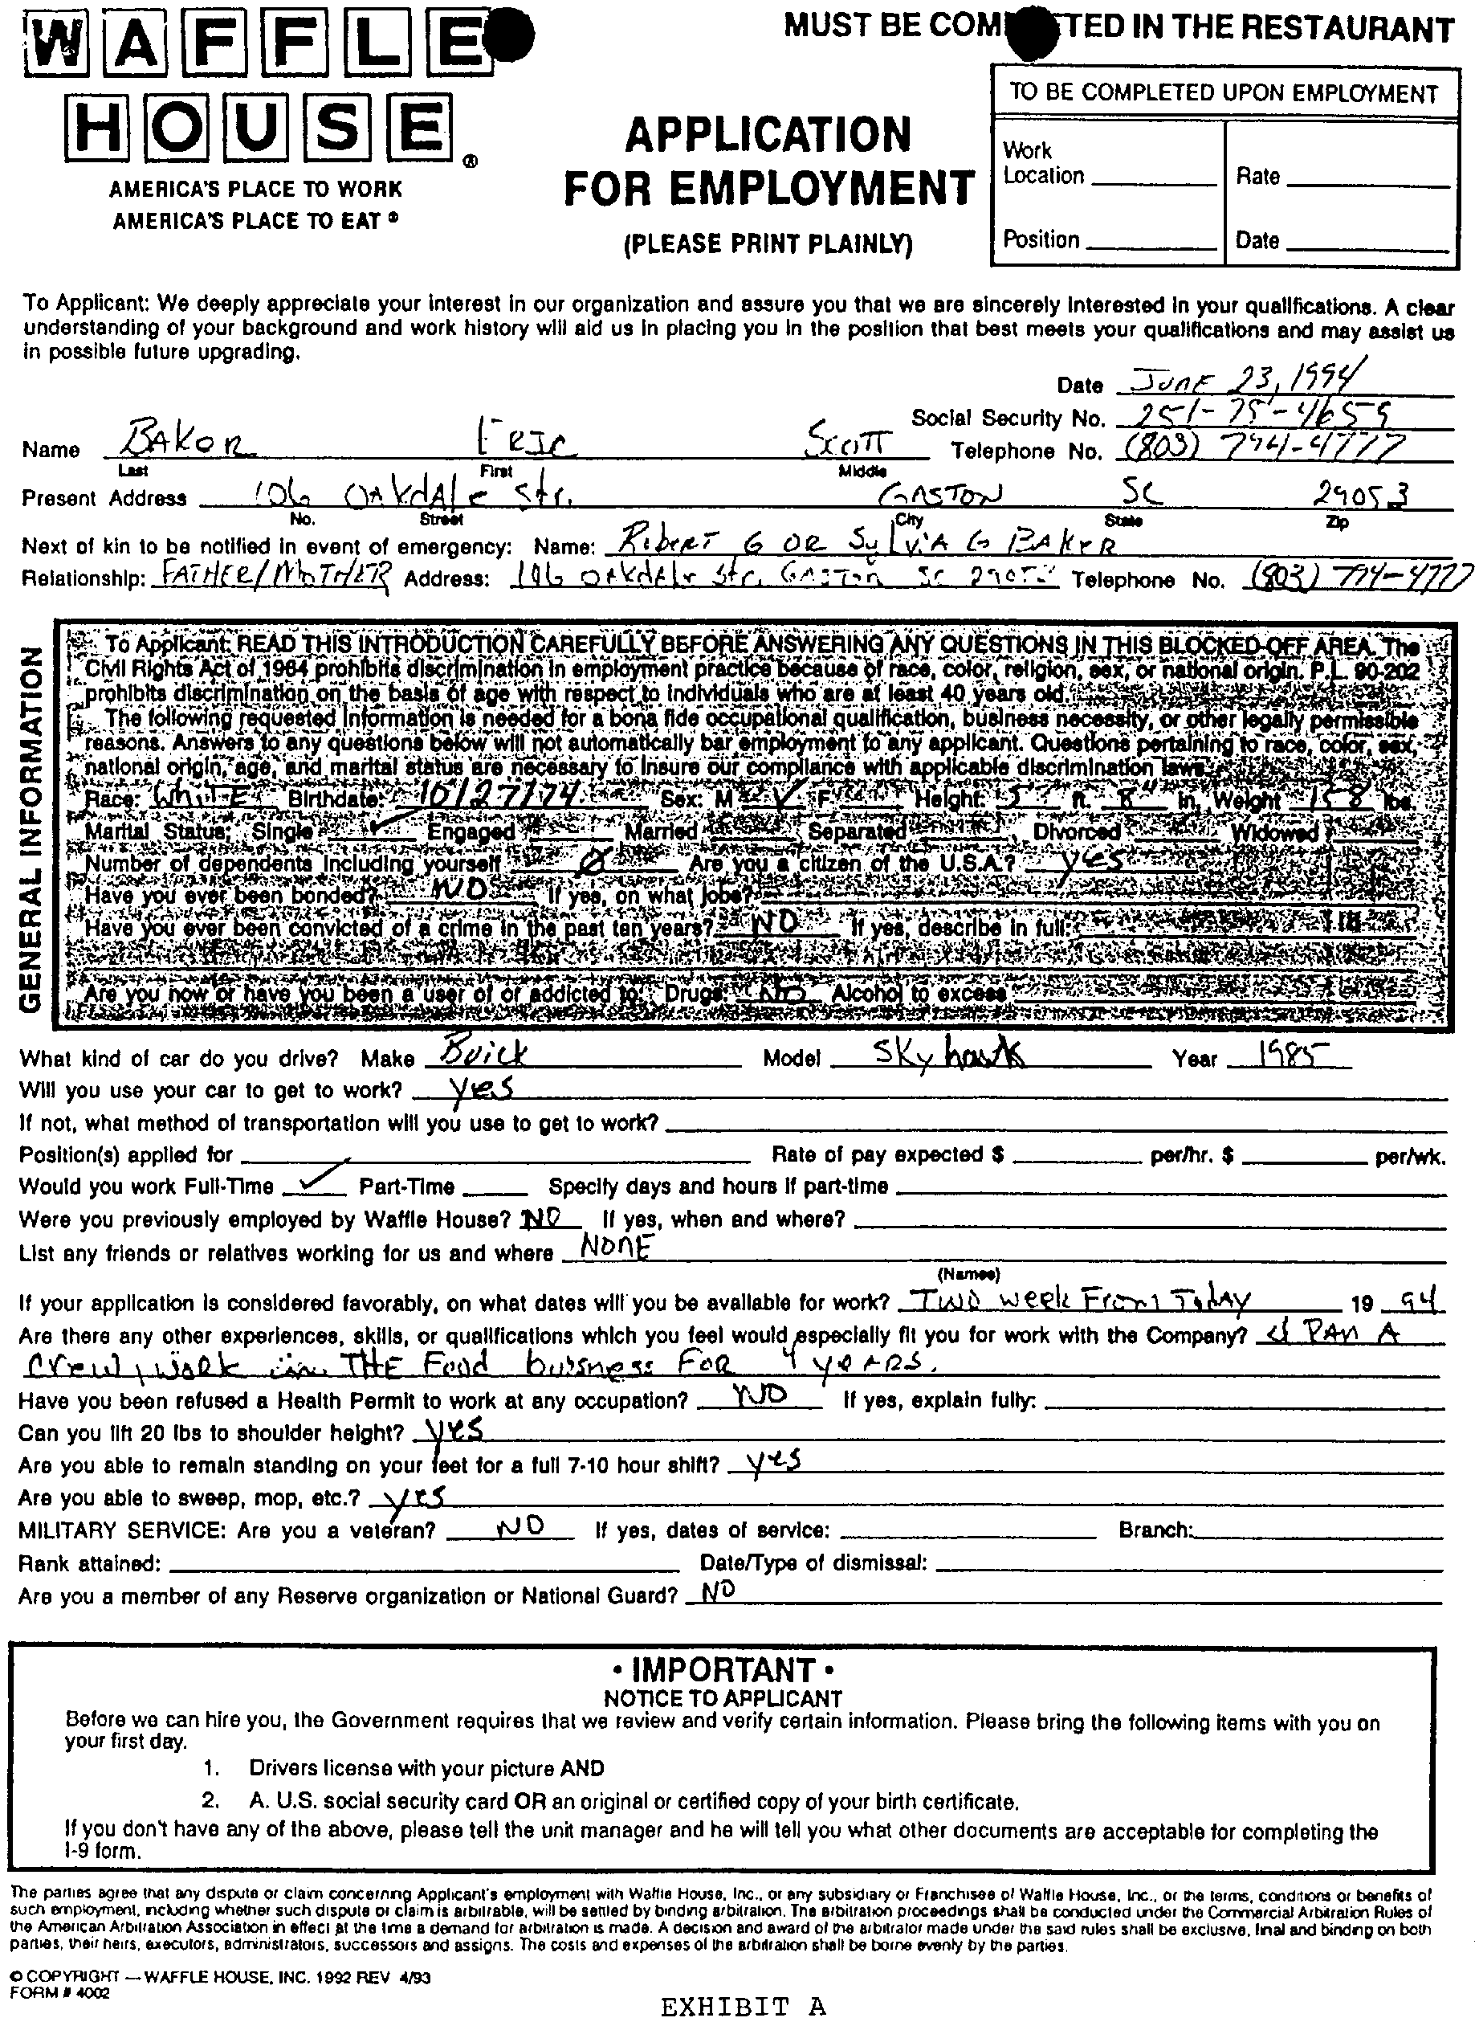
Waffle House Employment Application
Joint Appendix at 59, 61, EEOC v. Waffle House, No. 99-1823 (May 25, 2001)

Slide 19
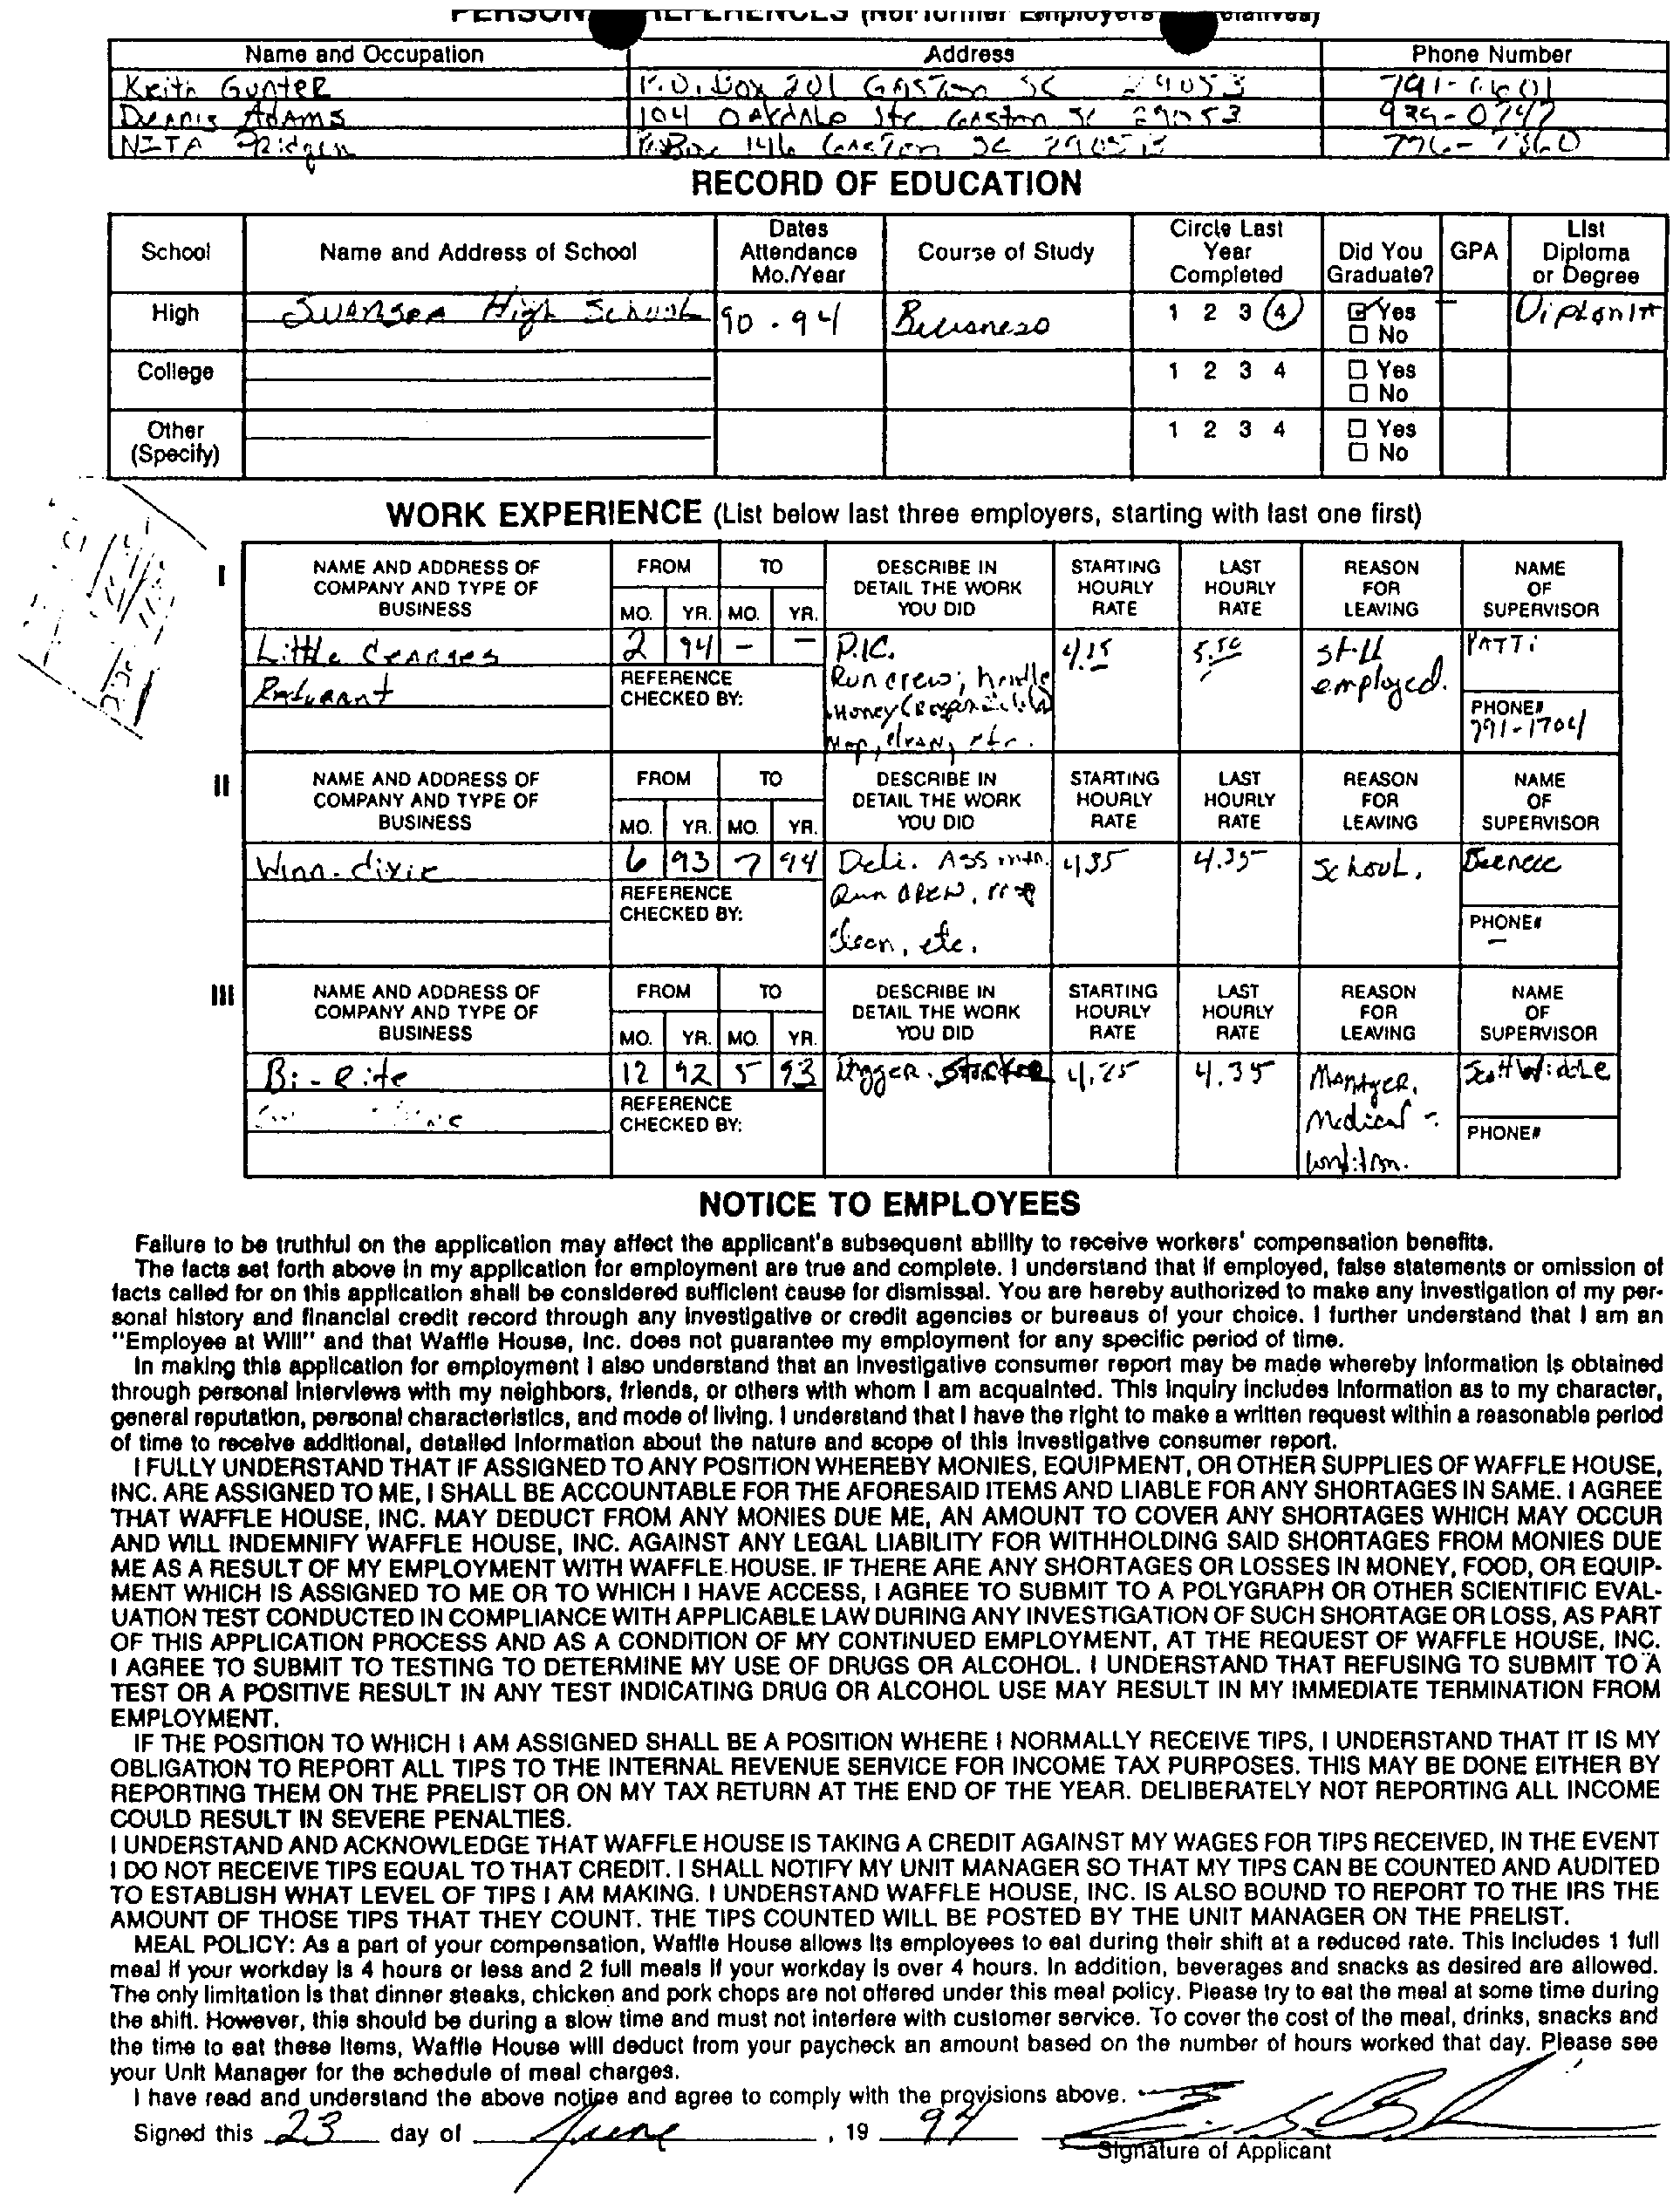

Slide 20
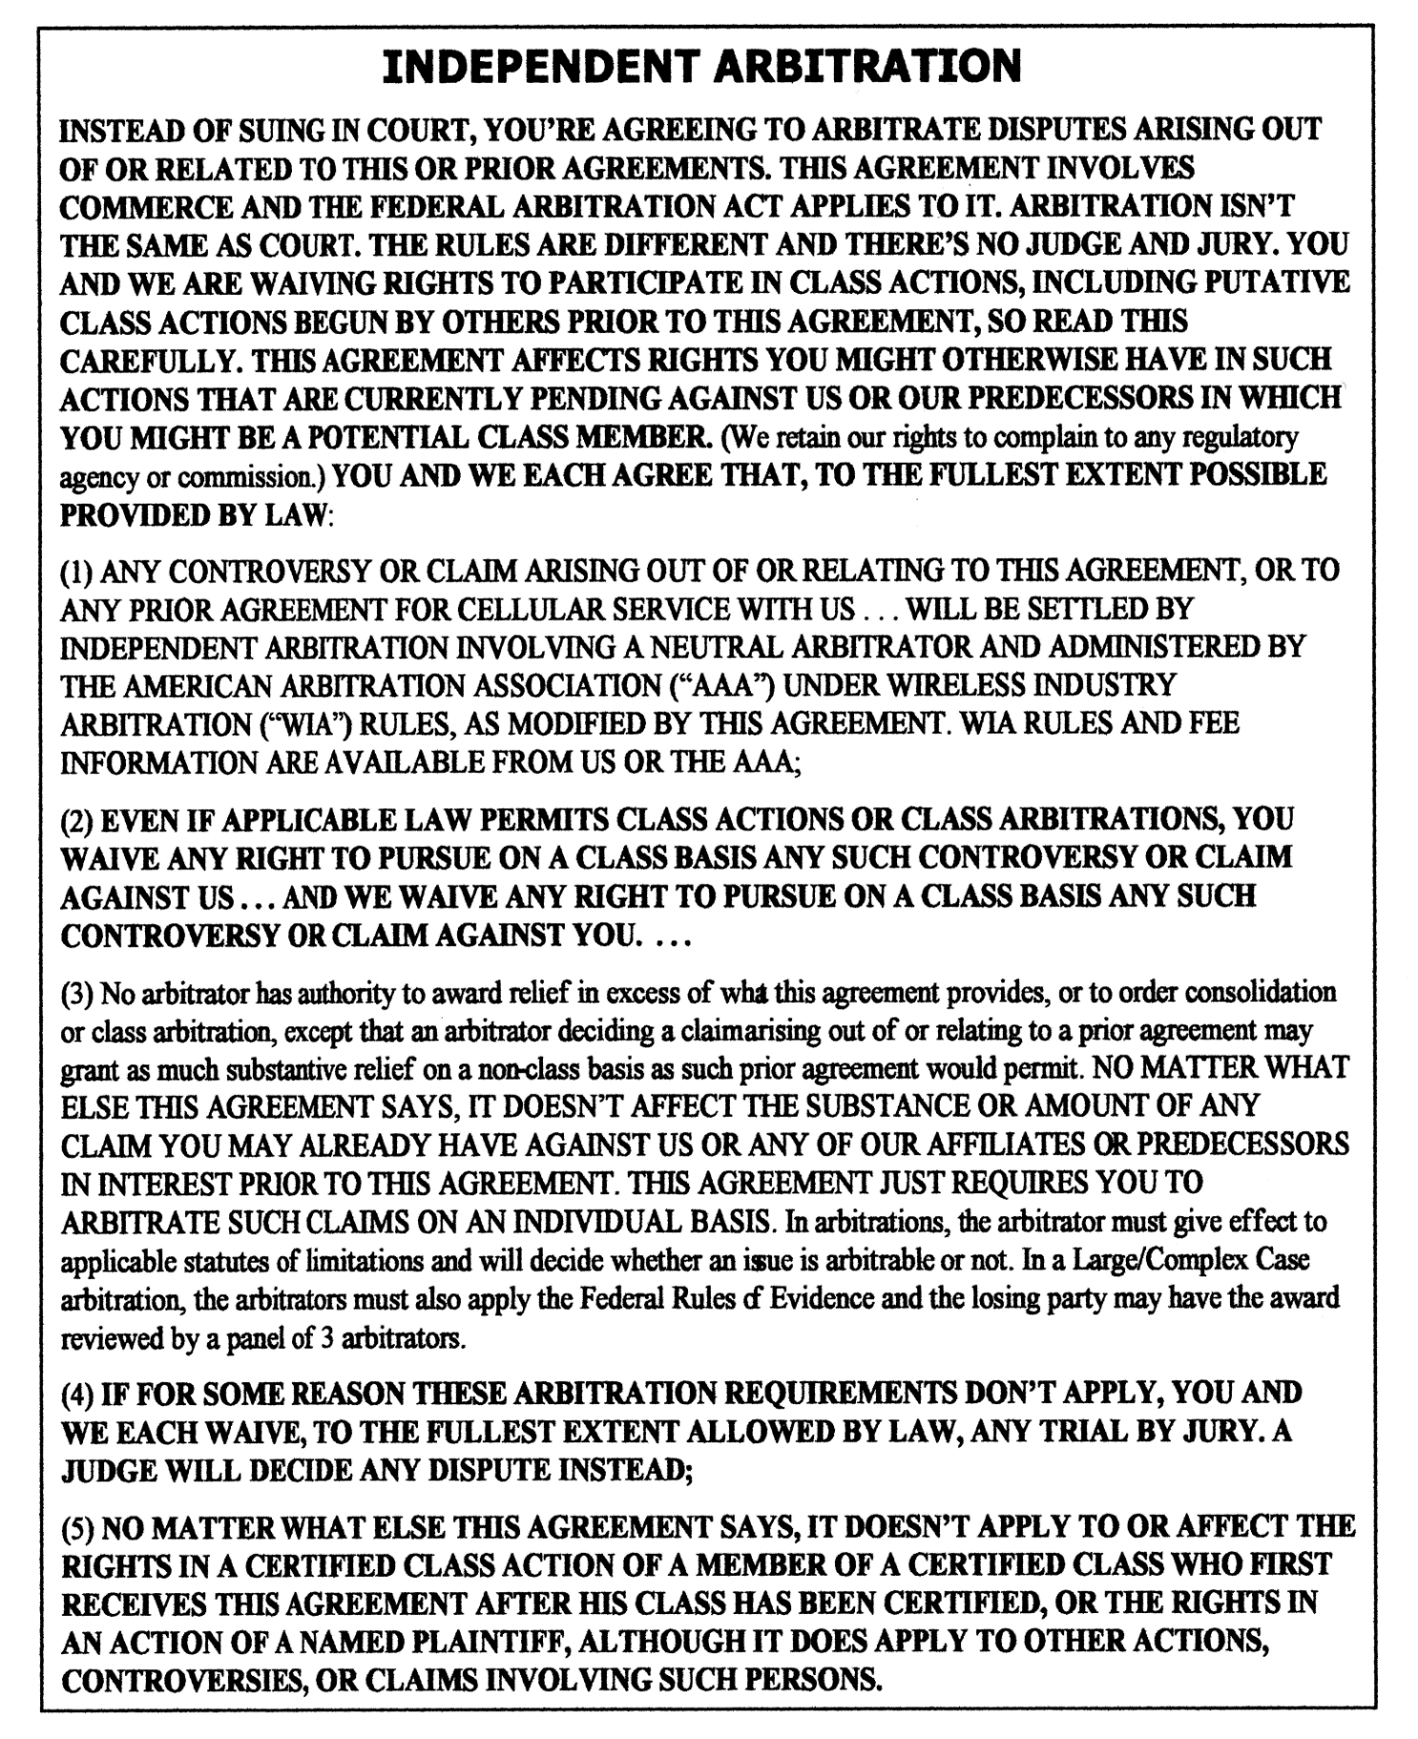
Document Accompanying the Purchase of a Cellular Phone, 2002.

Slide 21
Consumer Arbitrations Filed with the
American Arbitration Association, 2009-2014
Sources | Types |  |  | Average per Year | Total
AAA Data, Provider Organization Report June 2009 – July 2014 | AAA-defined consumer claims |  |  | 1,460 | 7,303
 |  | AAA claims involving AT&T | 85-120 million consumers | 27 | 134*
Consumer Financial Protection Bureau, 2015 Arbitration Study January 2010 – December 2012 | AAA claims in credit card, prepaid card, checking account, payday, private student, and auto loan markets |  | 80 million credit-card consumers | 616** | 1,847
* All 134 of the consumer claims involving AT&T were filed by consumers.
** Of the 616 consumer arbitrations a year, approximately two-thirds were filed by consumers.
Data from: AAA Data, July 2009-June 2014, Provider Organization Report; Consumer Financial Protection Bureau, Arbitration Study: Report to Congress Pursuant to Dodd-Frank Wall Street and Consumer Protection Act, Section 102.8(A) (2015).

Slide 22
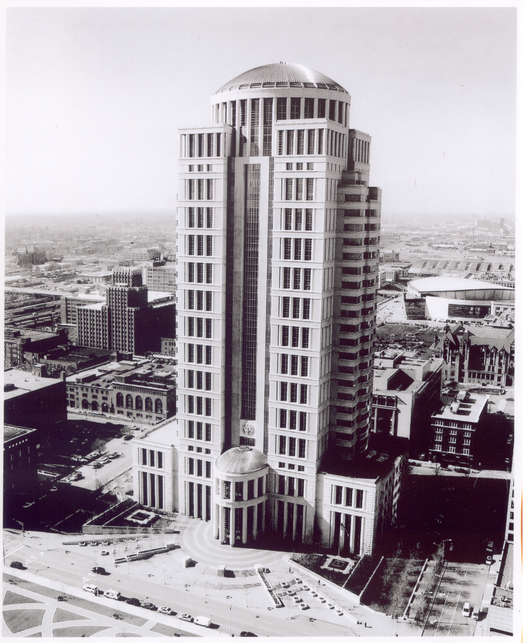
Thomas F. Eagleton Federal Courthouse, St. Louis, Missouri, 2000.
Architects: Hellmuth, Obata + Kassabaum, Inc. Photographer: The Honorable David D. Noce, U.S. Magistrate Judge for the Eastern District of Missouri. Photograph courtesy of and reproduced with the permission of the photographer.
Notes:
21
U:Justice Images/2001 St. Louis Federal courthouse

