Slide 1
The Future of the Courtroom – Innovative Jury and Courtroom Techniques
2017 District Conference, U.S. District for the District of Rhode Island
Providence, Rhode Island
March 23, 2017

Slide 2
A Brief Primer on Juror Decision-Making

Slide 3
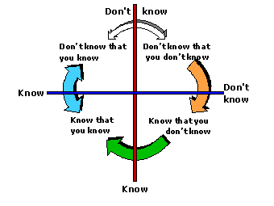
How We Know What We Know
Archival Studies
Mock Jury Studies
Juror Surveys and Interviews
Direct Observation of Mock and Actual Deliberations

Slide 4

The Story Model
People employ cognitive schema to navigate and interpret the world
Jurors use schema to analyze, filter and interpret trial evidence to construct a coherent “story” that fits the facts and applicable law
A good “story” …
  covers the provided information adequately (COVERAGE)
  Is consistent, plausible, and complete (COHERENCE)
  Is specific and includes detail (UNIQUE)
Notes:
Cognitive schema are heuristic filters comprised of life experiences, opinions, cultural norms, biases and stereotypes
How Jurors Use Preliminary Stories
1. Use as framework for analyzing evidence and arguments during trial.
2. Use as filter to decide what evidence is relevant and should be retained, and what evidence to discard.
3. Use as memory tool to hold on to more information than would be possible without a story.
4. Use as a story to persuade other jurors during deliberations.

Slide 5
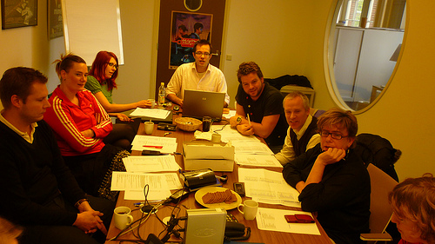
What jurors do well …
Jurors are extremely conscientious about their tasks
Jurors do understand the nuances of burden of proof
Jurors collectively have good comprehension of evidence

Slide 6

And not so well …
Even in relatively simple cases, the learning curve for jurors is steeper than it is for judges and lawyers
Jurors struggle to understand the law they are asked to apply
Notes:
Trial procedure is not an optimal manner of presenting information in a coherent way
Direct and cross-examination breaks up evidence
Jurors hear parties stories sequentially
Evidentiary limitations on what witnesses can testify to (facts, not opinions)
Many legal rules are counter-intuitive (presumption of innocence, defendant has no obligation to testify, circumstantial evidence carries the same weight as direct evidence)

Slide 7
