Slide 5
UNDERSTANDING
-- Perspective & Impression
PREPARING
-- Planning
EXECUTING
-- Telling & Control

Slide 9
IMPRESSION

Slide 10
PLANNING

Slide 17
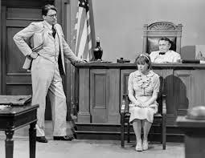

Slide 18
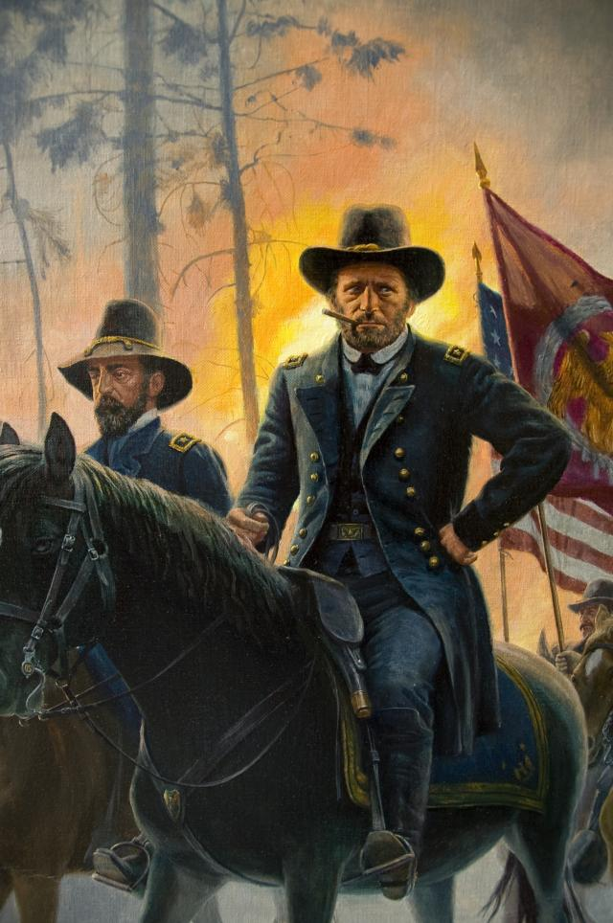

Slide 20
Cross Examination of Plaintiff, Susan Jones
Job Performance – Epinephrine Incident
December 28, 2008 Emergency response call re: young woman – difficulty breathing – administered epinephrine.
4 months into probationary period.
You, 2 volunteer EMT Privates (Dan Beard and Charlie Johnson) and a driver – Manny Medeiros.
p. 16, l. 7-10 You were in command on the vehicle as the “paid person.” (N.B. This comports with Chairman Leary’s testimony that the paid employee person on the rescue would be the person in charge, assuming that person had the highest certification --e.g. as an EMT-C --and it was not necessarily related to rank such as captain or lieutenant.)
(Exhibit V) RI EMS Asthma Protocol (COPD) In responding to this call, governed by RI Protocol, especially re: administration of Epinephrine. Did not follow.
p. 85 (Exhibit T) Ambulance run report of December 28, 2008 relating to Annie Lennon).
Air Respiration Rate 30; No size or weight info ; 1 mg EPI; no ratio; no events at LMC described (e.g. Dr. Sharpe); “Report called to LMC with no further instructions.”
p. 88, 1. 8 Jones acknowledges that it is her narrative.
p. 91, 1. 6-9 She admits an error in the narrative itself with respect to the dosage. (In other words she didn’t give “1 milligram.” Rather, she says she gave .5 milligram and it “might have been an error on my part on my narrative.”
p. 94 (Exhibit U) Plaintiff’s incident report of December 31, 2008).
Respiration Rate 30-32; “heavy set;” .5 mg EPI; 1:10,000 – but pushed 1:1,000 (Not in Exh. “T”)

Slide 22
RI EMS Run Report – Exh. “T”

Slide 24
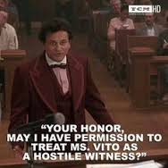

Slide 25
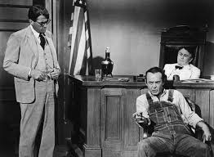

Slide 26
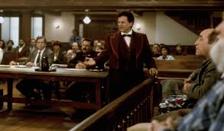

Slide 27
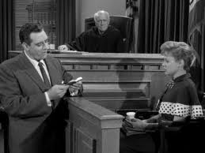

Slide 28
The Huffington Post
ARTS & CULTURE
10/14/2014 03:31pm
Updated 10/16/2014
“This Is The Painting That Saved Bill Murray’s Life”
By Joseph Erbentraut

