Slide 1
Direct examinations
Litigation Academy
2017 Direct & Cross Examination Skills Program
Hon. William E. Smith
Brooks Magratten

Slide 2
Direct v. Cross Examination

Slide 3
FRE 601: Competency to Testify
Every person is competent to be a witness unless these rules provide otherwise.
Where state law supplies the rule of decision, then state law governs the witness’s competency to testify.

Slide 4
FRE 602: Need for Personal Knowledge
A witness may testify to a matter only if evidence is introduced sufficient to support a finding that the witness has personal knowledge of the matter.
Evidence to prove personal knowledge may consist of the witness’s own testimony.

Slide 5
What is a Leading Question?

Slide 6
What is a Leading Question?
Tell us what you saw as you entered the intersection.
What was the color of the light when you entered the intersection?
Was the stoplight green when you entered the intersection?
The light was green when you entered the intersection, right?

Slide 7
You can lead on direct…sometimes
Witness background
Undisputed matters
Foundation to admit exhibits
Hostile witnesses
Problem witnesses (FRE 611(c))

Slide 8
Structure of the Direct Examination
Chronological
Impact

Slide 9
Use a Picture Frame
Give your witness context.
Help focus your witness’s testimony.

Slide 10
Lay Opinion (FRE 701)
Lay opinion must be:
rationally based on the witness’s perception;
helpful to clearly understanding the witness’s
testimony or to determining a fact in issue;
not based on scientific, technical, or other
specialized knowledge.

Slide 11
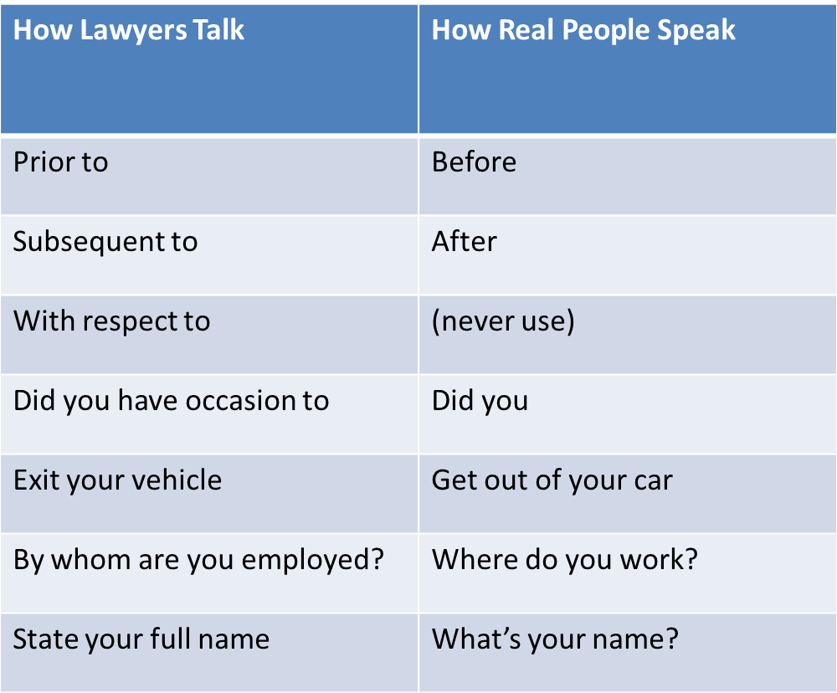
Diction

Slide 12
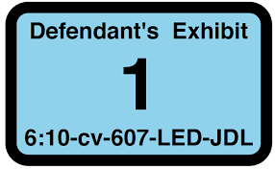
Moving Exhibits In Evidence
Ask witness to identify the document / thing.
Have witness explain why they recognize the document / thing.
Lay the foundation. See Chapter 7, Trials.

Slide 13
Prepare Your Witness
Review testimony with your witness.
Show witness the courtroom.
Make sure the witness knows what to expect.

Slide 14
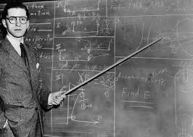
Bring Testimony To Life
Consider using demonstrative aids.
Get your witness on their feet.
Weave exhibits into the story.
Be careful about having your witness draw.

Slide 15
Refreshing Recollection
Witnesses will forget important facts.
Show the witness the document / object that may refresh recollection.
Ask the witness if the document / object refreshes their recollection about the facts at issue.
Take the document / object away from the witness.
Have the witness testify from their refreshed recollection.

Slide 16
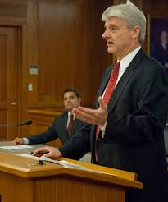
Redirect
Don’t do it unless you need to.
Keep it short.
Stay within scope of cross.

Slide 17
Quinlan v. Kane
Prepare 12 – 15 minutes of direct exam.
Prepare your witness tomorrow.
Email opposing counsel about topics you plan to cover.
Think about exhibits.
Think about documents / objects you can use to refresh recollection.

Slide 18
Questions?

Slide 19
contact
Brooks Magratten Prof. Niki Kuckes
Pierce Atwood LLP RWU School of Law
72 Pine Street Ten Metacomet Ave.
Providence, RI 02903 Bristol, RI 02809
bmagratten@pierceatwood.com nkuckes@rwu.edu
401-490-3422 401-254-4505

