Slide 1
Taking Depositions:
“The Middle of the Funnel”
David A. Wollin, Esq.
Hinckley, Allen & Snyder, LLP

Slide 2
Recap: Why Take a Deposition?
Discovery
  To learn what the witness knows
  To confirm facts you already know
  To obtain evidence in support of your claims or defenses
  To test your theories
To educate your client
To see, hear, and assess the witness
Notes:
Gathering Information
The most common reason for taking a deposition is to gather information. Depositions allow you to learn the facts. In other words, how the events occurred, what the other side knows what information supports your version of events, what the weaknesses are your own case, where the flaws exist in the opponent’s case, and what other witnesses might have useful information.
Find out what you don’t know.
Confirming what you think you know;
Testing out legal and factual theories;

Slide 3
Recap: How Do You Use a Deposition?
To impeach a testifying witness
As affirmative evidence for motions or trial
To refresh recollection of a testifying witness at trial

Slide 4
Recap: The Funnel Approach
You have already heard about the Top of the Funnel
Your questioning covers broad areas
You’re using open-ended questions – HOW, WHAT, WHO, WHEN, WHERE,
WHY, DESCRIBE, EXPLAIN, TELL ME

Slide 5
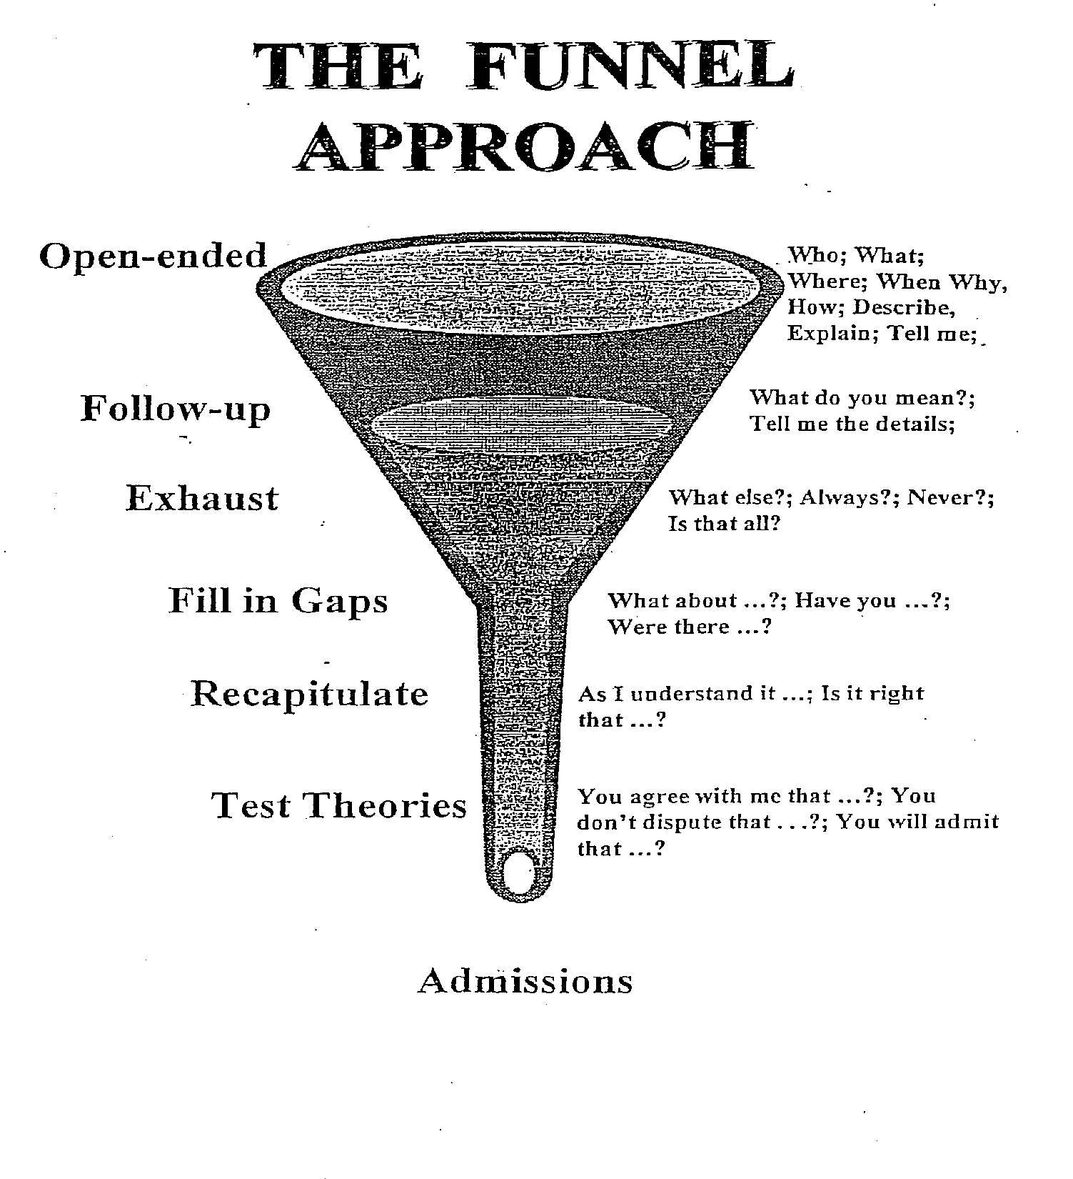
Notes:
The best method of gathering new information is through the use of what is called the funnel approach. The name of this technique comes from its resemblance to a funnel.
When starting to question on a new topic, the first step should be to get an overview. This will give you some idea of what you will encounter as the questioning proceeds. It will also get the witness talking about the topic and it encourages a discussion of those facts the witness considers important. Having some idea of what the witness considers to be important may prove to be useful information when you are determining how best to deal with the witness. Generally, the more open the question, the more you will learn from the witness. For example, in a contract action, your overview question might be:
Q: Tell me how this transaction came about?
And in a personal injury case, it could be:
Q: Tell me everything that happened to cause this accident?
"Getting the list"
The next step in using the funnel approach is "getting the list." The purpose here is to find out the breadth and scope of the witness's knowledge of a topic before finding out in detail what the witness knows about that topic. Getting the list is nothing more than staking out the limits of the witness's knowledge. Example questions are:
•Tell me how you first learned about ....
• What was your job at the time?
• How were you involved?
•Who else was involved?
• What did Dennis do?
• How could it have been prevented?
• How has the process changed?
• What is the policy now?
• When were you last involved with sales?
• Why did you leave?
Once you have obtained "the list" and have staked out the scope of the topics to be explored, you can then decide which items or subjects on the list are important and which can be ignored or postponed.
Let's take a look at how to go about getting the list in a specific context. Assume that the shipping manager at a parts supplier is being deposed about the manager's job responsibilities. An example of getting the list in that situation might look like this:
Q: What are your responsibilities as shipping manager?
A: I am in charge of all shipments going out of the company.
Q: What ocher responsibilities do you have?
A: If insurance is required on a shipment, I also arrange that.
Q: What else?
A: I have to arrange the type of shipping used.
Q: Any other responsibilities?
A: I have to make sure that the amount of the shipping
charges is passed on to billing.
Q: What else?
A: That's everything.
Although it may be termed "getting the list," often obtaining a chronology provides the best list. A chronology, like a list of duties, has the effect of staking out the limits of a witness's knowledge of a topic. For example,
getting a chronological list from the plaintiff in a personal injury case might sound like this:
Q: I want you to take me through what happened that day
from the moment you left the house until the accident
occurred. When did you leave the house?
A: About 8:15 in the morning.
Q: What happened after you left?
A: I drove down 15th Street.
Q: What next?
A: As I approached the intersection with Yale Street, I saw a car stopped at the stop sign on Yale.
Q: What happened next?
A: As I was going through the intersection) the car at the stop sign suddenly shot forward and hit my car.
Q: What next?
A: I heard a big crash, and I was thrown against the door.
Q: What happened next?
A: I was in a lot of pain, and someone must have called an ambulance because I was then taken to the hospital.
In contrast, getting the list from an eyewitness to the accident might be
very simple:
Q: Tell me everything you saw that day at the intersection at
the time of the accident?
[followed by a series of "What else?" questions]
Notice that there is no attempt at this point to explore or go into detail as to any part of the witness's answers. It does not make sense to distract the witness from recalling information or recounting a chronology by interrupting with questions about details. The idea is to get an overview of the witness's knowledge, with the details to follow later.

Slide 6
Middle of the Funnel
Follow-up, exhaust, fill in gaps
Narrow your areas as you understand what is relevant and useful
Ask narrow and focused questions as you fill in details and seek admissions
Dig, dig, dig – GET TO THE FACTS!
Notes:
Top of the Funnel: Open-Ended Questions
Once you have the list and have decided what topic on the list you will explore first, the next step is to begin questioning about the topic using open-ended questions. The questions should resemble the wide mouth of a funnel, gathering up everything the witness knows that may be relevant to the topic. The classic reporter's questions-who, what, when, where, why, how, supplemented by "describe" “explain" and ‘Tell me about'-will best
encourage witnesses to reveal all they know. Open-ended questions force the witness to provide the information covered by the question making it much more difficult to hide information or evade the question.
The value of open-ended questions is well illustrated by thinking about the children's game of Battleship. In the game, each side hides its ships by arranging them on a grid the opponent cannot see. Then each player drops
bombs on the other side's ships by calling out a location on the opponent's grid. If the location is not occupied by an opponent's ship, it is a miss, but, if it is occupied, it is a hit. Many depositions are like playing Battleship, with the taking attorney asking a series of narrow questions, hoping for a hit on what the witness knows, but also coming up with many misses. Here is an example of such an examination in a personal injury case.
Q: Were you driving west on Mattis Street at the rime of the
accident?
A: Yes.
Q: Were you driving within the speed limit?
A: Yes.
Q: Was the intersection a four-way stop?
A: Yes.
Q: Were you looking at the traffic ahead?
A: Yes.
Q: Was traffic heavy at that time of the morning?
A: No.
Q_: Did you see the plaintiff before the collision?
A: Yes
This technique works fine as long as you ask all the right questions. But if you fail to ask a question on a topic on which the witness has information, you will have a miss, just as in Battleship. In the above example, if you fail
to ask "Did you stop at the intersection?" the witness will never have to tell how she ignored the stop sign, went through the intersection, and collided with the plaintiff's car. The results are much better when you ask open-ended questions that force witnesses to tell what they know. Instead of playing Battleship, you are, in effect, asking to look at the opponent's grid.
If we were to rerun the above example using open-ended questions, it would sound like this:
Q: Tell me what you were doing just before the accident.
Q: Where were you going?
Q: Why were you going there?
Q: What were you looking at?
Q: What did you see?
Q: What was the traffic like?
Q: Describe the intersection for me.
Q: What did you do when you came to the intersection?
Q When did you first see the plaintiff?
Q: Tell me everything that happened after you saw the plaintiff.
Q: Why did the accident happen?
Using open-ended questions is particularly important when considering how witnesses are often prepared for their depositions. A standard instruction
is: "Listen to the question, answer only the question asked, do not volunteer." Open-ended questions do not permit the witness to parse the question and avoid providing information. In effect, the witness is forced to
volunteer information.

Slide 7
Two Types of Depositions
Rule 30(a)(1) v. 30(b)(6)
Notes:
Top of the Funnel: Open-Ended Questions
Once you have the list and have decided what topic on the list you will explore first, the next step is to begin questioning about the topic using open-ended questions. The questions should resemble the wide mouth of a funnel, gathering up everything the witness knows that may be relevant to the topic. The classic reporter's questions-who, what, when, where, why, how, supplemented by "describe" “explain" and ‘Tell me about'-will best
encourage witnesses to reveal all they know. Open-ended questions force the witness to provide the information covered by the question making it much more difficult to hide information or evade the question.
The value of open-ended questions is well illustrated by thinking about the children's game of Battleship. In the game, each side hides its ships by arranging them on a grid the opponent cannot see. Then each player drops
bombs on the other side's ships by calling out a location on the opponent's grid. If the location is not occupied by an opponent's ship, it is a miss, but, if it is occupied, it is a hit. Many depositions are like playing Battleship, with the taking attorney asking a series of narrow questions, hoping for a hit on what the witness knows, but also coming up with many misses. Here is an example of such an examination in a personal injury case.
Q: Were you driving west on Mattis Street at the rime of the
accident?
A: Yes.
Q: Were you driving within the speed limit?
A: Yes.
Q: Was the intersection a four-way stop?
A: Yes.
Q: Were you looking at the traffic ahead?
A: Yes.
Q: Was traffic heavy at that time of the morning?
A: No.
Q_: Did you see the plaintiff before the collision?
A: Yes
This technique works fine as long as you ask all the right questions. But if you fail to ask a question on a topic on which the witness has information, you will have a miss, just as in Battleship. In the above example, if you fail
to ask "Did you stop at the intersection?" the witness will never have to tell how she ignored the stop sign, went through the intersection, and collided with the plaintiff's car. The results are much better when you ask open-ended questions that force witnesses to tell what they know. Instead of playing Battleship, you are, in effect, asking to look at the opponent's grid.
If we were to rerun the above example using open-ended questions, it would sound like this:
Q: Tell me what you were doing just before the accident.
Q: Where were you going?
Q: Why were you going there?
Q: What were you looking at?
Q: What did you see?
Q: What was the traffic like?
Q: Describe the intersection for me.
Q: What did you do when you came to the intersection?
Q When did you first see the plaintiff?
Q: Tell me everything that happened after you saw the plaintiff.
Q: Why did the accident happen?
Using open-ended questions is particularly important when considering how witnesses are often prepared for their depositions. A standard instruction
is: "Listen to the question, answer only the question asked, do not volunteer." Open-ended questions do not permit the witness to parse the question and avoid providing information. In effect, the witness is forced to
volunteer information.

Slide 8
Rule 30. Deposition by Oral Examination
(a) When a Deposition May Be Taken.
(1) Without Leave. A party may, by oral questions, depose any person, including a party, without leave of court except as provided in Rule 30(a)(2). The deponent's attendance may be compelled by subpoena under Rule 45.
(2) With Leave. A party must obtain leave of court, and the court must grant leave to the extent consistent with Rule 26(b)(1) and (2):
(A) if the parties have not stipulated to the deposition and:
(i) the deposition would result in more than 10 depositions being taken under this rule or Rule 31 by the plaintiffs, or by the defendants, or by the third-party defendants;
(ii) the deponent has already been deposed in the case; or
(iii) the party seeks to take the deposition before the time specified in Rule 26(d), unless the party certifies in the notice, with supporting facts, that the deponent is expected to leave the United States and be unavailable for examination in this country after that time; or
(B) if the deponent is confined in prison.
Notes:
Top of the Funnel: Open-Ended Questions
Once you have the list and have decided what topic on the list you will explore first, the next step is to begin questioning about the topic using open-ended questions. The questions should resemble the wide mouth of a funnel, gathering up everything the witness knows that may be relevant to the topic. The classic reporter's questions-who, what, when, where, why, how, supplemented by "describe" “explain" and ‘Tell me about'-will best
encourage witnesses to reveal all they know. Open-ended questions force the witness to provide the information covered by the question making it much more difficult to hide information or evade the question.
The value of open-ended questions is well illustrated by thinking about the children's game of Battleship. In the game, each side hides its ships by arranging them on a grid the opponent cannot see. Then each player drops
bombs on the other side's ships by calling out a location on the opponent's grid. If the location is not occupied by an opponent's ship, it is a miss, but, if it is occupied, it is a hit. Many depositions are like playing Battleship, with the taking attorney asking a series of narrow questions, hoping for a hit on what the witness knows, but also coming up with many misses. Here is an example of such an examination in a personal injury case.
Q: Were you driving west on Mattis Street at the rime of the
accident?
A: Yes.
Q: Were you driving within the speed limit?
A: Yes.
Q: Was the intersection a four-way stop?
A: Yes.
Q: Were you looking at the traffic ahead?
A: Yes.
Q: Was traffic heavy at that time of the morning?
A: No.
Q_: Did you see the plaintiff before the collision?
A: Yes
This technique works fine as long as you ask all the right questions. But if you fail to ask a question on a topic on which the witness has information, you will have a miss, just as in Battleship. In the above example, if you fail
to ask "Did you stop at the intersection?" the witness will never have to tell how she ignored the stop sign, went through the intersection, and collided with the plaintiff's car. The results are much better when you ask open-ended questions that force witnesses to tell what they know. Instead of playing Battleship, you are, in effect, asking to look at the opponent's grid.
If we were to rerun the above example using open-ended questions, it would sound like this:
Q: Tell me what you were doing just before the accident.
Q: Where were you going?
Q: Why were you going there?
Q: What were you looking at?
Q: What did you see?
Q: What was the traffic like?
Q: Describe the intersection for me.
Q: What did you do when you came to the intersection?
Q When did you first see the plaintiff?
Q: Tell me everything that happened after you saw the plaintiff.
Q: Why did the accident happen?
Using open-ended questions is particularly important when considering how witnesses are often prepared for their depositions. A standard instruction
is: "Listen to the question, answer only the question asked, do not volunteer." Open-ended questions do not permit the witness to parse the question and avoid providing information. In effect, the witness is forced to
volunteer information.

Slide 9
Rule 30. Deposition by Oral Examination
(b) Notice of the Deposition; Other Formal Requirements.
(6) Notice or Subpoena Directed to an Organization. In its notice or subpoena, a party may name as the deponent a public or private corporation, a partnership, an association, a governmental agency, or other entity and must describe with reasonable particularity the matters for examination. The named organization must then designate one or more officers, directors, or managing agents, or designate other persons who consent to testify on its behalf; and it may set out the matters on which each person designated will testify. A subpoena must advise a nonparty organization of its duty to make this designation. The persons designated must testify about information known or reasonably available to the organization. This paragraph (6) does not preclude a deposition by any other procedure allowed by these rules.
Notes:
Top of the Funnel: Open-Ended Questions
Once you have the list and have decided what topic on the list you will explore first, the next step is to begin questioning about the topic using open-ended questions. The questions should resemble the wide mouth of a funnel, gathering up everything the witness knows that may be relevant to the topic. The classic reporter's questions-who, what, when, where, why, how, supplemented by "describe" “explain" and ‘Tell me about'-will best
encourage witnesses to reveal all they know. Open-ended questions force the witness to provide the information covered by the question making it much more difficult to hide information or evade the question.
The value of open-ended questions is well illustrated by thinking about the children's game of Battleship. In the game, each side hides its ships by arranging them on a grid the opponent cannot see. Then each player drops
bombs on the other side's ships by calling out a location on the opponent's grid. If the location is not occupied by an opponent's ship, it is a miss, but, if it is occupied, it is a hit. Many depositions are like playing Battleship, with the taking attorney asking a series of narrow questions, hoping for a hit on what the witness knows, but also coming up with many misses. Here is an example of such an examination in a personal injury case.
Q: Were you driving west on Mattis Street at the rime of the
accident?
A: Yes.
Q: Were you driving within the speed limit?
A: Yes.
Q: Was the intersection a four-way stop?
A: Yes.
Q: Were you looking at the traffic ahead?
A: Yes.
Q: Was traffic heavy at that time of the morning?
A: No.
Q_: Did you see the plaintiff before the collision?
A: Yes
This technique works fine as long as you ask all the right questions. But if you fail to ask a question on a topic on which the witness has information, you will have a miss, just as in Battleship. In the above example, if you fail
to ask "Did you stop at the intersection?" the witness will never have to tell how she ignored the stop sign, went through the intersection, and collided with the plaintiff's car. The results are much better when you ask open-ended questions that force witnesses to tell what they know. Instead of playing Battleship, you are, in effect, asking to look at the opponent's grid.
If we were to rerun the above example using open-ended questions, it would sound like this:
Q: Tell me what you were doing just before the accident.
Q: Where were you going?
Q: Why were you going there?
Q: What were you looking at?
Q: What did you see?
Q: What was the traffic like?
Q: Describe the intersection for me.
Q: What did you do when you came to the intersection?
Q When did you first see the plaintiff?
Q: Tell me everything that happened after you saw the plaintiff.
Q: Why did the accident happen?
Using open-ended questions is particularly important when considering how witnesses are often prepared for their depositions. A standard instruction
is: "Listen to the question, answer only the question asked, do not volunteer." Open-ended questions do not permit the witness to parse the question and avoid providing information. In effect, the witness is forced to
volunteer information.

Slide 10
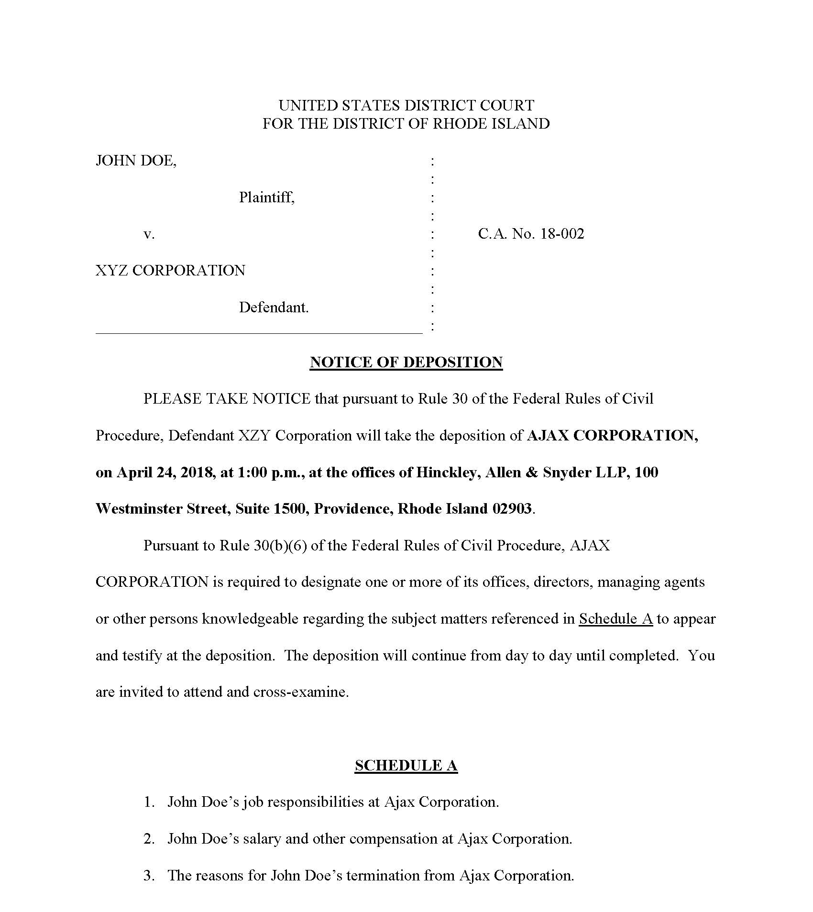
Notes:
Top of the Funnel: Open-Ended Questions
Once you have the list and have decided what topic on the list you will explore first, the next step is to begin questioning about the topic using open-ended questions. The questions should resemble the wide mouth of a funnel, gathering up everything the witness knows that may be relevant to the topic. The classic reporter's questions-who, what, when, where, why, how, supplemented by "describe" “explain" and ‘Tell me about'-will best
encourage witnesses to reveal all they know. Open-ended questions force the witness to provide the information covered by the question making it much more difficult to hide information or evade the question.
The value of open-ended questions is well illustrated by thinking about the children's game of Battleship. In the game, each side hides its ships by arranging them on a grid the opponent cannot see. Then each player drops
bombs on the other side's ships by calling out a location on the opponent's grid. If the location is not occupied by an opponent's ship, it is a miss, but, if it is occupied, it is a hit. Many depositions are like playing Battleship, with the taking attorney asking a series of narrow questions, hoping for a hit on what the witness knows, but also coming up with many misses. Here is an example of such an examination in a personal injury case.
Q: Were you driving west on Mattis Street at the rime of the
accident?
A: Yes.
Q: Were you driving within the speed limit?
A: Yes.
Q: Was the intersection a four-way stop?
A: Yes.
Q: Were you looking at the traffic ahead?
A: Yes.
Q: Was traffic heavy at that time of the morning?
A: No.
Q_: Did you see the plaintiff before the collision?
A: Yes
This technique works fine as long as you ask all the right questions. But if you fail to ask a question on a topic on which the witness has information, you will have a miss, just as in Battleship. In the above example, if you fail
to ask "Did you stop at the intersection?" the witness will never have to tell how she ignored the stop sign, went through the intersection, and collided with the plaintiff's car. The results are much better when you ask open-ended questions that force witnesses to tell what they know. Instead of playing Battleship, you are, in effect, asking to look at the opponent's grid.
If we were to rerun the above example using open-ended questions, it would sound like this:
Q: Tell me what you were doing just before the accident.
Q: Where were you going?
Q: Why were you going there?
Q: What were you looking at?
Q: What did you see?
Q: What was the traffic like?
Q: Describe the intersection for me.
Q: What did you do when you came to the intersection?
Q When did you first see the plaintiff?
Q: Tell me everything that happened after you saw the plaintiff.
Q: Why did the accident happen?
Using open-ended questions is particularly important when considering how witnesses are often prepared for their depositions. A standard instruction
is: "Listen to the question, answer only the question asked, do not volunteer." Open-ended questions do not permit the witness to parse the question and avoid providing information. In effect, the witness is forced to
volunteer information.

Slide 11
Take Control of the Deposition:
Rule 30(c)
(c) Examination and Cross-Examination; Record of the Examination; Objections; Written Questions.
(2) Objections. An objection at the time of the examination – whether to evidence, to a party's conduct, to the officer's qualifications, to the manner of taking the deposition, or to any other aspect of the deposition – must be noted on the record, but the examination still proceeds; the testimony is taken subject to any objection. An objection must be stated concisely in a nonargumentative and nonsuggestive manner. A person may instruct a deponent not to answer only when necessary to preserve a privilege, to enforce a limitation ordered by the court, or to present a motion under Rule 30(d)(3).
Notes:
Top of the Funnel: Open-Ended Questions
Once you have the list and have decided what topic on the list you will explore first, the next step is to begin questioning about the topic using open-ended questions. The questions should resemble the wide mouth of a funnel, gathering up everything the witness knows that may be relevant to the topic. The classic reporter's questions-who, what, when, where, why, how, supplemented by "describe" “explain" and ‘Tell me about'-will best
encourage witnesses to reveal all they know. Open-ended questions force the witness to provide the information covered by the question making it much more difficult to hide information or evade the question.
The value of open-ended questions is well illustrated by thinking about the children's game of Battleship. In the game, each side hides its ships by arranging them on a grid the opponent cannot see. Then each player drops
bombs on the other side's ships by calling out a location on the opponent's grid. If the location is not occupied by an opponent's ship, it is a miss, but, if it is occupied, it is a hit. Many depositions are like playing Battleship, with the taking attorney asking a series of narrow questions, hoping for a hit on what the witness knows, but also coming up with many misses. Here is an example of such an examination in a personal injury case.
Q: Were you driving west on Mattis Street at the rime of the
accident?
A: Yes.
Q: Were you driving within the speed limit?
A: Yes.
Q: Was the intersection a four-way stop?
A: Yes.
Q: Were you looking at the traffic ahead?
A: Yes.
Q: Was traffic heavy at that time of the morning?
A: No.
Q_: Did you see the plaintiff before the collision?
A: Yes
This technique works fine as long as you ask all the right questions. But if you fail to ask a question on a topic on which the witness has information, you will have a miss, just as in Battleship. In the above example, if you fail
to ask "Did you stop at the intersection?" the witness will never have to tell how she ignored the stop sign, went through the intersection, and collided with the plaintiff's car. The results are much better when you ask open-ended questions that force witnesses to tell what they know. Instead of playing Battleship, you are, in effect, asking to look at the opponent's grid.
If we were to rerun the above example using open-ended questions, it would sound like this:
Q: Tell me what you were doing just before the accident.
Q: Where were you going?
Q: Why were you going there?
Q: What were you looking at?
Q: What did you see?
Q: What was the traffic like?
Q: Describe the intersection for me.
Q: What did you do when you came to the intersection?
Q When did you first see the plaintiff?
Q: Tell me everything that happened after you saw the plaintiff.
Q: Why did the accident happen?
Using open-ended questions is particularly important when considering how witnesses are often prepared for their depositions. A standard instruction
is: "Listen to the question, answer only the question asked, do not volunteer." Open-ended questions do not permit the witness to parse the question and avoid providing information. In effect, the witness is forced to
volunteer information.

Slide 12
Possible Responses:
Please do not coach the witness.
Your objection must be short, concise and not suggest the answer.
You are obstructing this deposition.
Notes:
Top of the Funnel: Open-Ended Questions
Once you have the list and have decided what topic on the list you will explore first, the next step is to begin questioning about the topic using open-ended questions. The questions should resemble the wide mouth of a funnel, gathering up everything the witness knows that may be relevant to the topic. The classic reporter's questions-who, what, when, where, why, how, supplemented by "describe" “explain" and ‘Tell me about'-will best
encourage witnesses to reveal all they know. Open-ended questions force the witness to provide the information covered by the question making it much more difficult to hide information or evade the question.
The value of open-ended questions is well illustrated by thinking about the children's game of Battleship. In the game, each side hides its ships by arranging them on a grid the opponent cannot see. Then each player drops
bombs on the other side's ships by calling out a location on the opponent's grid. If the location is not occupied by an opponent's ship, it is a miss, but, if it is occupied, it is a hit. Many depositions are like playing Battleship, with the taking attorney asking a series of narrow questions, hoping for a hit on what the witness knows, but also coming up with many misses. Here is an example of such an examination in a personal injury case.
Q: Were you driving west on Mattis Street at the rime of the
accident?
A: Yes.
Q: Were you driving within the speed limit?
A: Yes.
Q: Was the intersection a four-way stop?
A: Yes.
Q: Were you looking at the traffic ahead?
A: Yes.
Q: Was traffic heavy at that time of the morning?
A: No.
Q_: Did you see the plaintiff before the collision?
A: Yes
This technique works fine as long as you ask all the right questions. But if you fail to ask a question on a topic on which the witness has information, you will have a miss, just as in Battleship. In the above example, if you fail
to ask "Did you stop at the intersection?" the witness will never have to tell how she ignored the stop sign, went through the intersection, and collided with the plaintiff's car. The results are much better when you ask open-ended questions that force witnesses to tell what they know. Instead of playing Battleship, you are, in effect, asking to look at the opponent's grid.
If we were to rerun the above example using open-ended questions, it would sound like this:
Q: Tell me what you were doing just before the accident.
Q: Where were you going?
Q: Why were you going there?
Q: What were you looking at?
Q: What did you see?
Q: What was the traffic like?
Q: Describe the intersection for me.
Q: What did you do when you came to the intersection?
Q When did you first see the plaintiff?
Q: Tell me everything that happened after you saw the plaintiff.
Q: Why did the accident happen?
Using open-ended questions is particularly important when considering how witnesses are often prepared for their depositions. A standard instruction
is: "Listen to the question, answer only the question asked, do not volunteer." Open-ended questions do not permit the witness to parse the question and avoid providing information. In effect, the witness is forced to
volunteer information.

Slide 13
Middle of the Funnel – The Basics
Listen to the answers and follow up when necessary and appropriate
Exhaust each topic before moving on to a new topic
Questions should be short and clear
Don’t leave any stones unturned
Dig, dig, dig – GET TO THE FACTS!

Slide 14
Middle of the Funnel – Topics
Events or occurrences
Meetings or communications
Recollections
Witnesses
Others with knowledge
Documents

Slide 15
Events or Meetings
Where did it occur?
When did it occur?
Who was present – names, titles, contact information?
What occurred?
How long did it last?
What was discussed?
Who said what to whom?
Any documents generated?
Where are those documents?

Slide 16
Example – Fender Bender
Q: When did you first see the plaintiff?
A: I saw him about 200 yards away, approaching on Kirby Street.
Q: How far was the plaintiff from the intersection?
A: About 100 yards.
Q: How far were you from the intersection?
A: About the same distance.
Q: What traffic control devices, if any, were there at the intersection?
A: It was a four-way stop with stop signs at all four corners.
Q: What did the plaintiff’s car do when it arrived at the intersection?
A: It came to a stop.
Q: What did you do when you came to the intersection?
A: I slowed down to about five miles per hour.
Notes:
Top of the Funnel: Open-Ended Questions
Once you have the list and have decided what topic on the list you will explore first, the next step is to begin questioning about the topic using open-ended questions. The questions should resemble the wide mouth of a funnel, gathering up everything the witness knows that may be relevant to the topic. The classic reporter's questions-who, what, when, where, why, how, supplemented by "describe" “explain" and ‘Tell me about'-will best
encourage witnesses to reveal all they know. Open-ended questions force the witness to provide the information covered by the question making it much more difficult to hide information or evade the question.
The value of open-ended questions is well illustrated by thinking about the children's game of Battleship. In the game, each side hides its ships by arranging them on a grid the opponent cannot see. Then each player drops
bombs on the other side's ships by calling out a location on the opponent's grid. If the location is not occupied by an opponent's ship, it is a miss, but, if it is occupied, it is a hit. Many depositions are like playing Battleship, with the taking attorney asking a series of narrow questions, hoping for a hit on what the witness knows, but also coming up with many misses. Here is an example of such an examination in a personal injury case.
Q: Were you driving west on Mattis Street at the rime of the
accident?
A: Yes.
Q: Were you driving within the speed limit?
A: Yes.
Q: Was the intersection a four-way stop?
A: Yes.
Q: Were you looking at the traffic ahead?
A: Yes.
Q: Was traffic heavy at that time of the morning?
A: No.
Q_: Did you see the plaintiff before the collision?
A: Yes
This technique works fine as long as you ask all the right questions. But if you fail to ask a question on a topic on which the witness has information, you will have a miss, just as in Battleship. In the above example, if you fail
to ask "Did you stop at the intersection?" the witness will never have to tell how she ignored the stop sign, went through the intersection, and collided with the plaintiff's car. The results are much better when you ask open-ended questions that force witnesses to tell what they know. Instead of playing Battleship, you are, in effect, asking to look at the opponent's grid.
If we were to rerun the above example using open-ended questions, it would sound like this:
Q: Tell me what you were doing just before the accident.
Q: Where were you going?
Q: Why were you going there?
Q: What were you looking at?
Q: What did you see?
Q: What was the traffic like?
Q: Describe the intersection for me.
Q: What did you do when you came to the intersection?
Q When did you first see the plaintiff?
Q: Tell me everything that happened after you saw the plaintiff.
Q: Why did the accident happen?
Using open-ended questions is particularly important when considering how witnesses are often prepared for their depositions. A standard instruction
is: "Listen to the question, answer only the question asked, do not volunteer." Open-ended questions do not permit the witness to parse the question and avoid providing information. In effect, the witness is forced to
volunteer information.

Slide 17
Example – Documents
Were any documents created?
What kind? (Notes, e-mails, etc.)
By whom?
How many?
What is contained in each document?
Where are they now?
Where are they normally kept?
If they do not exist, why?
What is your document retention policy?

Slide 18
Documents (con’t): Hearsay Exceptions
The following are not excluded by the rule against hearsay, regardless of whether the declarant is available as a witness:
(6) Records of a Regularly Conducted Activity. A record of an act, event, condition, opinion, or diagnosis if:
(A) the record was made at or near the time by — or from information transmitted by — someone with knowledge;
(B) the record was kept in the course of a regularly conducted activity of a business, organization, occupation, or calling, whether or not for profit;
(C) making the record was a regular practice of that activity;
(D) all these conditions are shown by the testimony of the custodian or another qualified witness, or by a certification that complies with Rule 902(11) or (12) or with a statute permitting certification; and
(E) neither the opponent does not show that the source of information nor or the method or circumstances of preparation indicate a lack of trustworthiness.
Notes:
Top of the Funnel: Open-Ended Questions
Once you have the list and have decided what topic on the list you will explore first, the next step is to begin questioning about the topic using open-ended questions. The questions should resemble the wide mouth of a funnel, gathering up everything the witness knows that may be relevant to the topic. The classic reporter's questions-who, what, when, where, why, how, supplemented by "describe" “explain" and ‘Tell me about'-will best
encourage witnesses to reveal all they know. Open-ended questions force the witness to provide the information covered by the question making it much more difficult to hide information or evade the question.
The value of open-ended questions is well illustrated by thinking about the children's game of Battleship. In the game, each side hides its ships by arranging them on a grid the opponent cannot see. Then each player drops
bombs on the other side's ships by calling out a location on the opponent's grid. If the location is not occupied by an opponent's ship, it is a miss, but, if it is occupied, it is a hit. Many depositions are like playing Battleship, with the taking attorney asking a series of narrow questions, hoping for a hit on what the witness knows, but also coming up with many misses. Here is an example of such an examination in a personal injury case.
Q: Were you driving west on Mattis Street at the rime of the
accident?
A: Yes.
Q: Were you driving within the speed limit?
A: Yes.
Q: Was the intersection a four-way stop?
A: Yes.
Q: Were you looking at the traffic ahead?
A: Yes.
Q: Was traffic heavy at that time of the morning?
A: No.
Q_: Did you see the plaintiff before the collision?
A: Yes
This technique works fine as long as you ask all the right questions. But if you fail to ask a question on a topic on which the witness has information, you will have a miss, just as in Battleship. In the above example, if you fail
to ask "Did you stop at the intersection?" the witness will never have to tell how she ignored the stop sign, went through the intersection, and collided with the plaintiff's car. The results are much better when you ask open-ended questions that force witnesses to tell what they know. Instead of playing Battleship, you are, in effect, asking to look at the opponent's grid.
If we were to rerun the above example using open-ended questions, it would sound like this:
Q: Tell me what you were doing just before the accident.
Q: Where were you going?
Q: Why were you going there?
Q: What were you looking at?
Q: What did you see?
Q: What was the traffic like?
Q: Describe the intersection for me.
Q: What did you do when you came to the intersection?
Q When did you first see the plaintiff?
Q: Tell me everything that happened after you saw the plaintiff.
Q: Why did the accident happen?
Using open-ended questions is particularly important when considering how witnesses are often prepared for their depositions. A standard instruction
is: "Listen to the question, answer only the question asked, do not volunteer." Open-ended questions do not permit the witness to parse the question and avoid providing information. In effect, the witness is forced to
volunteer information.

Slide 19
Documents (con’t): Hearsay Exceptions
(8) Public Records. A record or statement of a public office if:
(A) it sets out:
(i) the office’s activities;
(ii) a matter observed while under a legal duty to report, but not including, in a criminal case, a matter observed by law-enforcement personnel; or
(iii) in a civil case or against the government in a criminal case, factual findings from a legally authorized investigation; and
(B) neither the opponent does not show that the source of information nor or other circumstances indicate a lack of trustworthiness.
Notes:
Top of the Funnel: Open-Ended Questions
Once you have the list and have decided what topic on the list you will explore first, the next step is to begin questioning about the topic using open-ended questions. The questions should resemble the wide mouth of a funnel, gathering up everything the witness knows that may be relevant to the topic. The classic reporter's questions-who, what, when, where, why, how, supplemented by "describe" “explain" and ‘Tell me about'-will best
encourage witnesses to reveal all they know. Open-ended questions force the witness to provide the information covered by the question making it much more difficult to hide information or evade the question.
The value of open-ended questions is well illustrated by thinking about the children's game of Battleship. In the game, each side hides its ships by arranging them on a grid the opponent cannot see. Then each player drops
bombs on the other side's ships by calling out a location on the opponent's grid. If the location is not occupied by an opponent's ship, it is a miss, but, if it is occupied, it is a hit. Many depositions are like playing Battleship, with the taking attorney asking a series of narrow questions, hoping for a hit on what the witness knows, but also coming up with many misses. Here is an example of such an examination in a personal injury case.
Q: Were you driving west on Mattis Street at the rime of the
accident?
A: Yes.
Q: Were you driving within the speed limit?
A: Yes.
Q: Was the intersection a four-way stop?
A: Yes.
Q: Were you looking at the traffic ahead?
A: Yes.
Q: Was traffic heavy at that time of the morning?
A: No.
Q_: Did you see the plaintiff before the collision?
A: Yes
This technique works fine as long as you ask all the right questions. But if you fail to ask a question on a topic on which the witness has information, you will have a miss, just as in Battleship. In the above example, if you fail
to ask "Did you stop at the intersection?" the witness will never have to tell how she ignored the stop sign, went through the intersection, and collided with the plaintiff's car. The results are much better when you ask open-ended questions that force witnesses to tell what they know. Instead of playing Battleship, you are, in effect, asking to look at the opponent's grid.
If we were to rerun the above example using open-ended questions, it would sound like this:
Q: Tell me what you were doing just before the accident.
Q: Where were you going?
Q: Why were you going there?
Q: What were you looking at?
Q: What did you see?
Q: What was the traffic like?
Q: Describe the intersection for me.
Q: What did you do when you came to the intersection?
Q When did you first see the plaintiff?
Q: Tell me everything that happened after you saw the plaintiff.
Q: Why did the accident happen?
Using open-ended questions is particularly important when considering how witnesses are often prepared for their depositions. A standard instruction
is: "Listen to the question, answer only the question asked, do not volunteer." Open-ended questions do not permit the witness to parse the question and avoid providing information. In effect, the witness is forced to
volunteer information.

Slide 20
Question Tree: Multiple Funnels
Topic A
Topic B
Topic C
Topic D
Subtopics
A-1, A-2, A-3
Subtopics
B-1, B-2, B-3
Subtopics
C-1, C-2, C-3
Subtopics
D-1, D-2, D-3
Sub-subtopics
A-1-A, A-1-B,
A-1-C
Sub-subtopics
A-2-A, A-2-B,
A-2-C
Sub-subtopics
A-3-A, A-3-B,
A-3-C
Notes:
Top of the Funnel: Open-Ended Questions
Once you have the list and have decided what topic on the list you will explore first, the next step is to begin questioning about the topic using open-ended questions. The questions should resemble the wide mouth of a funnel, gathering up everything the witness knows that may be relevant to the topic. The classic reporter's questions-who, what, when, where, why, how, supplemented by "describe" “explain" and ‘Tell me about'-will best
encourage witnesses to reveal all they know. Open-ended questions force the witness to provide the information covered by the question making it much more difficult to hide information or evade the question.
The value of open-ended questions is well illustrated by thinking about the children's game of Battleship. In the game, each side hides its ships by arranging them on a grid the opponent cannot see. Then each player drops
bombs on the other side's ships by calling out a location on the opponent's grid. If the location is not occupied by an opponent's ship, it is a miss, but, if it is occupied, it is a hit. Many depositions are like playing Battleship, with the taking attorney asking a series of narrow questions, hoping for a hit on what the witness knows, but also coming up with many misses. Here is an example of such an examination in a personal injury case.
Q: Were you driving west on Mattis Street at the rime of the
accident?
A: Yes.
Q: Were you driving within the speed limit?
A: Yes.
Q: Was the intersection a four-way stop?
A: Yes.
Q: Were you looking at the traffic ahead?
A: Yes.
Q: Was traffic heavy at that time of the morning?
A: No.
Q_: Did you see the plaintiff before the collision?
A: Yes
This technique works fine as long as you ask all the right questions. But if you fail to ask a question on a topic on which the witness has information, you will have a miss, just as in Battleship. In the above example, if you fail
to ask "Did you stop at the intersection?" the witness will never have to tell how she ignored the stop sign, went through the intersection, and collided with the plaintiff's car. The results are much better when you ask open-ended questions that force witnesses to tell what they know. Instead of playing Battleship, you are, in effect, asking to look at the opponent's grid.
If we were to rerun the above example using open-ended questions, it would sound like this:
Q: Tell me what you were doing just before the accident.
Q: Where were you going?
Q: Why were you going there?
Q: What were you looking at?
Q: What did you see?
Q: What was the traffic like?
Q: Describe the intersection for me.
Q: What did you do when you came to the intersection?
Q When did you first see the plaintiff?
Q: Tell me everything that happened after you saw the plaintiff.
Q: Why did the accident happen?
Using open-ended questions is particularly important when considering how witnesses are often prepared for their depositions. A standard instruction
is: "Listen to the question, answer only the question asked, do not volunteer." Open-ended questions do not permit the witness to parse the question and avoid providing information. In effect, the witness is forced to
volunteer information.

Slide 21
Example: Sub-funnel
Assume, for example, the deposition of an insurance agent where the issue is when the agent learned of a policyholder’s request to change beneficiaries. The initial funnel might go as follows:
Q: How did you learn that the plaintiff wished to change the beneficiaries on his policy?
A: He sent a letter to my office asking me to change the beneficiaries.
Q: When did you see that letter?
A: On April 3 of last year.
Applying a new funnel to the subtopic of “how mail is handled”:
Q: When is the mail delivered to your office?
A: About 11:00 a.m. each day.
Notes:
Top of the Funnel: Open-Ended Questions
Once you have the list and have decided what topic on the list you will explore first, the next step is to begin questioning about the topic using open-ended questions. The questions should resemble the wide mouth of a funnel, gathering up everything the witness knows that may be relevant to the topic. The classic reporter's questions-who, what, when, where, why, how, supplemented by "describe" “explain" and ‘Tell me about'-will best
encourage witnesses to reveal all they know. Open-ended questions force the witness to provide the information covered by the question making it much more difficult to hide information or evade the question.
The value of open-ended questions is well illustrated by thinking about the children's game of Battleship. In the game, each side hides its ships by arranging them on a grid the opponent cannot see. Then each player drops
bombs on the other side's ships by calling out a location on the opponent's grid. If the location is not occupied by an opponent's ship, it is a miss, but, if it is occupied, it is a hit. Many depositions are like playing Battleship, with the taking attorney asking a series of narrow questions, hoping for a hit on what the witness knows, but also coming up with many misses. Here is an example of such an examination in a personal injury case.
Q: Were you driving west on Mattis Street at the rime of the
accident?
A: Yes.
Q: Were you driving within the speed limit?
A: Yes.
Q: Was the intersection a four-way stop?
A: Yes.
Q: Were you looking at the traffic ahead?
A: Yes.
Q: Was traffic heavy at that time of the morning?
A: No.
Q_: Did you see the plaintiff before the collision?
A: Yes
This technique works fine as long as you ask all the right questions. But if you fail to ask a question on a topic on which the witness has information, you will have a miss, just as in Battleship. In the above example, if you fail
to ask "Did you stop at the intersection?" the witness will never have to tell how she ignored the stop sign, went through the intersection, and collided with the plaintiff's car. The results are much better when you ask open-ended questions that force witnesses to tell what they know. Instead of playing Battleship, you are, in effect, asking to look at the opponent's grid.
If we were to rerun the above example using open-ended questions, it would sound like this:
Q: Tell me what you were doing just before the accident.
Q: Where were you going?
Q: Why were you going there?
Q: What were you looking at?
Q: What did you see?
Q: What was the traffic like?
Q: Describe the intersection for me.
Q: What did you do when you came to the intersection?
Q When did you first see the plaintiff?
Q: Tell me everything that happened after you saw the plaintiff.
Q: Why did the accident happen?
Using open-ended questions is particularly important when considering how witnesses are often prepared for their depositions. A standard instruction
is: "Listen to the question, answer only the question asked, do not volunteer." Open-ended questions do not permit the witness to parse the question and avoid providing information. In effect, the witness is forced to
volunteer information.

Slide 22
Example (con’t)
Q: Where does the carrier put the mail?
A: In the mailbox outside of the office front door.
Q: Who brings in the mail?
A: My secretary.
Q: When does your secretary bring in the mail?
A: He usually checks around 11:00 each day.
Q: Let’s go back to what you were saying before . . . You know, about your secretary picking up the mail. What does he do with the mail after picking it up?
Notes:
Top of the Funnel: Open-Ended Questions
Once you have the list and have decided what topic on the list you will explore first, the next step is to begin questioning about the topic using open-ended questions. The questions should resemble the wide mouth of a funnel, gathering up everything the witness knows that may be relevant to the topic. The classic reporter's questions-who, what, when, where, why, how, supplemented by "describe" “explain" and ‘Tell me about'-will best
encourage witnesses to reveal all they know. Open-ended questions force the witness to provide the information covered by the question making it much more difficult to hide information or evade the question.
The value of open-ended questions is well illustrated by thinking about the children's game of Battleship. In the game, each side hides its ships by arranging them on a grid the opponent cannot see. Then each player drops
bombs on the other side's ships by calling out a location on the opponent's grid. If the location is not occupied by an opponent's ship, it is a miss, but, if it is occupied, it is a hit. Many depositions are like playing Battleship, with the taking attorney asking a series of narrow questions, hoping for a hit on what the witness knows, but also coming up with many misses. Here is an example of such an examination in a personal injury case.
Q: Were you driving west on Mattis Street at the rime of the
accident?
A: Yes.
Q: Were you driving within the speed limit?
A: Yes.
Q: Was the intersection a four-way stop?
A: Yes.
Q: Were you looking at the traffic ahead?
A: Yes.
Q: Was traffic heavy at that time of the morning?
A: No.
Q_: Did you see the plaintiff before the collision?
A: Yes
This technique works fine as long as you ask all the right questions. But if you fail to ask a question on a topic on which the witness has information, you will have a miss, just as in Battleship. In the above example, if you fail
to ask "Did you stop at the intersection?" the witness will never have to tell how she ignored the stop sign, went through the intersection, and collided with the plaintiff's car. The results are much better when you ask open-ended questions that force witnesses to tell what they know. Instead of playing Battleship, you are, in effect, asking to look at the opponent's grid.
If we were to rerun the above example using open-ended questions, it would sound like this:
Q: Tell me what you were doing just before the accident.
Q: Where were you going?
Q: Why were you going there?
Q: What were you looking at?
Q: What did you see?
Q: What was the traffic like?
Q: Describe the intersection for me.
Q: What did you do when you came to the intersection?
Q When did you first see the plaintiff?
Q: Tell me everything that happened after you saw the plaintiff.
Q: Why did the accident happen?
Using open-ended questions is particularly important when considering how witnesses are often prepared for their depositions. A standard instruction
is: "Listen to the question, answer only the question asked, do not volunteer." Open-ended questions do not permit the witness to parse the question and avoid providing information. In effect, the witness is forced to
volunteer information.

Slide 23
Be a Skeptic
“I don’t recall”
  Who else was present?
  Who else knows?
  Who else might know?
  Who else would you expect to have that information?
  Were there any notes that might have that information?
  Whose responsibility would it have been to know?
  Whose responsibility would it have been to take notes?
  Is there anything that might help you remember?
  Anyone you could talk to?
Get the witness to talk!
Notes:
Gathering Information
The most common reason for taking a deposition is to gather information. Depositions allow you to learn the facts. In other words, how the events occurred, what the other side knows what information supports your version of events, what the weaknesses are your own case, where the flaws exist in the opponent’s case, and what other witnesses might have useful information.
Find out what you don’t know.
Confirming what you think you know;
Testing out legal and factual theories;

Slide 24
Remember These Phrases:
ANYTHING ELSE?
or
HAVE YOU TOLD ME
EVERYTHING ABOUT . . . ?
Notes:
Top of the Funnel: Open-Ended Questions
Once you have the list and have decided what topic on the list you will explore first, the next step is to begin questioning about the topic using open-ended questions. The questions should resemble the wide mouth of a funnel, gathering up everything the witness knows that may be relevant to the topic. The classic reporter's questions-who, what, when, where, why, how, supplemented by "describe" “explain" and ‘Tell me about'-will best
encourage witnesses to reveal all they know. Open-ended questions force the witness to provide the information covered by the question making it much more difficult to hide information or evade the question.
The value of open-ended questions is well illustrated by thinking about the children's game of Battleship. In the game, each side hides its ships by arranging them on a grid the opponent cannot see. Then each player drops
bombs on the other side's ships by calling out a location on the opponent's grid. If the location is not occupied by an opponent's ship, it is a miss, but, if it is occupied, it is a hit. Many depositions are like playing Battleship, with the taking attorney asking a series of narrow questions, hoping for a hit on what the witness knows, but also coming up with many misses. Here is an example of such an examination in a personal injury case.
Q: Were you driving west on Mattis Street at the rime of the
accident?
A: Yes.
Q: Were you driving within the speed limit?
A: Yes.
Q: Was the intersection a four-way stop?
A: Yes.
Q: Were you looking at the traffic ahead?
A: Yes.
Q: Was traffic heavy at that time of the morning?
A: No.
Q_: Did you see the plaintiff before the collision?
A: Yes
This technique works fine as long as you ask all the right questions. But if you fail to ask a question on a topic on which the witness has information, you will have a miss, just as in Battleship. In the above example, if you fail
to ask "Did you stop at the intersection?" the witness will never have to tell how she ignored the stop sign, went through the intersection, and collided with the plaintiff's car. The results are much better when you ask open-ended questions that force witnesses to tell what they know. Instead of playing Battleship, you are, in effect, asking to look at the opponent's grid.
If we were to rerun the above example using open-ended questions, it would sound like this:
Q: Tell me what you were doing just before the accident.
Q: Where were you going?
Q: Why were you going there?
Q: What were you looking at?
Q: What did you see?
Q: What was the traffic like?
Q: Describe the intersection for me.
Q: What did you do when you came to the intersection?
Q When did you first see the plaintiff?
Q: Tell me everything that happened after you saw the plaintiff.
Q: Why did the accident happen?
Using open-ended questions is particularly important when considering how witnesses are often prepared for their depositions. A standard instruction
is: "Listen to the question, answer only the question asked, do not volunteer." Open-ended questions do not permit the witness to parse the question and avoid providing information. In effect, the witness is forced to
volunteer information.

Slide 25
Listen and Take Notes, But:
Don’t be slavish to your outline
Don’t be over-focused on note-taking
Take notes of avenues of exploration
Watch witness; pick up cues

Slide 26
Example – Failure to Listen
Q: Did you talk with the defendant about what had happened?
A: Not on that day.
Q: Did you let your employer know what had happened? [switching to a different topic]
Q: If you didn’t talk with the defendant that day about what happened, when did you talk with him?
Notes:
Top of the Funnel: Open-Ended Questions
Once you have the list and have decided what topic on the list you will explore first, the next step is to begin questioning about the topic using open-ended questions. The questions should resemble the wide mouth of a funnel, gathering up everything the witness knows that may be relevant to the topic. The classic reporter's questions-who, what, when, where, why, how, supplemented by "describe" “explain" and ‘Tell me about'-will best
encourage witnesses to reveal all they know. Open-ended questions force the witness to provide the information covered by the question making it much more difficult to hide information or evade the question.
The value of open-ended questions is well illustrated by thinking about the children's game of Battleship. In the game, each side hides its ships by arranging them on a grid the opponent cannot see. Then each player drops
bombs on the other side's ships by calling out a location on the opponent's grid. If the location is not occupied by an opponent's ship, it is a miss, but, if it is occupied, it is a hit. Many depositions are like playing Battleship, with the taking attorney asking a series of narrow questions, hoping for a hit on what the witness knows, but also coming up with many misses. Here is an example of such an examination in a personal injury case.
Q: Were you driving west on Mattis Street at the rime of the
accident?
A: Yes.
Q: Were you driving within the speed limit?
A: Yes.
Q: Was the intersection a four-way stop?
A: Yes.
Q: Were you looking at the traffic ahead?
A: Yes.
Q: Was traffic heavy at that time of the morning?
A: No.
Q_: Did you see the plaintiff before the collision?
A: Yes
This technique works fine as long as you ask all the right questions. But if you fail to ask a question on a topic on which the witness has information, you will have a miss, just as in Battleship. In the above example, if you fail
to ask "Did you stop at the intersection?" the witness will never have to tell how she ignored the stop sign, went through the intersection, and collided with the plaintiff's car. The results are much better when you ask open-ended questions that force witnesses to tell what they know. Instead of playing Battleship, you are, in effect, asking to look at the opponent's grid.
If we were to rerun the above example using open-ended questions, it would sound like this:
Q: Tell me what you were doing just before the accident.
Q: Where were you going?
Q: Why were you going there?
Q: What were you looking at?
Q: What did you see?
Q: What was the traffic like?
Q: Describe the intersection for me.
Q: What did you do when you came to the intersection?
Q When did you first see the plaintiff?
Q: Tell me everything that happened after you saw the plaintiff.
Q: Why did the accident happen?
Using open-ended questions is particularly important when considering how witnesses are often prepared for their depositions. A standard instruction
is: "Listen to the question, answer only the question asked, do not volunteer." Open-ended questions do not permit the witness to parse the question and avoid providing information. In effect, the witness is forced to
volunteer information.

Slide 27
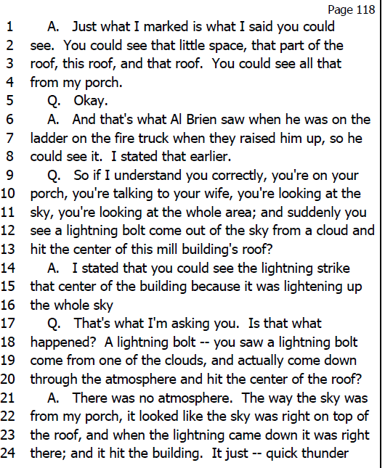
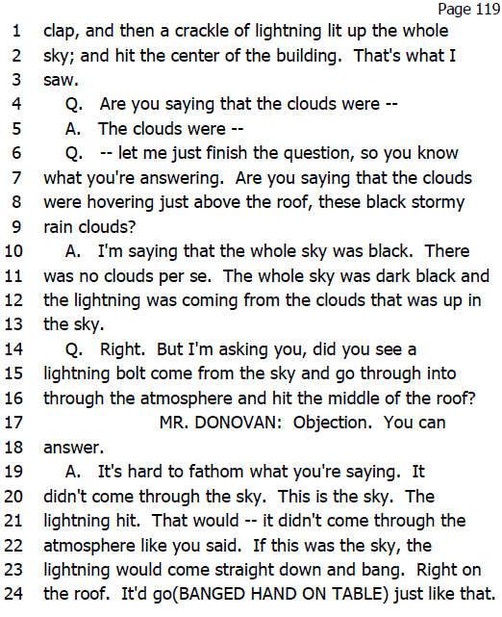
Example: Mill Building Roof Collapse

Slide 28
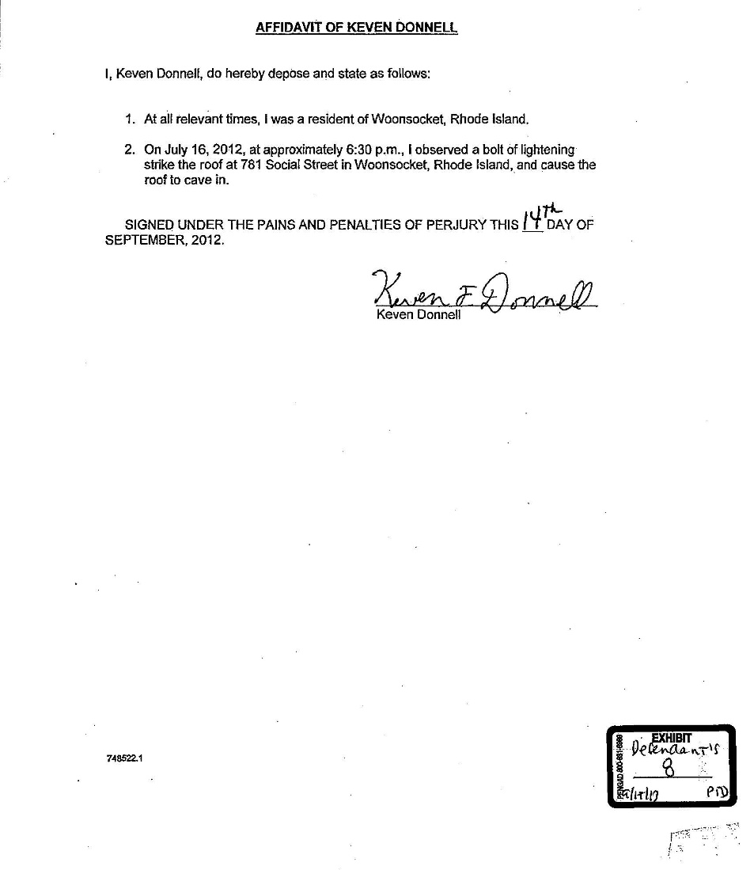
Notes:
Top of the Funnel: Open-Ended Questions
Once you have the list and have decided what topic on the list you will explore first, the next step is to begin questioning about the topic using open-ended questions. The questions should resemble the wide mouth of a funnel, gathering up everything the witness knows that may be relevant to the topic. The classic reporter's questions-who, what, when, where, why, how, supplemented by "describe" “explain" and ‘Tell me about'-will best
encourage witnesses to reveal all they know. Open-ended questions force the witness to provide the information covered by the question making it much more difficult to hide information or evade the question.
The value of open-ended questions is well illustrated by thinking about the children's game of Battleship. In the game, each side hides its ships by arranging them on a grid the opponent cannot see. Then each player drops
bombs on the other side's ships by calling out a location on the opponent's grid. If the location is not occupied by an opponent's ship, it is a miss, but, if it is occupied, it is a hit. Many depositions are like playing Battleship, with the taking attorney asking a series of narrow questions, hoping for a hit on what the witness knows, but also coming up with many misses. Here is an example of such an examination in a personal injury case.
Q: Were you driving west on Mattis Street at the rime of the
accident?
A: Yes.
Q: Were you driving within the speed limit?
A: Yes.
Q: Was the intersection a four-way stop?
A: Yes.
Q: Were you looking at the traffic ahead?
A: Yes.
Q: Was traffic heavy at that time of the morning?
A: No.
Q_: Did you see the plaintiff before the collision?
A: Yes
This technique works fine as long as you ask all the right questions. But if you fail to ask a question on a topic on which the witness has information, you will have a miss, just as in Battleship. In the above example, if you fail
to ask "Did you stop at the intersection?" the witness will never have to tell how she ignored the stop sign, went through the intersection, and collided with the plaintiff's car. The results are much better when you ask open-ended questions that force witnesses to tell what they know. Instead of playing Battleship, you are, in effect, asking to look at the opponent's grid.
If we were to rerun the above example using open-ended questions, it would sound like this:
Q: Tell me what you were doing just before the accident.
Q: Where were you going?
Q: Why were you going there?
Q: What were you looking at?
Q: What did you see?
Q: What was the traffic like?
Q: Describe the intersection for me.
Q: What did you do when you came to the intersection?
Q When did you first see the plaintiff?
Q: Tell me everything that happened after you saw the plaintiff.
Q: Why did the accident happen?
Using open-ended questions is particularly important when considering how witnesses are often prepared for their depositions. A standard instruction
is: "Listen to the question, answer only the question asked, do not volunteer." Open-ended questions do not permit the witness to parse the question and avoid providing information. In effect, the witness is forced to
volunteer information.

Slide 29
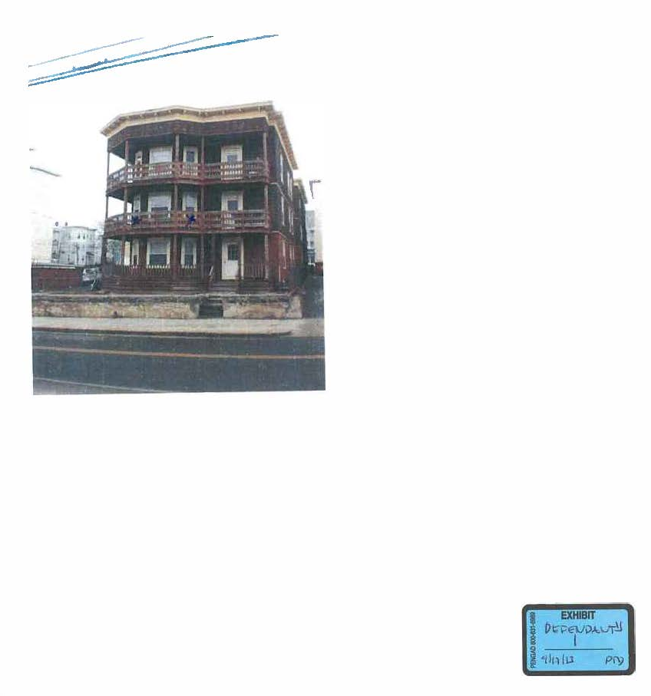
Notes:
Top of the Funnel: Open-Ended Questions
Once you have the list and have decided what topic on the list you will explore first, the next step is to begin questioning about the topic using open-ended questions. The questions should resemble the wide mouth of a funnel, gathering up everything the witness knows that may be relevant to the topic. The classic reporter's questions-who, what, when, where, why, how, supplemented by "describe" “explain" and ‘Tell me about'-will best
encourage witnesses to reveal all they know. Open-ended questions force the witness to provide the information covered by the question making it much more difficult to hide information or evade the question.
The value of open-ended questions is well illustrated by thinking about the children's game of Battleship. In the game, each side hides its ships by arranging them on a grid the opponent cannot see. Then each player drops
bombs on the other side's ships by calling out a location on the opponent's grid. If the location is not occupied by an opponent's ship, it is a miss, but, if it is occupied, it is a hit. Many depositions are like playing Battleship, with the taking attorney asking a series of narrow questions, hoping for a hit on what the witness knows, but also coming up with many misses. Here is an example of such an examination in a personal injury case.
Q: Were you driving west on Mattis Street at the rime of the
accident?
A: Yes.
Q: Were you driving within the speed limit?
A: Yes.
Q: Was the intersection a four-way stop?
A: Yes.
Q: Were you looking at the traffic ahead?
A: Yes.
Q: Was traffic heavy at that time of the morning?
A: No.
Q_: Did you see the plaintiff before the collision?
A: Yes
This technique works fine as long as you ask all the right questions. But if you fail to ask a question on a topic on which the witness has information, you will have a miss, just as in Battleship. In the above example, if you fail
to ask "Did you stop at the intersection?" the witness will never have to tell how she ignored the stop sign, went through the intersection, and collided with the plaintiff's car. The results are much better when you ask open-ended questions that force witnesses to tell what they know. Instead of playing Battleship, you are, in effect, asking to look at the opponent's grid.
If we were to rerun the above example using open-ended questions, it would sound like this:
Q: Tell me what you were doing just before the accident.
Q: Where were you going?
Q: Why were you going there?
Q: What were you looking at?
Q: What did you see?
Q: What was the traffic like?
Q: Describe the intersection for me.
Q: What did you do when you came to the intersection?
Q When did you first see the plaintiff?
Q: Tell me everything that happened after you saw the plaintiff.
Q: Why did the accident happen?
Using open-ended questions is particularly important when considering how witnesses are often prepared for their depositions. A standard instruction
is: "Listen to the question, answer only the question asked, do not volunteer." Open-ended questions do not permit the witness to parse the question and avoid providing information. In effect, the witness is forced to
volunteer information.

Slide 30
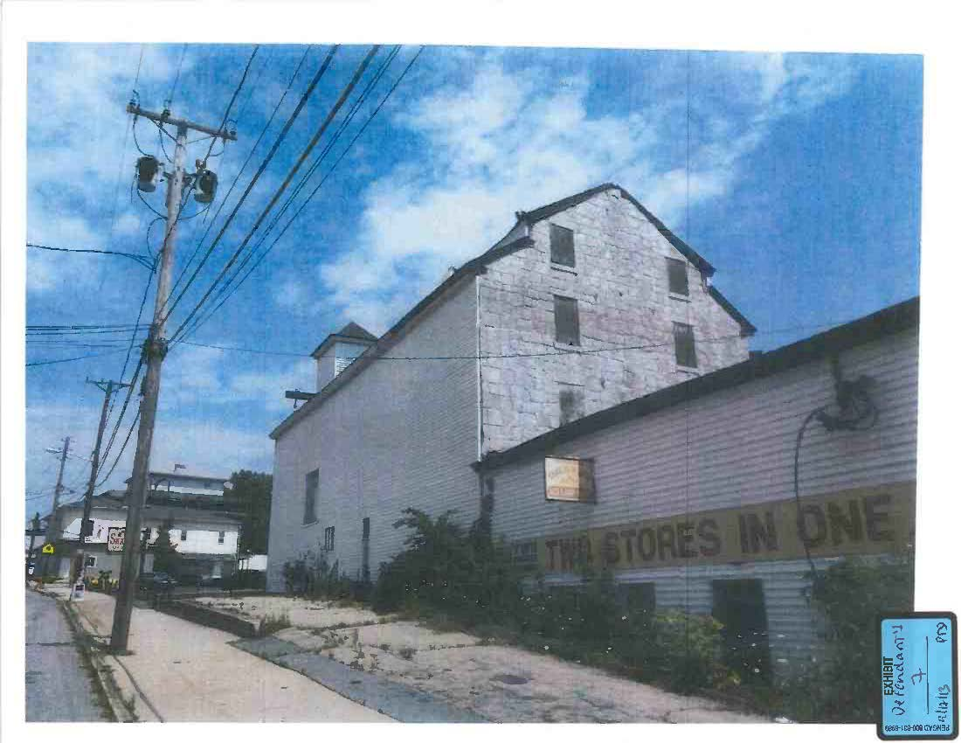
Notes:
Top of the Funnel: Open-Ended Questions
Once you have the list and have decided what topic on the list you will explore first, the next step is to begin questioning about the topic using open-ended questions. The questions should resemble the wide mouth of a funnel, gathering up everything the witness knows that may be relevant to the topic. The classic reporter's questions-who, what, when, where, why, how, supplemented by "describe" “explain" and ‘Tell me about'-will best
encourage witnesses to reveal all they know. Open-ended questions force the witness to provide the information covered by the question making it much more difficult to hide information or evade the question.
The value of open-ended questions is well illustrated by thinking about the children's game of Battleship. In the game, each side hides its ships by arranging them on a grid the opponent cannot see. Then each player drops
bombs on the other side's ships by calling out a location on the opponent's grid. If the location is not occupied by an opponent's ship, it is a miss, but, if it is occupied, it is a hit. Many depositions are like playing Battleship, with the taking attorney asking a series of narrow questions, hoping for a hit on what the witness knows, but also coming up with many misses. Here is an example of such an examination in a personal injury case.
Q: Were you driving west on Mattis Street at the rime of the
accident?
A: Yes.
Q: Were you driving within the speed limit?
A: Yes.
Q: Was the intersection a four-way stop?
A: Yes.
Q: Were you looking at the traffic ahead?
A: Yes.
Q: Was traffic heavy at that time of the morning?
A: No.
Q_: Did you see the plaintiff before the collision?
A: Yes
This technique works fine as long as you ask all the right questions. But if you fail to ask a question on a topic on which the witness has information, you will have a miss, just as in Battleship. In the above example, if you fail
to ask "Did you stop at the intersection?" the witness will never have to tell how she ignored the stop sign, went through the intersection, and collided with the plaintiff's car. The results are much better when you ask open-ended questions that force witnesses to tell what they know. Instead of playing Battleship, you are, in effect, asking to look at the opponent's grid.
If we were to rerun the above example using open-ended questions, it would sound like this:
Q: Tell me what you were doing just before the accident.
Q: Where were you going?
Q: Why were you going there?
Q: What were you looking at?
Q: What did you see?
Q: What was the traffic like?
Q: Describe the intersection for me.
Q: What did you do when you came to the intersection?
Q When did you first see the plaintiff?
Q: Tell me everything that happened after you saw the plaintiff.
Q: Why did the accident happen?
Using open-ended questions is particularly important when considering how witnesses are often prepared for their depositions. A standard instruction
is: "Listen to the question, answer only the question asked, do not volunteer." Open-ended questions do not permit the witness to parse the question and avoid providing information. In effect, the witness is forced to
volunteer information.

Slide 31
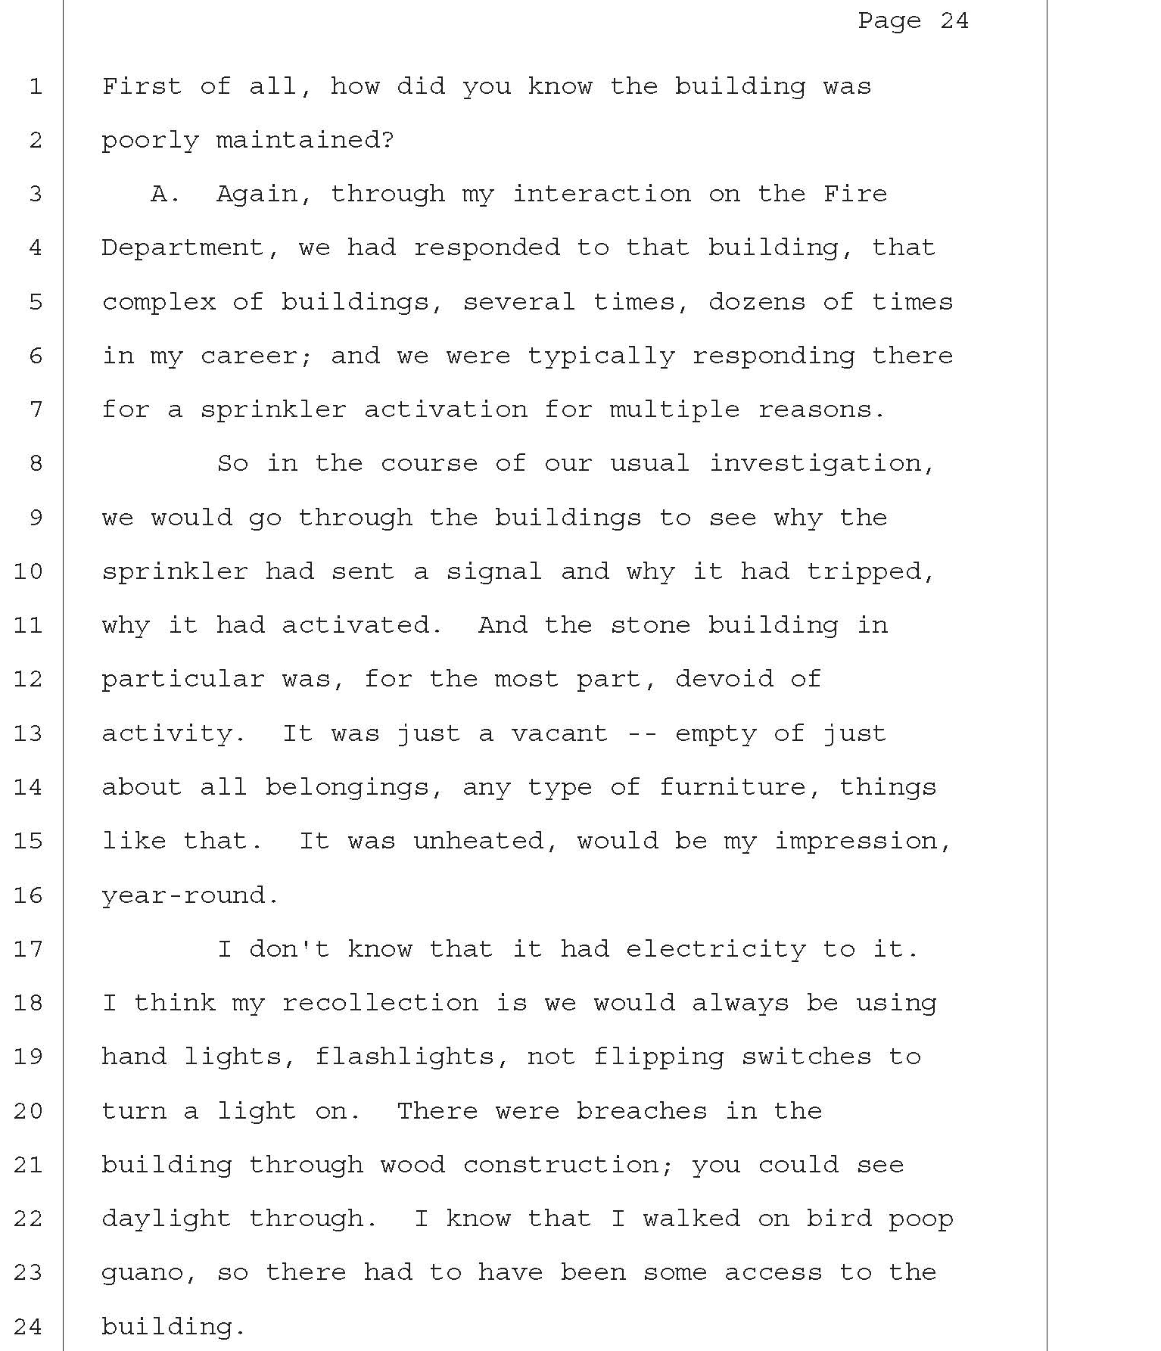
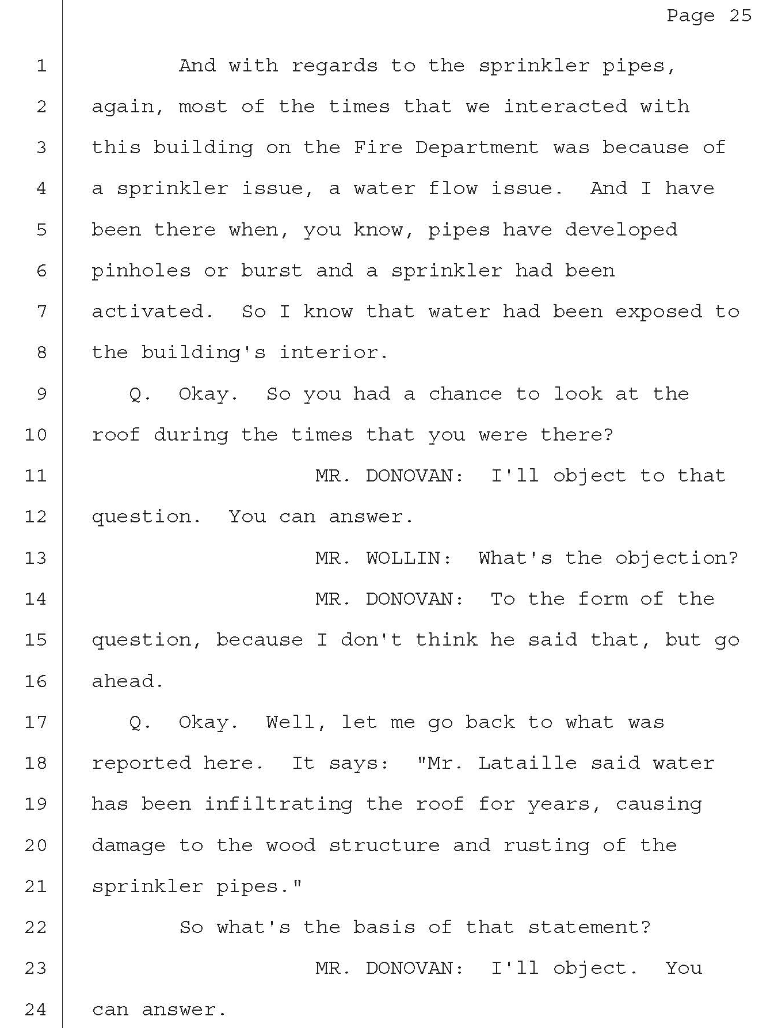
Fire Official

Slide 32
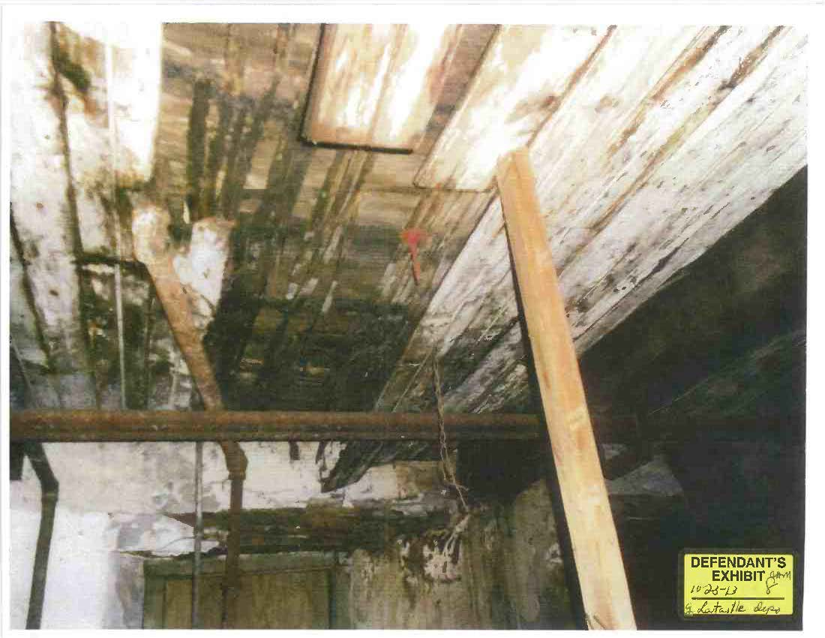
Notes:
Top of the Funnel: Open-Ended Questions
Once you have the list and have decided what topic on the list you will explore first, the next step is to begin questioning about the topic using open-ended questions. The questions should resemble the wide mouth of a funnel, gathering up everything the witness knows that may be relevant to the topic. The classic reporter's questions-who, what, when, where, why, how, supplemented by "describe" “explain" and ‘Tell me about'-will best
encourage witnesses to reveal all they know. Open-ended questions force the witness to provide the information covered by the question making it much more difficult to hide information or evade the question.
The value of open-ended questions is well illustrated by thinking about the children's game of Battleship. In the game, each side hides its ships by arranging them on a grid the opponent cannot see. Then each player drops
bombs on the other side's ships by calling out a location on the opponent's grid. If the location is not occupied by an opponent's ship, it is a miss, but, if it is occupied, it is a hit. Many depositions are like playing Battleship, with the taking attorney asking a series of narrow questions, hoping for a hit on what the witness knows, but also coming up with many misses. Here is an example of such an examination in a personal injury case.
Q: Were you driving west on Mattis Street at the rime of the
accident?
A: Yes.
Q: Were you driving within the speed limit?
A: Yes.
Q: Was the intersection a four-way stop?
A: Yes.
Q: Were you looking at the traffic ahead?
A: Yes.
Q: Was traffic heavy at that time of the morning?
A: No.
Q_: Did you see the plaintiff before the collision?
A: Yes
This technique works fine as long as you ask all the right questions. But if you fail to ask a question on a topic on which the witness has information, you will have a miss, just as in Battleship. In the above example, if you fail
to ask "Did you stop at the intersection?" the witness will never have to tell how she ignored the stop sign, went through the intersection, and collided with the plaintiff's car. The results are much better when you ask open-ended questions that force witnesses to tell what they know. Instead of playing Battleship, you are, in effect, asking to look at the opponent's grid.
If we were to rerun the above example using open-ended questions, it would sound like this:
Q: Tell me what you were doing just before the accident.
Q: Where were you going?
Q: Why were you going there?
Q: What were you looking at?
Q: What did you see?
Q: What was the traffic like?
Q: Describe the intersection for me.
Q: What did you do when you came to the intersection?
Q When did you first see the plaintiff?
Q: Tell me everything that happened after you saw the plaintiff.
Q: Why did the accident happen?
Using open-ended questions is particularly important when considering how witnesses are often prepared for their depositions. A standard instruction
is: "Listen to the question, answer only the question asked, do not volunteer." Open-ended questions do not permit the witness to parse the question and avoid providing information. In effect, the witness is forced to
volunteer information.

Slide 33
Any Questions?
Notes:
Top of the Funnel: Open-Ended Questions
Once you have the list and have decided what topic on the list you will explore first, the next step is to begin questioning about the topic using open-ended questions. The questions should resemble the wide mouth of a funnel, gathering up everything the witness knows that may be relevant to the topic. The classic reporter's questions-who, what, when, where, why, how, supplemented by "describe" “explain" and ‘Tell me about'-will best
encourage witnesses to reveal all they know. Open-ended questions force the witness to provide the information covered by the question making it much more difficult to hide information or evade the question.
The value of open-ended questions is well illustrated by thinking about the children's game of Battleship. In the game, each side hides its ships by arranging them on a grid the opponent cannot see. Then each player drops
bombs on the other side's ships by calling out a location on the opponent's grid. If the location is not occupied by an opponent's ship, it is a miss, but, if it is occupied, it is a hit. Many depositions are like playing Battleship, with the taking attorney asking a series of narrow questions, hoping for a hit on what the witness knows, but also coming up with many misses. Here is an example of such an examination in a personal injury case.
Q: Were you driving west on Mattis Street at the rime of the
accident?
A: Yes.
Q: Were you driving within the speed limit?
A: Yes.
Q: Was the intersection a four-way stop?
A: Yes.
Q: Were you looking at the traffic ahead?
A: Yes.
Q: Was traffic heavy at that time of the morning?
A: No.
Q_: Did you see the plaintiff before the collision?
A: Yes
This technique works fine as long as you ask all the right questions. But if you fail to ask a question on a topic on which the witness has information, you will have a miss, just as in Battleship. In the above example, if you fail
to ask "Did you stop at the intersection?" the witness will never have to tell how she ignored the stop sign, went through the intersection, and collided with the plaintiff's car. The results are much better when you ask open-ended questions that force witnesses to tell what they know. Instead of playing Battleship, you are, in effect, asking to look at the opponent's grid.
If we were to rerun the above example using open-ended questions, it would sound like this:
Q: Tell me what you were doing just before the accident.
Q: Where were you going?
Q: Why were you going there?
Q: What were you looking at?
Q: What did you see?
Q: What was the traffic like?
Q: Describe the intersection for me.
Q: What did you do when you came to the intersection?
Q When did you first see the plaintiff?
Q: Tell me everything that happened after you saw the plaintiff.
Q: Why did the accident happen?
Using open-ended questions is particularly important when considering how witnesses are often prepared for their depositions. A standard instruction
is: "Listen to the question, answer only the question asked, do not volunteer." Open-ended questions do not permit the witness to parse the question and avoid providing information. In effect, the witness is forced to
volunteer information.

