Slide 1
“PREPARING” THE WITNESS and
“DEFENDING” the
DEPOSITION

Slide 2
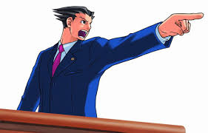

Slide 4
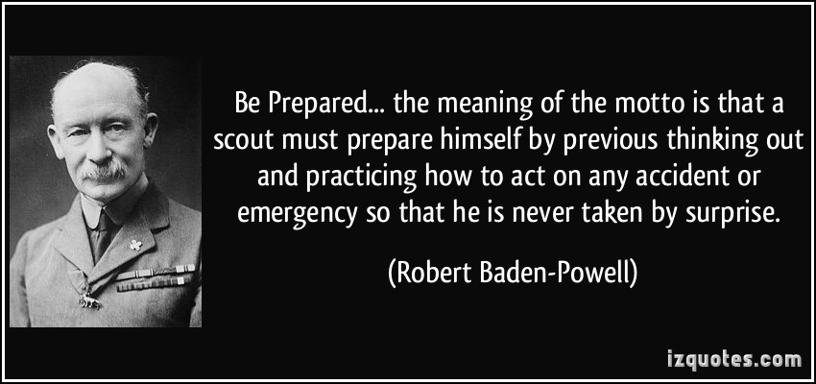

Slide 5
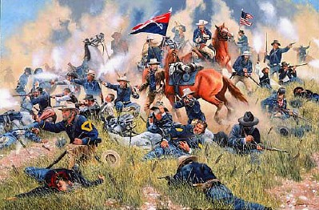

Slide 9
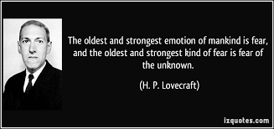

Slide 12
P.R.E.P.
Prepare
Reassure
Educate
Practice

Slide 13
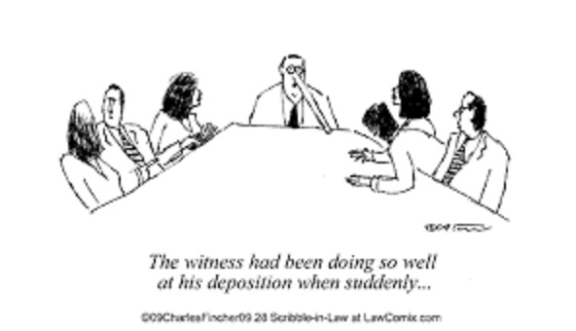

Slide 16
FUNNEL

Slide 17
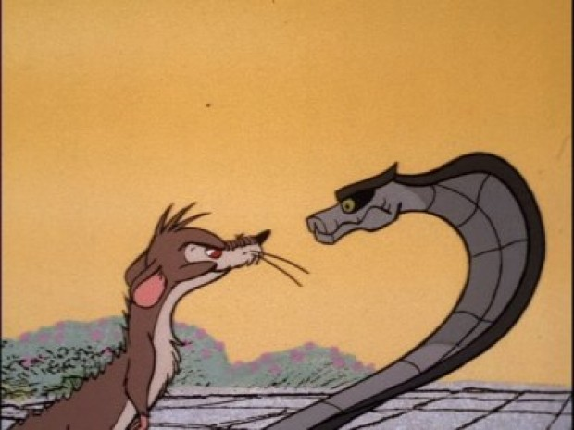
Reptile Theory & Other Strategies

Slide 18
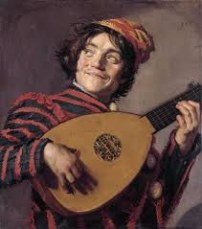
L.U.T.E.
Listen
Understand
Think
Express

