Slide 1
Litigation Academy United States District Court for the District of Rhode Island Roger Williams University School of Law Rhode Island Chapter, Federal Bar Association
Deposition Skills
John S. Foley
FoleyCerilli, P.C.
56 Pine Street Suite 200
Providence, Rhode Island 02903

Slide 2
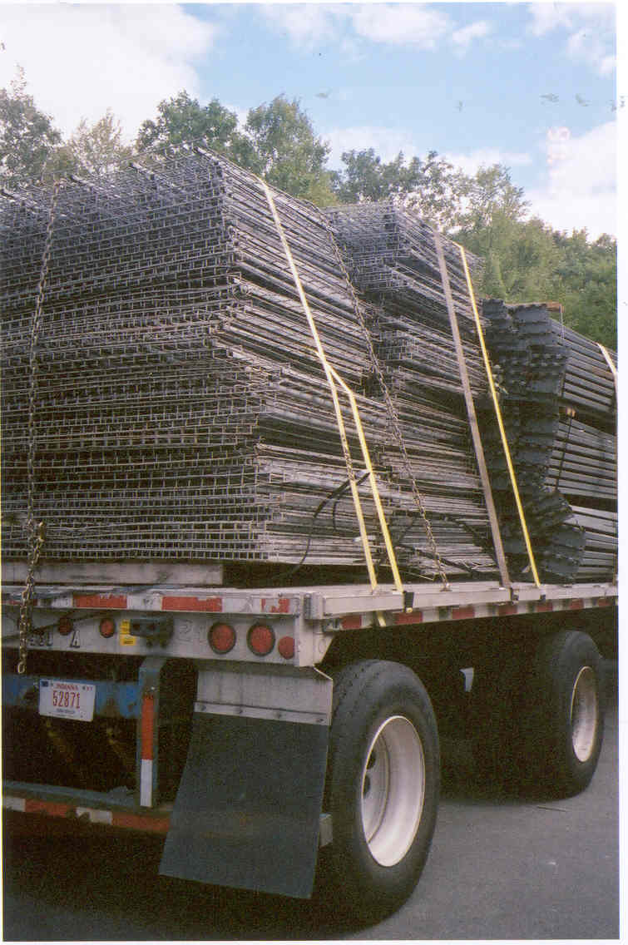

Slide 3
Goals of a Deposition
1. Discover information
2. Obtain factual admissions to support a motion for summary judgment
3. Lock in testimony so you can impeach at trial if it changes

Slide 4
Admonitions Topics
1. Discover information: “Frame of Mind” admonitions
2. Use for summary judgment: “Clean Transcript” instructions
3. Use for impeachment: “Prevent Excuses” directions

Slide 5
“Frame of Mind” Admonitions
1. The same oath as in court?
2. The oath requires truthful, accurate, complete answers?
3. Whatever recollection you have, even if vague or incomplete

Slide 6
“Clean Transcript” Admonitions
1. Stenographic recording
2. Spoken answers; no gestures
3. Speak clearly
4. Only one person talks at a time
5. Objections: answer anyway

Slide 7
“Prevent Excuses” Admonitions
1. “I didn’t understand that question.”
2. “I was tired, I needed to take a break.”
3. “I needed to talk to my lawyer about that.”
4. “I realized later that I made a mistake when I
said that.”
5. “I was taking painkillers that day and I was really out of it.”

