Slide 1
Deposition Ethics
Litigation Academy
April 26, 2018

Slide 2
The Dos and Don’ts
of Being a
Potted Plant

Slide 3
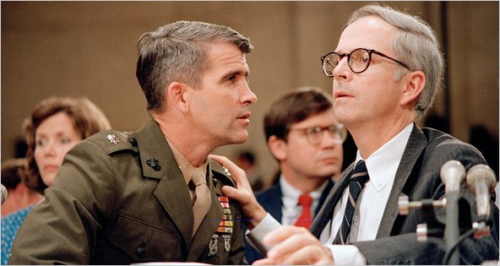
Lawyer Brendan Sullivan* defending Oliver North testimony to Congress during Iran-Contra hearings (1987)
'I'm not a potted plant. I'm here as the lawyer, that's my job.”
*Rhode Island native

Slide 4
Let’s start with the Don’ts.
How to defend a deposition in an ethical way.

Slide 5
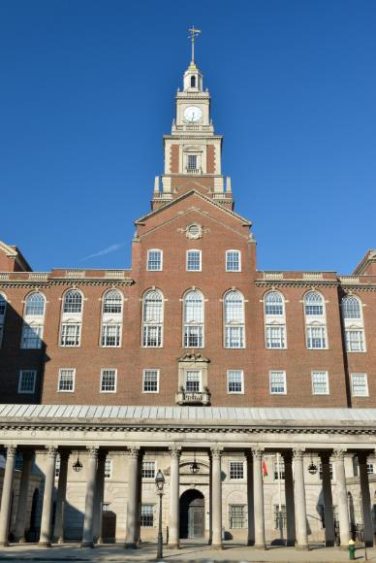
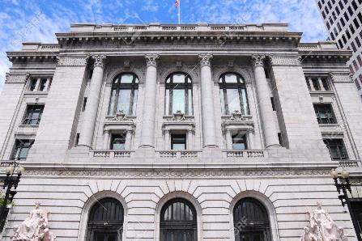
The Don’ts depend (in part) on the Court:
Fed. R. Civ. P. 30 (c) and (d)
Kelvey v. Coughlin

Slide 6
Let’s start with:
Kelvey v. Coughlin

Slide 7
What to do?
You are defending the deposition of your client.
The lawyer taking the deposition persists in asking questions that you believe to be intrusive and harassing.
At what point can you direct your client not to answer?

Slide 8
Never.*
* Except to preserve a privilege.

Slide 9
Example from Kelvey:

Slide 10
“The only instance, we repeat, the only instance in which an attorney is justified in instructing a deponent not to answer is when the question calls for information that is privileged.”
Kelvey v. Coughlin, 625 A.2d 775, 776 (R.I. 1993)

Slide 11
Where privilege is at issue, at what point should you direct your client not to answer?
Q: Did you meet with your lawyer?
Q: Who was present at the meeting?
Q: Was the meeting for the purpose of getting legal advice?
Q: What did you discuss at the meeting?

Slide 12
“Even in cases of a privilege objection, the deponent is permitted to answer questions as to the underlying circumstances . . . .”
Kelvey v. Coughlin, 625 A.2d 775, 776 (R.I. 1993)

Slide 13
And we mean it! Post-Kelvey Rulings
In deposition in bus accident case, plaintiff’s lawyer asked bus driver to draw a diagram showing the position of the bus.
Defense counsel directed him not to.
RI Supreme Court held:
Improper. “There is no general privilege protecting diagrammatic testimony.”
Cunningham v. Heard, 667 A.2d 537, 538 (1995)
Notes:
Summarize presentation content by restating the important points from the lessons.
What do you want the audience to remember when they leave your presentation?
Save your presentation to a video for easy distribution (To create a video, click the File tab, and then click Share. Under File Types, click Create a Video.)

Slide 14
And we mean it! Post-Kelvey Rulings
In deposition in medical malpractice case, defendant doctor was asked to explain the standard of care applicable to his treatment of the plaintiff.
Defense counsel directed him not to.
RI Supreme Court held:
Improper. The motion judge was correct that “no privilege existed.”
Menard v. Blazer, 669 A.2d 1160, 1162 (1996)
Notes:
Summarize presentation content by restating the important points from the lessons.
What do you want the audience to remember when they leave your presentation?
Save your presentation to a video for easy distribution (To create a video, click the File tab, and then click Share. Under File Types, click Create a Video.)

Slide 15
And we mean it! Post-Kelvey Rulings
In deposition in personal injury case against hotel, staff were asked what facts they told the insurance investigator after the accident.
Defense counsel told them not to answer.
RI Supreme Court held:
Improper. “Witnesses in our state courts do not become the exclusive property of whatever litigant first contacts and interviews them.”
Menard v. Blazer, 669 A.2d 1160, 1162 (1996)
Notes:
Summarize presentation content by restating the important points from the lessons.
What do you want the audience to remember when they leave your presentation?
Save your presentation to a video for easy distribution (To create a video, click the File tab, and then click Share. Under File Types, click Create a Video.)

Slide 16
Or maybe not? Post-Kelvey Rulings
In deposition in auto accident case, plaintiff’s counsel asked mother of injured minor reasons for her divorce and other personal matters.
Defense counsel directed her not to answer.
RI Supreme Court held:
Improper, but “we nevertheless conclude that the hearing justice did not err in denying defendants’ motion to reopen discovery.”
Menard v. Blazer, 669 A.2d 1160, 1162 (1996)
Notes:
Summarize presentation content by restating the important points from the lessons.
What do you want the audience to remember when they leave your presentation?
Save your presentation to a video for easy distribution (To create a video, click the File tab, and then click Share. Under File Types, click Create a Video.)

Slide 17
What to do?
You are defending the deposition of your client.
Your client is giving deposition answers that are inconsistent with the evidence he produced.
How to get your client to look at the documents?

Slide 18
Example from Kelvey:

Slide 19
Another Example from Kelvey:

Slide 20
“Counsel for the deponent shall refrain from gratuitous comments and directing the deponent in regard to times, dates, documents, testimony, and the like . . . .”
Kelvey v. Coughlin, 625 A.2d 775, 777 (R.I. 1993)

Slide 21
NOT ALLOWED
Gratuitous remarks: “If you know . . .”
Directing the deponent:
“He’s asking you about the 25th, not the 26th.”
“Look at the documents in front of you.”
“I can’t imagine how he would know that”

Slide 22
What about non-verbal cues?

Slide 23
Example from Kelvey:
(Problematic)

Slide 24
What to do?
You are defending the deposition of your client.
Opposing counsel has asked a question that you believe materially misstates the evidence.
How do you get the misstatement into the deposition record?

Slide 25
Example from Kelvey:

Slide 26
“Counsel shall refrain from cueing the deponent by objecting in any manner other than stating an objection for the record followed by a word or two describing the legal basis for the objection.”
Kelvey v. Coughlin, 625 A.2d 775, 777 (R.I. 1993)

Slide 27
ALLOWED
“Objection, to the form of the question.”
“Objection, compound question.”
“Objection, misstates the facts.”

Slide 28
NOT ALLOWED
“Objection, the question asks her to talk about a meeting she did not attend.”
“Objection, you have misstated the standard of care.”
“Objection, the light was red when the defendant went through the intersection, not green.”

Slide 29
What to do?
You are defending the deposition of your client.
You and opposing counsel get into a serious dispute about his course of conduct during the deposition.
Should you memorialize this by putting this discussion on the record?

Slide 30
“Counsel shall refrain from dialogue on the record during the course of the deposition.”
Kelvey v. Coughlin, 625 A.2d 775, 777 (R.I. 1993)
(with a few exceptions)

Slide 31
So what can you do if opposing counsel is abusing the witness or otherwise engaging in deposition misconduct?

Slide 32
“[C]ounsel may call for suspension of the deposition and then immediately apply to the court in which the case is pending, or the court in which the case will be brought, for an immediate ruling and remedy. .”
Kelvey v. Coughlin, 625 A.2d 775, 777 (R.I. 1993)

Slide 33
One Option in Egregious Cases:
“It is hereby ordered that any and all future depositions shall be held in Courtroom 10 or such other room within this courthouse as this Court shall direct so that this Court can more easily monitor any discovery disputes that arise.”
Coutu v. Tracy, 2004 WL 2821636 (R.I. 2004)

Slide 34
What about federal court?
Fed. R. Civ. P. 30 (c) and (d)

Slide 35
Federal Rule of Civil Procedure 30(c)(2)
Objections. . . . An objection must be stated concisely in a nonargumentative and nonsuggestive manner.
“Speaking objections and coaching objections are simply not permitted in depositions in federal cases.”
Notes:
Summarize presentation content by restating the important points from the lessons.
What do you want the audience to remember when they leave your presentation?
Save your presentation to a video for easy distribution (To create a video, click the File tab, and then click Share. Under File Types, click Create a Video.)

Slide 36
Federal Rule of Civil Procedure 30(c)(2)
Objections. . . . A person may instruct a deponent not to answer only when necessary to preserve a privilege, to enforce a limitation ordered by the court, or to present a motion under Rule 30(d)(3).
Notes:
Summarize presentation content by restating the important points from the lessons.
What do you want the audience to remember when they leave your presentation?
Save your presentation to a video for easy distribution (To create a video, click the File tab, and then click Share. Under File Types, click Create a Video.)

Slide 37
Federal Rule of Civil Procedure 30(d)(1)
Motion to Terminate or Limit.
(A) Grounds. At any time during a deposition, the deponent or a party may move to terminate or limit it on the ground that it is being conducted in bad faith or in a manner that unreasonably annoys, embarrasses, or oppresses the deponent or party.
Notes:
Summarize presentation content by restating the important points from the lessons.
What do you want the audience to remember when they leave your presentation?
Save your presentation to a video for easy distribution (To create a video, click the File tab, and then click Share. Under File Types, click Create a Video.)

Slide 38
What about the Do’s?
Don’t forget that you really are not a potted plant!

Slide 39
What to do?
You are defending the deposition of your client.
Opposing counsel repeatedly poses questions that are irrelevant to any issue in the case.
What do you need to do to preserve your objection?

Slide 40
Nothing.*
* Until later.

Slide 41
Basic Distinction
Objections that are preserved whether or not made at the deposition
Objections that are waived if not made at the deposition
FRCP Rule 32(d)(3)(A)
FRCP Rule 32(d)(3)(B)

Slide 42
Federal Rule of Civil Procedure 32(d)(3)
(A) Objection to Competence, Relevance, or Materiality. An objection to a deponent's competence--or to the competence, relevance, or materiality of testimony--is not waived by a failure to make the objection before or during the deposition, unless the ground for it might have been corrected at that time.
Notes:
Summarize presentation content by restating the important points from the lessons.
What do you want the audience to remember when they leave your presentation?
Save your presentation to a video for easy distribution (To create a video, click the File tab, and then click Share. Under File Types, click Create a Video.)

Slide 43
Federal Rule of Civil Procedure 32(d)(3)
(d) Waiver of Objections. . . .
(B) Objection to an Error or Irregularity. An objection to an error or irregularity at an oral examination is waived if:
(i) it relates to the manner of taking the deposition, the form of a question or answer, the oath or affirmation, a party's conduct, or other matters that might have been corrected at that time; and
(ii) it is not timely made during the deposition.
Notes:
Summarize presentation content by restating the important points from the lessons.
What do you want the audience to remember when they leave your presentation?
Save your presentation to a video for easy distribution (To create a video, click the File tab, and then click Share. Under File Types, click Create a Video.)

Slide 44
Otherwise stated:
Deposition objections “ordinarily should be limited to those that under Rule 32(d)(3) might be waived if not made at that time, i.e., objections on grounds that might be immediately obviated, removed, or cured, such as to the form of a question or the responsiveness of any answer.”
Southgate v. Vermont Mutual Insurance Co., 2007 WL 1813547 (D.R.I. 2007)
Notes:
Summarize presentation content by restating the important points from the lessons.
What do you want the audience to remember when they leave your presentation?
Save your presentation to a video for easy distribution (To create a video, click the File tab, and then click Share. Under File Types, click Create a Video.)

Slide 45
Example of Problem:
Q: Did you learn about the company’s financial problems at the meeting, or was that not until later?
A: Yes.

Slide 46
Challenge Problem:
What to do?
You are defending the deposition of your client.
Your client has forgotten some key events and given damaging testimony.
Can you raise this with him during a break in the deposition?

Slide 47
Rule No. 1: Know your court.
“More and more judges are issuing discovery orders that do not allow conferences between the defending lawyer and the witness during the pendency of the deposition, even during breaks and recesses, except when necessary to discuss whether to assert a privilege or when required as a matter of professional responsibility to ensure that the witness is not committing perjury. Some courts accomplish the same end through local rules.”
The Effective Deposition, p. 333

Slide 48
If there is no such rule, can you use discussions with your client during breaks to:
Discuss issues of privilege that have or may arise
Remind him or her of deposition protocol (listen to the question, answer only the question asked, etc.)
Show him or her documents
Discuss his or her deposition answers

Slide 49
Go forth and depose (properly)!

