Slide 1
Taking Depositions “The Top of the Funnel”
J. Richard Ratcliffe, Esq.
Ratcliffe Harten Galamaga LLP

Slide 2
Goals of the Program
Demystify and simplify the process of taking or defending a deposition
Give you an opportunity to experiment, try techniques, make mistakes
Realistic experience in a testing laboratory where you control the experiment and get immediate feedback

Slide 3
Why take a deposition?
Discovery / To build your case
To learn new information
To confirm facts you already know
To test your theories
To educate your client
To “see, hear, and smell” the witness
Notes:
Gathering Information
The most common reason for taking a deposition is to gather information. Depositions allow you to learn the facts. In other words, how the events occurred, what the other side knows what information supports your version of events, what the weaknesses are your own case, where the flaws exist in the opponent’s case, and what other witnesses might have useful information.
Find out what you don’t know.
Confirming what you think you know;
Testing out legal and factual theories;

Slide 4
PURPOSE
To find out what the witness knows about relevant topics…
Notes:
Information-Gathering Questioning
When engaged in information gathering, you are trying co find out what relevant facts and information the witness knows about the issues in the
case. You hope the answers will be helpful co the case, but you want to know what the witness has to say even if the answers contain harmful "bad facts."
In short, you want to know everything the witness has to say on the topics, both good and bad.
The reasons for finding out about good facts are obvious. But bad facts do not disappear from the case merely because you don't ask about them in a deposition. If you don't ask about them during discovery, you may hear these bad facts for the first time when the other side offers them at trial or raises them in a motion for summary judgment.
Learning about bad facts at the deposition gives you the rime and opportunity to figure out what to do about them. It may be that you can attack the facts at the deposition or later through further investigation or discovery.

Slide 5
How Do You Use A Deposition?
As affirmative evidence for motions or trial
To refresh recollection of a testifying witness
To impeach a testifying witness

Slide 6
LONG BEFORE THE DEPOSITION BEGINS…

Slide 7
Preparing Yourself
REVIEW/CONSULT:
Documents produced
Other deposition transcripts
Motion papers
Your client, expert
Independent research
MAKE NOTES:
Outline vs. script
Keyed to documents

Slide 8
TECHNIQUE: THE FUNNEL APPROACH
Get the coverage or breadth of the topic first
Start your questioning in broad areas to avoid unintended gaps
Use open-ended questions - HOW, WHAT, WHO, WHEN, WHERE, WHY, DESCRIBE, EXPLAIN, TELL ME

Slide 9
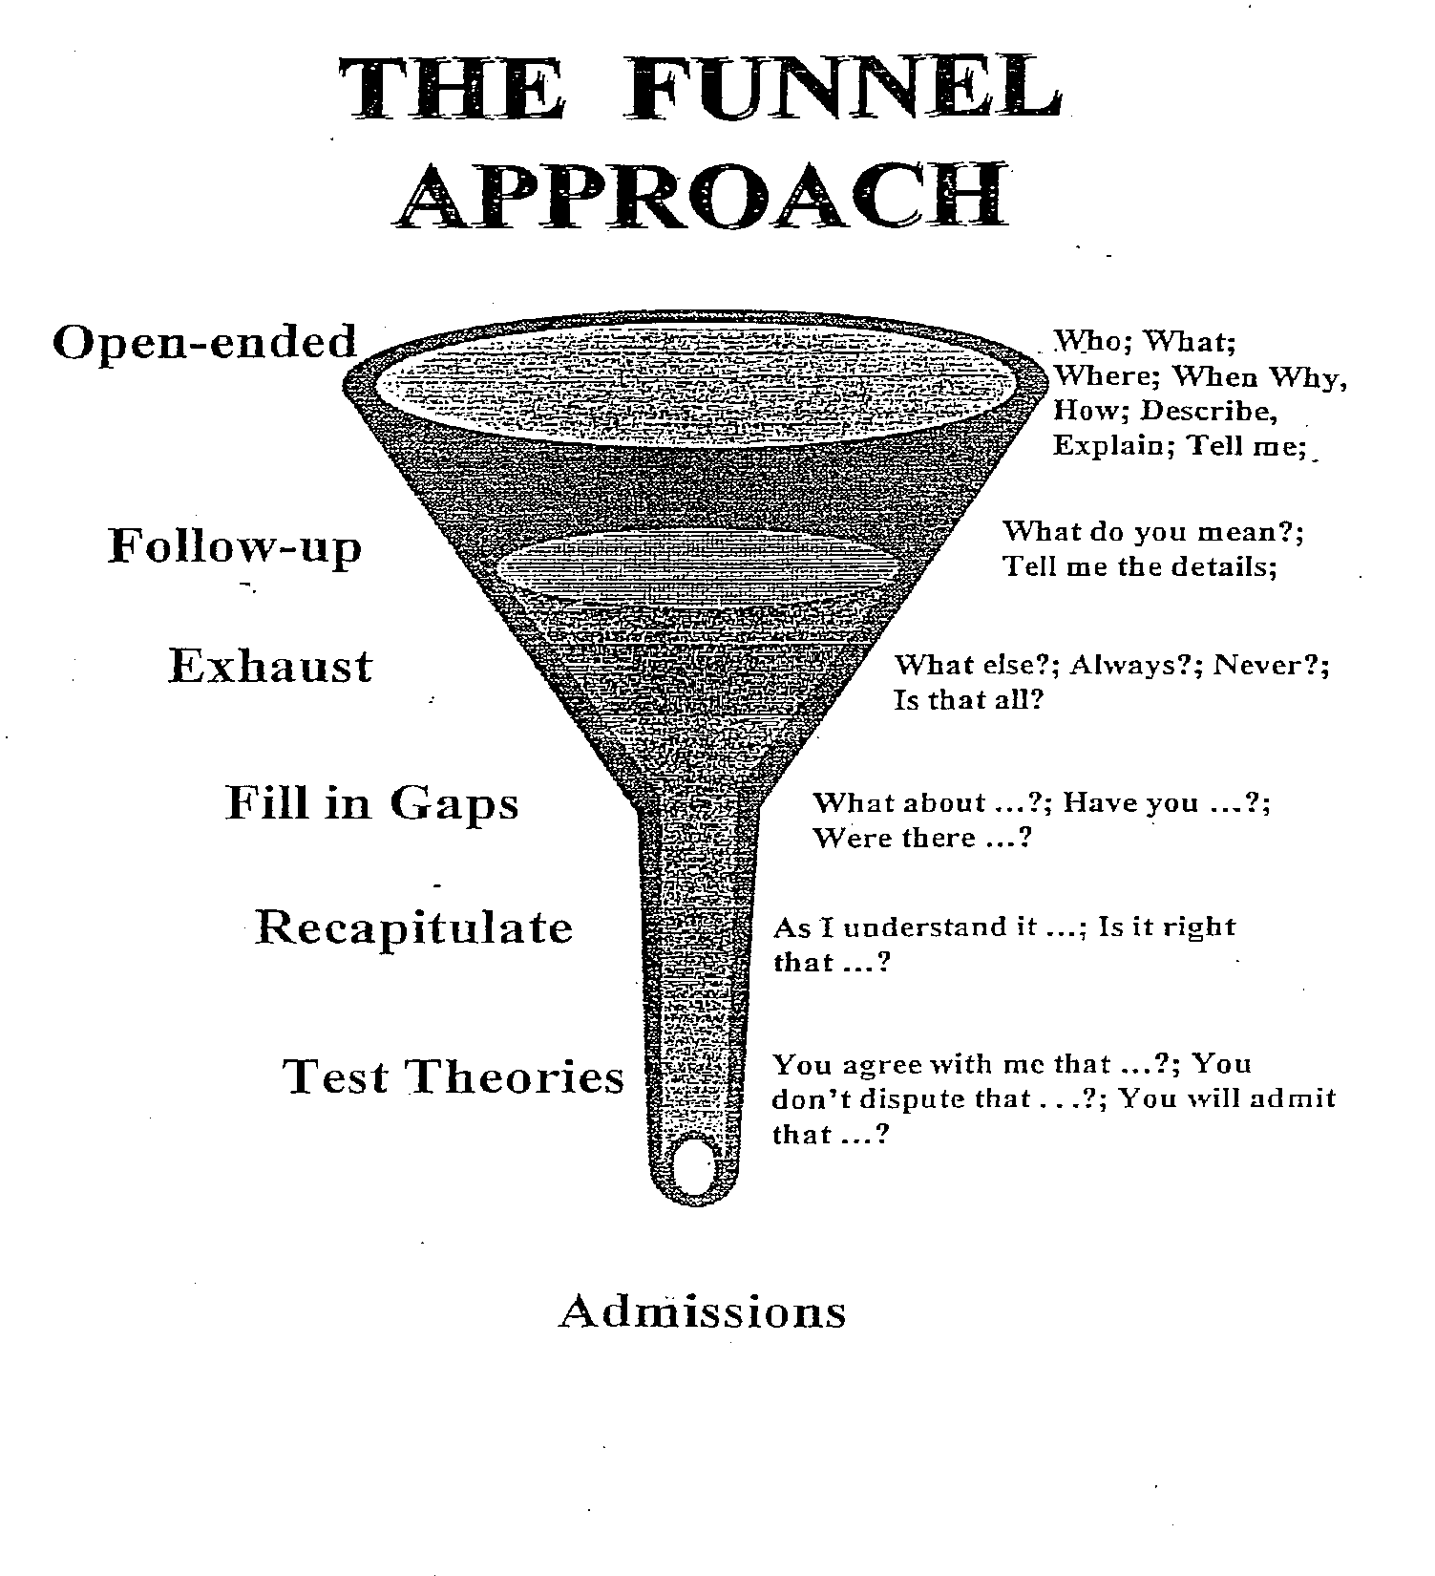
Notes:
The best method of gathering new information is through the use of what is called the funnel approach. The name of this technique comes from its resemblance to a funnel.
When starting to question on a new topic, the first step should be to get an overview. This will give you some idea of what you will encounter as the questioning proceeds. It will also get the witness talking about the topic and it encourages a discussion of those facts the witness considers important. Having some idea of what the witness considers to be important may prove to be useful information when you are determining how best to deal with the witness. Generally, the more open the question, the more you will learn from the witness. For example, in a contract action, your overview question might be:
Q: Tell me how this transaction came about?
And in a personal injury case, it could be:
Q: Tell me everything that happened to cause this accident?
"Getting the list"
The next step in using the funnel approach is "getting the list." The purpose here is to find out the breadth and scope of the witness's knowledge of a topic before finding out in detail what the witness knows about that topic. Getting the list is nothing more than staking out the limits of the witness's knowledge. Example questions are:
•Tell me how you first learned about ....
• What was your job at the time?
• How were you involved?
•Who else was involved?
• What did Dennis do?
• How could it have been prevented?
• How has the process changed?
• What is the policy now?
• When were you last involved with sales?
• Why did you leave?
Once you have obtained "the list" and have staked out the scope of the topics to be explored, you can then decide which items or subjects on the list are important and which can be ignored or postponed.
Let's take a look at how to go about getting the list in a specific context. Assume that the shipping manager at a parts supplier is being deposed about the manager's job responsibilities. An example of getting the list in that situation might look like this:
Q: What are your responsibilities as shipping manager?
A: I am in charge of all shipments going out of the company.
Q: What ocher responsibilities do you have?
A: If insurance is required on a shipment, I also arrange that.
Q: What else?
A: I have to arrange the type of shipping used.
Q: Any other responsibilities?
A: I have to make sure that the amount of the shipping
charges is passed on to billing.
Q: What else?
A: That's everything.
Although it may be termed "getting the list," often obtaining a chronology provides the best list. A chronology, like a list of duties, has the effect of staking out the limits of a witness's knowledge of a topic. For example,
getting a chronological list from the plaintiff in a personal injury case might sound like this:
Q: I want you to take me through what happened that day
from the moment you left the house until the accident
occurred. When did you leave the house?
A: About 8:15 in the morning.
Q: What happened after you left?
A: I drove down 15th Street.
Q: What next?
A: As I approached the intersection with Yale Street, I saw a car stopped at the stop sign on Yale.
Q: What happened next?
A: As I was going through the intersection) the car at the stop sign suddenly shot forward and hit my car.
Q: What next?
A: I heard a big crash, and I was thrown against the door.
Q: What happened next?
A: I was in a lot of pain, and someone must have called an ambulance because I was then taken to the hospital.
In contrast, getting the list from an eyewitness to the accident might be
very simple:
Q: Tell me everything you saw that day at the intersection at
the time of the accident?
[followed by a series of "What else?" questions]
Notice that there is no attempt at this point to explore or go into detail as to any part of the witness's answers. It does not make sense to distract the witness from recalling information or recounting a chronology by interrupting with questions about details. The idea is to get an overview of the witness's knowledge, with the details to follow later.

Slide 10
The Funnel Approach (cont’d)
Gradually narrow your areas as you gain confidence as to what is relevant and useful
Ask narrow and pointed questions as you fill in details and seek admissions
Insure completeness by always asking “anything else?”
Recapitulate and summarize where useful, being careful of how you paraphrase
Notes:
Top of the Funnel: Open-Ended Questions
Once you have the list and have decided what topic on the list you will explore first, the next step is to begin questioning about the topic using open-ended questions. The questions should resemble the wide mouth of a funnel, gathering up everything the witness knows that may be relevant to the topic. The classic reporter's questions-who, what, when, where, why, how, supplemented by "describe" “explain" and ‘Tell me about'-will best
encourage witnesses to reveal all they know. Open-ended questions force the witness to provide the information covered by the question making it much more difficult to hide information or evade the question.
The value of open-ended questions is well illustrated by thinking about the children's game of Battleship. In the game, each side hides its ships by arranging them on a grid the opponent cannot see. Then each player drops
bombs on the other side's ships by calling out a location on the opponent's grid. If the location is not occupied by an opponent's ship, it is a miss, but, if it is occupied, it is a hit. Many depositions are like playing Battleship, with the taking attorney asking a series of narrow questions, hoping for a hit on what the witness knows, but also coming up with many misses. Here is an example of such an examination in a personal injury case.
Q: Were you driving west on Mattis Street at the rime of the
accident?
A: Yes.
Q: Were you driving within the speed limit?
A: Yes.
Q: Was the intersection a four-way stop?
A: Yes.
Q: Were you looking at the traffic ahead?
A: Yes.
Q: Was traffic heavy at that time of the morning?
A: No.
Q_: Did you see the plaintiff before the collision?
A: Yes
This technique works fine as long as you ask all the right questions. But if you fail to ask a question on a topic on which the witness has information, you will have a miss, just as in Battleship. In the above example, if you fail
to ask "Did you stop at the intersection?" the witness will never have to tell how she ignored the stop sign, went through the intersection, and collided with the plaintiff's car. The results are much better when you ask open-ended questions that force witnesses to tell what they know. Instead of playing Battleship, you are, in effect, asking to look at the opponent's grid.
If we were to rerun the above example using open-ended questions, it would sound like this:
Q: Tell me what you were doing just before the accident.
Q: Where were you going?
Q: Why were you going there?
Q: What were you looking at?
Q: What did you see?
Q: What was the traffic like?
Q: Describe the intersection for me.
Q: What did you do when you came to the intersection?
Q When did you first see the plaintiff?
Q: Tell me everything that happened after you saw the plaintiff.
Q: Why did the accident happen?
Using open-ended questions is particularly important when considering how witnesses are often prepared for their depositions. A standard instruction
is: "Listen to the question, answer only the question asked, do not volunteer." Open-ended questions do not permit the witness to parse the question and avoid providing information. In effect, the witness is forced to
volunteer information.

Slide 11
The Funnel Approach (cont’d)
Listen to the answers and follow up when necessary and appropriate, then or later
Exhaust each topic before moving on to a new topic
Questions should be short and clear; try to use 10 words or less

Slide 12
You already understand the theory: you were deposed as a child!
Did you go to a party last night? Yes.
Was Susan there? Yes.
Did Chris go too? Yes.
Did Tommy go? Yes.
Did you get there at 7:30 like you planned? No.
No? 7:00? No. 8:00? About.
Did you go straight home afterwards? No.
Did you go to someone’s house? Yes.
Did you hang out at Starbucks? No.
Did Karen’s parents stay the whole time? No.
What do you mean?
They weren't there? I don’t know.

Slide 13
Your skills improve when you become a parent:
Where were you tonight?
Who was there with you? Who else? Anyone else?
What did you do? What else did you do? Anything else?
When did you get there? When did you leave?
Where else did you go?
Who went with you?
How long did you stay?
Who was in the house? Who chaperoned?

Slide 14
Consider:
Which method was easier as the questioner?
Which got you more information?
Which got the person talking?
Which gives you more confidence that you learned all the information there was to learn?
But, as the one being interrogated, which do you prefer (especially if you have something to hide)?

Slide 15
Demonstration
Closed vs Open Ended Questions at the Top of the Funnel

Slide 16
How Do You Obtain A Deposition?
By notice to a party or subpoena to a non-party
Must include:
Witness name
Date and time
Location
Reference to applicable rule
Document request / subpoena

Slide 17
Theory of using exhibits
Why?
To understand what it is
To refresh witness’s recollection
To challenge witness’s recollection
When?
After exhausting witness’s recollection, to avoid premature “closure” on topic

Slide 18
Demonstration
USING EXHIBITS

Slide 19
The Process at the Deposition
Mark it (language, premarking)
Distribute it to witness and others (bring copies)
Identify it for the record, always using exhibit number (also Bates numbers)
Get witness to confirm and authenticate (lay foundation for later use)
Ask questions based on it

Slide 20
PURPOSE
To see
If your understanding of the facts is correct
If your theory will hold up
Where your theory requires modification
How far you can go with this witness

Slide 21
Forming Proper Questions
Avoid double negatives and filler language
Example of double negative
Q: They weren't to be paid out of any Company funds in January or February 2004; is that correct?
Examples of filler language
Q: It is my understanding that Company A owns 100% of Company B, is that correct?
A: Yes.
Q: Are you aware if any investment, capital or funding was provided for the
projects in November of 2016?
A. No.

Slide 22
Don’t testify: Ask concise questions!
Q: It seems to me, although I don’t want to assume, that you made these references to Paragraph 5 when you were testifying about your prior experience and you said you have extensive experience in that industry and … then you went on and basically outlined your curriculum vitae. It seems to me that the point you were trying to make is “I am someone who speaks with authority and, based upon my prior experience, my understanding Paragraph 5 is ...” What is your understanding of Paragraph 5?

